Slide 1
MIDD Oversight Advisory Committee
Marcus Stubblefield
Criminal Justice Strategy & Policy Section Manager
Office of Performance, Strategy & Budget
Office of King County Executive
Mstubblefield@kingcounty.gov
(206) 263-2174

Slide 2
Our Vision:
An equitable, fair, accessible and effective criminal justice system that increases alternatives and improves outcomes for those affected by it. Ultimately, a community with dramatically reduced numbers of people victimized by crime or involved in the criminal justice system.

Slide 3
Our Mission:
We provide objective, innovative and expert research, analysis, strategic direction, coordination and project management to the County’s criminal justice continuum in order to improve functions and outcomes by providing strategic planning which balances policies, practices and changing community needs. We focus on complex, cross-agency, and multi-system challenges which will benefit from centralized leadership or support.

Slide 4
CJ Philosophy
Changing Hearts
Changing Minds
Changing Systems
Uplifting humanity and building healthier and safer communities with a strong emphasis on equity and social justice.

Slide 5
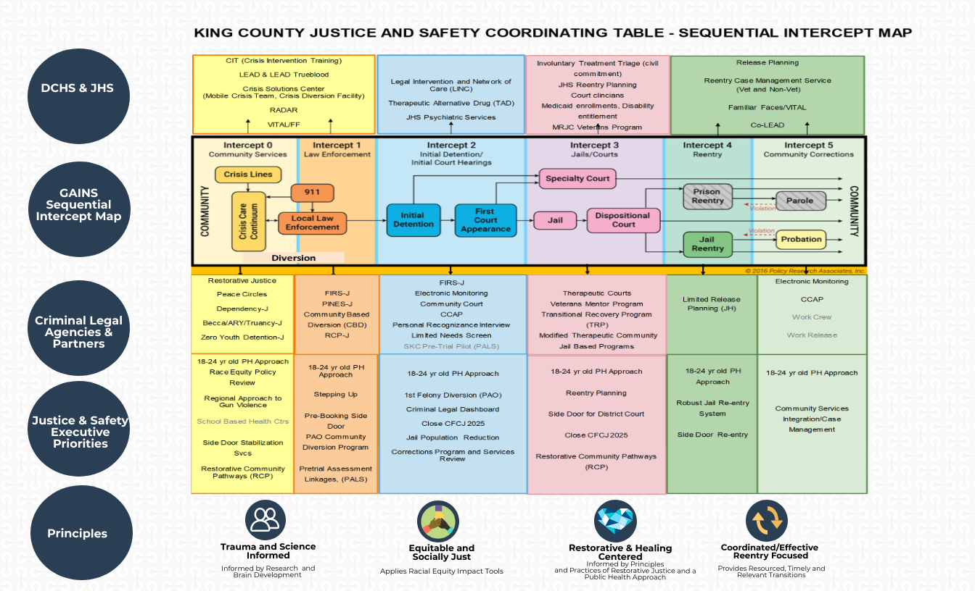

Slide 6
King County Criminal Justice Team Values
Treat all people with dignity and respect
See all people as possibilities/resources not problems
Value all people’s time and lived experience
People Centered Approach
Uplift people’s humanity
Do the right thing
Be Transparent
Not do more harm
Keep it simple
Decrease reliance on incarceration as the answer and increase more culturally responsive community based services

Slide 7
Personal Thoughts
We need to be thinking of how we meet needs upstream and no longer become relevant in people lives.
Stop criminalizing issues of mental health and substance use
CJ is the most expensive babysitting service in the country.
Imagine if we funded Behavioral Health/Public Health like we funded CJ (Courts, DAJD, LE)
Using a Public Health Approach to Criminal Justice
We need to truly understand the interconnectedness of the various components and stop treating them as individual situations and applying methodology that works towards holistic health

Slide 8
Contact Information
Marcus Stubblefield
Criminal Justice Strategy and Policy Section Manager
Office of Performance, Strategy & Budget
Office of King County Executive
MStubblefield@kingcounty.gov
(206) 263-2174

