Slide 1
January 29, 2025 Webinar Personal Property Update
Mike Wikstrom
Personal Property Supervisor
King County Department of Assessments
206-263-2347
mike.wikstrom@kingcounty.gov

Slide 2
Personal Property Update
Personal property intro
About the Personal Property Section
Filing tips
Listing problems
Please interrupt if you have a question
https://dor.wa.gov/taxes-rates/property-tax/personal-property-valuation-guidelines
https://dor.wa.gov/sites/default/files/2022-02/PersProp.pdf

Slide 4
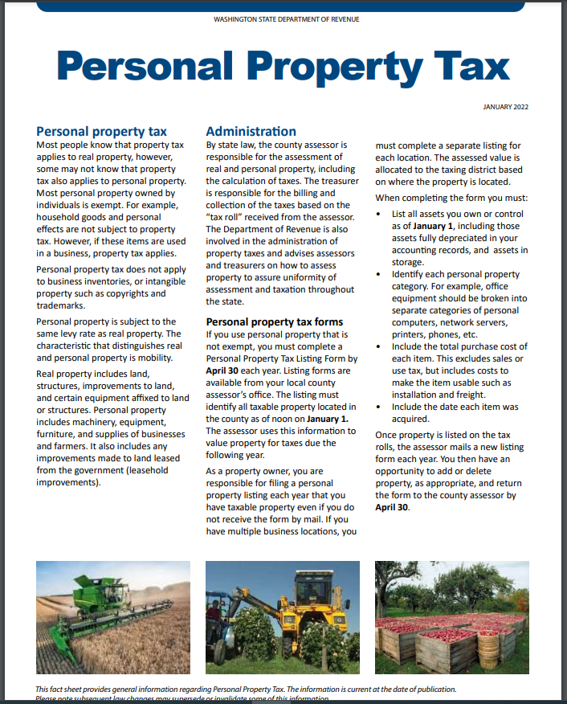

Slide 5
Tangible Personal Property
Machinery & Equipment (M&E)
Furniture & Fixtures (F&F)
Signs
Farm M & E
Leased Equipment
Leasehold Improvements
Communications Equipment
Small Tools, etc.
Software, licenses, and subscriptions
Supplies
Equipment used by remote staff

Slide 6
Who is Required to List?
Every individual, corporation, LLC, association, partnership, trust, or estate shall list all personal property in its ownership, possession, or control which is subject to taxation
Total cost, acquisition year, description
Includes freight, installation
Excludes sales tax

Slide 7
Assessment Cycle
2022 – 3rd omit year for AY 2025
2023 – 2nd omit year for AY 2025
2024 – 1st omit year for AY 2025
2025
Taxes due on assets acquired in 2023 or earlier
Listings due for assets acquired in 2024 or earlier
Advance taxes collected for TY 2025 and TY 2026 on sales or closures
2026 – Taxes due on assets acquired in 2024 or earlier
2026 – Taxes due on 2025 omits

Slide 8
Other Requirements
April 30 filing deadline
Up to 25% non-filing penalty, plus 20% per year
Subject to auditing and omitted assessments
“In all cases of failure to obtain a statement of personal property, from any cause, it shall be the duty of the assessor to determine the amount of, and assess the value of, all property” RCW 84.40.200

Slide 9
Exemptions
Household effects
Inventory
Tribal or foreign-government owned
Head of family (report in listing)
Non-profit (apply to DOR)
Farm equipment (apply to Assessor)
Alcohol fuel or biodiesel manufacture (report to Assessor)

Slide 10
About us
12 auditors and support staff
Functions
Account maintenance
28,000 business accounts
22,000 annual listings
Sales, name changes, new and closed businesses
Compliance
Discovery
Auditing

Slide 11
About us
Assessment stats 2024:
Total taxpayers 16,600
Total value $19.4 billion
Median $71K

Slide 12
Common Listing Problems
Filing in more than one format
eListing and paper
Assessment notices are ignored
Over- or Under-reporting LHI
Owner-occupied
Real property
Listing assets of apartments or condos
Business sold, closed, moved out of KC

Slide 13
Problems (cont)
Improper asset categories
Duplicate accounts
Not removing scrapped assets
Customization and development of software
Software: canned and subscription
Report total annual cost
Subscriptions assessed 100% of annual cost
Canned 100% first year, 50% second, then 0

Slide 14
Problems (cont)
Over-reporting supplies, or none reported
Reporting home-based businesses
Listing leased equipment
Assets that were transferred out of the county
Sales tax: no for PP, yes for LHI
No account number
Items in storage

Slide 15
Resources
Email Address – Customer Service | personal.property@kingcounty.gov
Email Address – Listings | email.listings@kingcounty.gov
Phone | 206-296-5126 or 800-325-6165 x65126
Hours of Operation | Monday through Friday 8:30 to 4:30 Pacific
Website | http://www.kingcounty.gov/assessor/
Leasehold (Tenant) Improvements, Property Tax Bulletin, Department of Revenue | https://dor.wa.gov/sites/default/files/legacy/Docs/Pubs/Prop_Tax/NewsletterQ12014.pdf
Mailing Address | King County Department of Assessments Personal Property Section King Street Center 201 South Jackson Street, Room 708 Seattle, WA 98104
RCW | Chapter 84.40 https://app.leg.wa.gov/RCW/default.aspx?cite=84
WAC | Chapter 458-12-060

