Slide 1




How does measles spread?
  Coughing and sneezing
  Measles can live in the air and on surfaces for up to 2 hours
This means you can catch measles from entering a room where an infected person has been, even if they left over an hour ago.

Slide 2



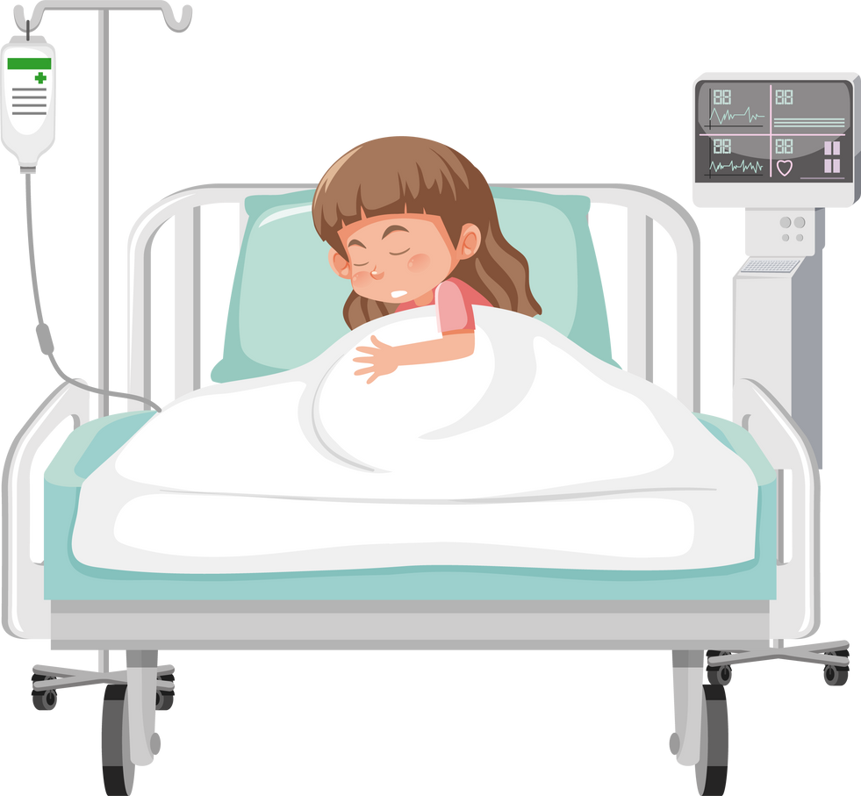
Why do we worry about Measles?
Measles can be very serious, especially for young children, pregnant people, and people with weakened immune systems.
It can cause pneumonia, encephalitis (brain swelling), hearing loss, brain damage, and even death.

