Slide 1

2026-27 Safer Choices and Hazardous Waste Disposal Education RFA
Pre-Proposal Conference
Healthy People,
Clean Environment
Saba Al Hazari, Contract Specialist
Hena Parveen, Educator Consultant
December 9, 2025

Slide 2
Agenda
  Overview of Hazardous Waste Management Program
  Key elements of the Request for Applications
  What to submit
  Application Evaluation
  Timeline
  Q&A

Slide 3
RFA Submission Reminders
Submit your complete application in one email, with all required documents included as attachments.
Send completed applications to: cpres-EHS@kingcounty.gov
Due Date: January 30, 2026, no later than 2:00 PM
Late applications are not accepted

Slide 4

Hazardous Waste Management Program
We are a coalition of local governments working together for a healthier and cleaner King County. We provide grant funding to cities, towns, and tribal governments within King County to help properly dispose of hazardous waste and to promote using safer alternatives.

Slide 5


We Solve Toxic Exposure Issues While Providing Services to Protect the Public
Public education about hazardous exposures, prevention methods, and safer alternatives and practices.
Hazardous waste disposal services for King County households and pre-qualified businesses.
Policy initiatives, like product stewardship, to address the production, use, and disposal of hazardous materials.

Slide 6
Residential Services Program
Focuses on helping residents reduce exposure to hazardous household chemicals and safely manage, store, and dispose of hazardous products.
Serve all of King communities and prioritize communities disproportionately burdened by environmental and health inequities.
This RFA is funded by the Hazardous Waste Management Program and administered by Residential Services Program.

Slide 7
2026-27 Safer Choices and
Hazardous Waste Disposal Education RFA
The Challenge:
Many everyday household products contain chemicals that may affect human health and can pollute the environment if they’re used, stored, or disposed of incorrectly.
Community Need:
Many communities- especially BIPOC, immigrant, refugee, and limited-English-proficient residents- face disproportionate exposure risks and have less access to safer choice information and safe disposal.
Community often rely on trusted messengers to share culturally relevant and accessible information.
The Opportunity:
Safer-choices education and tools support behavior change, reduce exposure.
Partnerships helps make sure resources reach residents in ways that are meaningful, respectful, and culturally grounded.

Slide 8
2026-27 Safer Choices and
Hazardous Waste Disposal Education RFA
Purpose of RFA:
To increase community awareness, equip residents with tools for safer choices and proper disposal of hazardous materials, and drive behavior change that protects community health and the environment.
Goals:
Reduce household exposure to harmful chemicals.
Promote safer, less-toxic alternatives.
Increase proper disposal of hazardous waste.
Strengthen community partnerships and networks that promote environmental health.

Slide 9
Who can apply
There are no restrictions on who can apply.
Represent and serve BIPOC, immigrant, refugee, and limited-English-proficient communities and have deep trusted relationships in these communities.
Experience delivering culturally responsive, intergenerational environmental health education.
Demonstrate capacity to lead community engagement to support behavior change and partner with diverse audiences.
Applicants must be able to provide services that support all King County residents.

Slide 10
Scope of Work- Annual Activities
Participate in community events such as workshops, trainings, and tabling.
Deliver safer-choices and disposal education that supports community behavior change.
Engage diverse audiences across King County.
Adapt materials to be linguistically and culturally relevant.
Track participation using Public Health data collection and reporting tools.
Submit progress reports with activity summaries and participation data. Identify successes, challenges, and recommendations.

Slide 11
Total Funding and Awards
Total available: up to $100,000
Expected awardees: 2
Funding per awardee: up to $25,000/year ($50,000 total)
Single-award scenario: If only one organization is selected, funding may be up to $50,000/year with an expanded scope of work

Slide 12
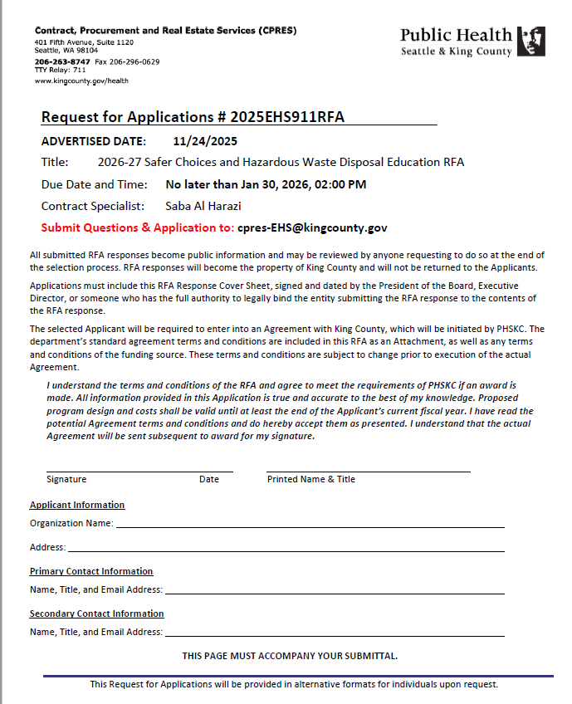
What to submit
Completed and signed RFP cover page.
Narrative (includes 6 required questions including budget and 1 optional question)
Submit RFP: cpres-EHS@kingcounty.gov

Slide 13
RFP Evaluation
PHSKC will review applications to make sure they are complete
Committee of experts will review and score applications
Interviews may be conducted with applicants if selection is not made based on written applications alone

Slide 14
RFP Rating
Criteria | Max. Points
Organizational Capacity: Readiness to run the project; qualified staff; strong admin/financial systems; proven collaboration with diverse community partners. | 15
Relevant Experience: Experience delivering environmental or health education, adapting content for community needs, and demonstrating measurable community impact. | 15
Community & Intergenerational Engagement: Intergenerational and youth education experience; strong equity and anti-racism practices; culturally responsive engagement with diverse communities. | 20
Outreach & Engagement Approach: Clear plan for events/trainings; strong community collaboration model; ability to use PH data tools and feedback; realistic, measurable approach to deliverables. | 20
Budget: Reasonable, justified costs that align with the proposed activities and core program needs. | 10
Total from written application | 80
If interviews are conducted: up to 40 points (for a total possible 120)

Slide 15
Timeline
Date | Event
November 24, 2025 | Request for Applications issued
December 9, 2025 | Virtual Information Session
January 22, 2026 | Final Day to ask questions
January 30, 2026, no later than 2:00 PM | RFA responses due
February 12, 2026 | Interviews with proposers (if necessary)
February 23, 2026 | Notice of Selection (tentative)
March 15, 2026 | Tentative agreement start date
December 31, 2027 | Project completion

Slide 16
Next Steps if Selected
A representative of the PHSKC program will reach out to the awarded Proposer to begin negotiations on the program elements of the Agreement.
The Proposer shall submit within five (5) Days of notification from the County the following:
Insurance certificate and endorsement meeting the levels of coverage needed.
King County Substitute W-9 (if not on file with the County within the past two (2) years).
King County Responsibility Detail & Attestation Form
The Substitute W-9 and the Responsibility Detail & Attestation forms are available for download at kingcounty.gov/depts/finance-business-operations/procurement/forms.aspx.

Slide 17
Next Steps if Selected
General Insurance Requirements for the selected Proposer are contained on PHSKC’s website
kingcounty.gov/depts/health/partnerships/contracts/insurance-requirements.aspx.
Specific coverage limits for this work are:
Commercial General Liability, to include Products and Completed Operations, in the amount of $1,000,000 combined single limit; $1,000,000 aggregate
Workers' Compensation and Stop-Gap Employer's Liability for a limit of $1,000,000
Professional Liability coverage of at least $1,000,000
Automobile Liability statutory coverage

