Slide 1
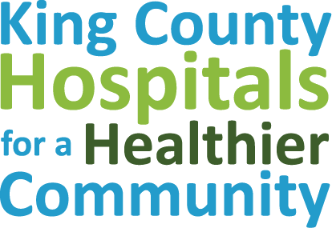
King County 2021/2022
Community Health Needs Assessment

Slide 2
Agenda
COVID-19 & areas to monitor in King County
King County’s demographics & languages
What’s getting better?
What is failing to improve or getting worse?
A snapshot of social & health King County
Community priorities
Life expectancy
Current e-cig or vape pen use
Unintentional injury deaths
Mental health
Food insecurity

Slide 3
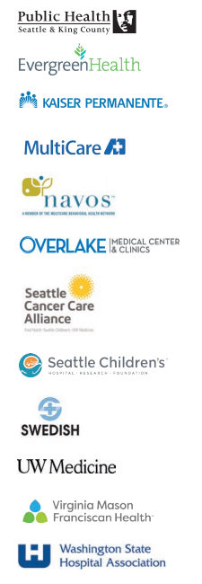
About: King County Hospitals for a Healthier Community (HHC) collaborative
King County Hospitals for a Healthier Community, includes:
Public Health – Seattle & King County
10 hospital/health systems
Washington State Hospital Association
Joint Community Health Needs Assessment:
Meets Affordable Care Act IRS requirement for 501c3 hospitals to complete a CHNA report every 3-years
HHC members create their own community health improvement strategies based on CHNA report findings and community engagement
Reduces duplication of efforts and data requests
Creates opportunity to align efforts, learn about best practices,& collectively invest in data, programs, and policies to promote health among King County residents
Notes:
The King County Hospitals for a Healthier Community (HHC) includes 10 hospitals/health systems in King County and Public Health – Seattle & King County (PHSKC) with the fiscal administrative support of the Washington State Hospital Association (WSHA). This collaborative was formed in 2012 to identify the greatest needs and strengths of local communities in order to develop coordinated plans to support the health and well-being of King County residents. One of the primary goals of HHC has been to collaborate on a joint community health needs assessment (CHNA) in order to avoid duplication of efforts, which, in turn, would help focus available resources on a community’s most important health needs. HHC has collectively produced three CHNA reports: the 2015/2016 report, the 2018/2019 report, and the most recent 2021/2022 report.

Slide 4
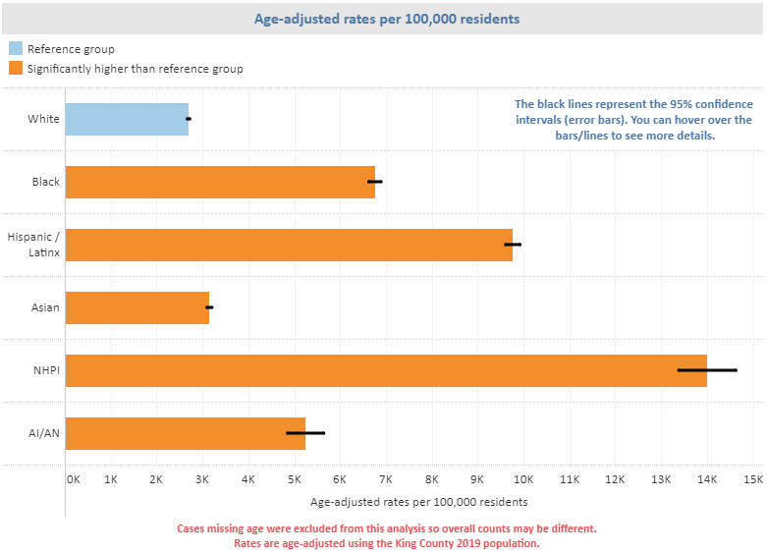
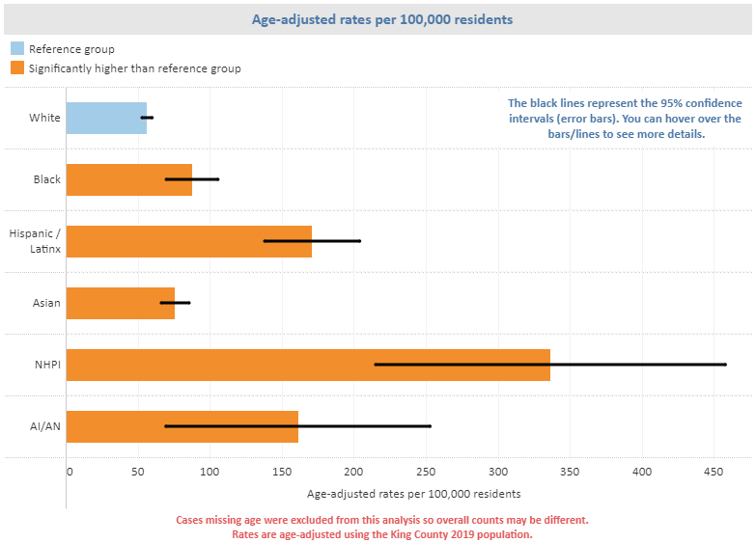
COVID-19 in King County
COVID-19 has disproportionally affected communities of color and residents of South King County.
Communities of color are overrepresented in COVID-19 cases, deaths, hospitalizations – and are also more likely to be negatively impacted by community mitigation strategies.
COVID-19 confirmed cases (as of 5/3/21)
COVID-19 deaths (as of 5/3/21)
For most recent data, see dashboard here:
https://kingcounty.gov/depts/health/covid-19/data/race-ethnicity.aspx [this webpage is in English]
Notes:
As a brief overview of COVID-19 as context for the CHNA report, we know that communities of color and residents of South King County are disproportionately impacted by COVID-19 and are overrepresented in cases, deaths, and hospitalizations. Communities of color are also reflected in many industry sectors that have been significantly impacted by COVID-19.
As of May 3, 2021: All communities of color had higher rates of COVID-19 cases compared to white residents in King County (as you can see in chart on the left) with the highest rate of confirmed cases among Native Hawaiian/Pacific Islander (NHPI) and Hispanic/Latinx communities, followed by Black, American Indian/Alaska Native (AIAN), and Asian residents.
As of May 3, 2021: all communities of color had significantly higher rates of COVID-19 deaths compared to white residents in King County (see chart on the right), with death rates highest among Native Hawaiian/Pacific Islander (NHPI), Hispanic/Latinx, and American Indian/Alaska Native (AIAN), followed by Black and Asian residents.

Slide 5
COVID-19 & areas to monitor
Unemployment
Food insecurity
King County COVID-19 dashboards include:
• Race/ethnicity dashboard
• Economic, social, and overall health impacts dashboard
• Health insurance and access to healthcare
• Family violence
• 2-1-1 calls to identify community needs
• Behavioral health needs and services
• Daily traffic
• Food insecurity
• Unemployment claims
• King County Eviction Prevention and Rental Assistance Program
Data reports & infographics related to COVID-19 include:
• Computer and internet access in King County
• Economic, social, and overall health impacts
• Increases in food needs
• Behavioral health needs and services
• Changes in transportation patterns
• Unemployment claims
To view more recent & additional data, all COVID-19 dashboards are linked on page 14:
2021/22 CHNA Report [this webpage is in English]
Access to healthcare
Mental and behavioral health
Notes:
There are many concerning impacts of COVID-19 though these 4 high-level areas reflect some areas of initial concern and places to monitor moving forward through COVID-19 response and recovery that were highlighted in the 2021/2022 CHNA report.
Unemployment: Roughly one in three workers (34.5%) in King County filed initial unemployment insurance (UI) claims with the between March 1 and November 7, 2020. Native Hawaiian/Pacific Islander workers filed the highest number of claims per capita, followed by Black workers. Industries with the largest number of employees filing unemployment claims include: accommodation and food services, manufacturing, retail, construction, and healthcare and social assistance.
Food insecurity: Food insufficiency has almost doubled after implementation of mitigation strategies to slow the spread of COVID-19. Food insecurity is especially high among households that are low-income, include children, or have recently had or expect job loss.
Access to healthcare: Analysis of recommended vaccination rates (series 4:3:1:3:3:1:4) for children ages 19-35 months showed a decrease in vaccination coverage as of June 30, 2020 compared to rates as of December 31, 2019, likely reflecting decreased access to and use of healthcare services during the COVID-19 pandemic.
Mental & behavioral health: The number of calls to King County’s behavioral health crisis line increased after the start of social distancing. April 2020 — as well as between June and October 2020 — were significantly higher than those in the same months of 2019. Washington state survey data show the number of people with symptoms of depression had increased by more than 30% between April and May 2020.

Slide 6
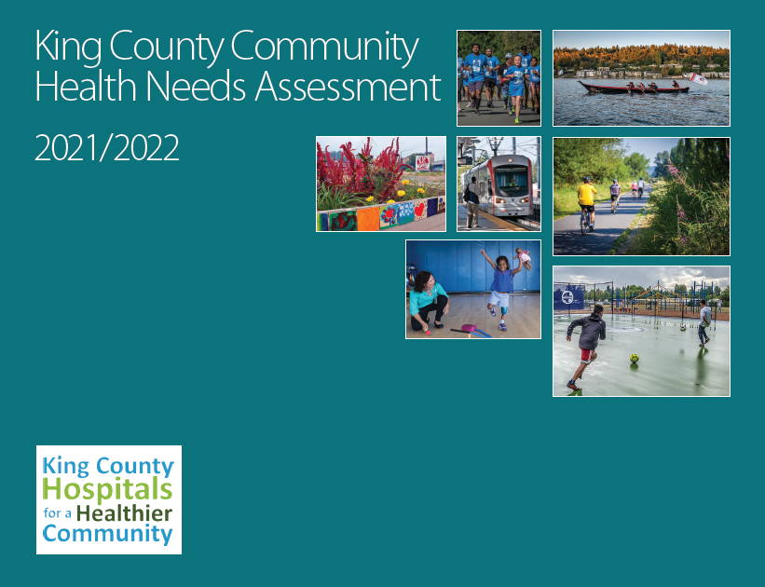
Recap of Key Findings: CHNA 2021/2022
www.kingcounty.gov/chna
www.kingcounty.gov/chi
Notes:
The next few slides include a recap of key findings from the CHNA report to inform community benefit programs and health improvement strategies. Please visit www.kingcounty.gov/chna [this webpage is in English] to view the full report.

Slide 7
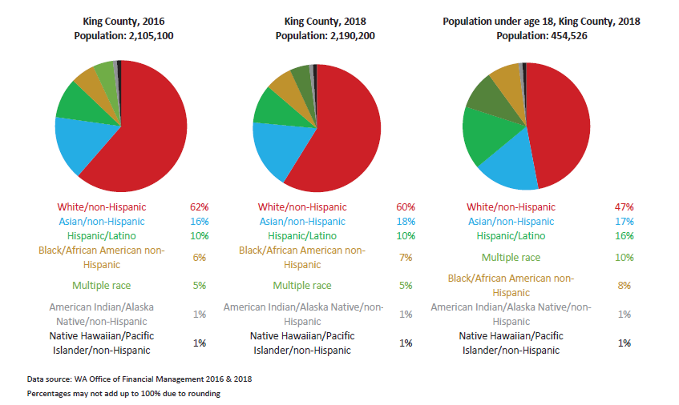
King County’s changing population
In the past three years, King County has experienced a substantial growth spurt – in population and diversity
More than half of King County children are children of color
Notes:
King County has experienced substantial growth. In 2018, the King County population was roughly 2.19 million (2,190,200).
Between 2016 and 2018, the county population grew by more than 85,000 residents. It has approximately doubled since 1990, with increasing diversity. More than half of King County children are children of color.

Slide 8
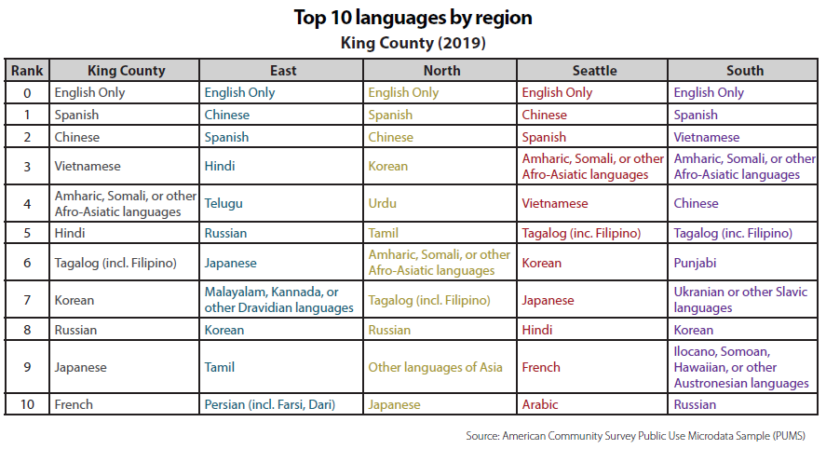
King County’s languages
One in four King County residents live in a household where a language other than English is spoken.
Additional data is available by smaller geographies online (see ‘Top 10 by PUMA’ tab):
Top 10 languages by region (2019) [this webpage is in English]
Notes:
King County is home to diverse communities by race/ethnicity as well as by language - 1 in 4 residents live in a household where a language other than English is spoken. Top 10 languages by King County and by region (including South King County) are presented here, which are important to inform community outreach and engagement.
Additional data available by smaller geographies on the CHI indicator dashboard online.

Slide 9
What’s gotten better & where can we improve
since the 2018/2019 CHNA report (pre-COVID)?
Across King County,
successes include:
Across King County,
opportunities for improvement include:
Obesity rate is declining for American Indian/Alaska Native residents.
Over the last 8 years, life expectancy has declined in the South Region as well as among Hispanic & Native Hawaiian/ Pacific Islander residents.
Youth using
e-cigs/vape pens
are increasing.
Continued declines in cigarette smoking for adults & youth.
Ongoing areas from 18/19 report for improvement:
Youth depression has continued to rise for the past 10 years – more than 1 out of 3 students in 12th grade report depressive feelings.
Drug-induced deaths have increased over the past 10 years with dramatic increases in overdose deaths involving methamphetamine & fentanyl.
More residents are dying from unintentional injuries.
Continued declines in daily sugary beverage intake for youth.
The gap between white and Black food insecure households has quadrupled over a 5-year period.
More mothers receive early & adequate prenatal care.
Communities of color continue to be disproportionately uninsured with widening racial/ethnic disparities.
Homelessness has declined for unaccompanied youth & young adults.
Youth obesity rates are increasing. Physical activity continues to decline.
Notes:
This information is included in the Executive Summary of the CHNA report (pg. 6) to reflect new areas that have improved since the last report as well as new areas for improvement since the last report.
**
What’s getting better? (key successes)
Obesity
- Obesity among American Indian/Alaska Native residents appears to be declining. Since the 2010-2012 estimate where more than half of American Indian/Alaska Native resident were obese, the obesity rate among this group has declined by more than 50%.
- While estimates may be imprecise due to small population numbers, a concurrent increase in the percentage of American Indian/Alaska Native adults that are overweight but not obese signals improvement in overall body mass index (BMI), a measure used in health care to assess obesity.
Cigarette smoking
- Cigarette smoking has continued to decline county-wide. The adult smoking rate dropped from 13.9% (2011–2013) to 11.1% (2014–2018).
Sugary beverage intake for youth
- Comparing data from 2014 and 2018, fewer students reported daily consumption in all King County regions.
Early & adequate prenatal care
- More pregnant mothers received early and adequate prenatal care — which is defined as initiating prenatal care in the first trimester and having at least 80% of the medically recommended number of prenatal visits.
Homelessness
- From 2018 to 2019, the total # of homeless individuals decreased & also decreased for unaccompanied youth & young adults by 28%. In 2020, the total # of homeless individuals increased though appeared to still decrease for unaccompanied youth & young adults (though direct comparisons from 2020 to prior years is not advised due to changes in methodology).
What has not improved or has gotten worse?
Life expectancy
While overall life expectancy of King County residents has not significantly changed, recent analyses reveal worsening racial/ethnic disparities in life expectancy.
Over the last 8 years, life expectancy has declined in the South Region as well as among Hispanic & Native Hawaiian/ Pacific Islander residents.
Unintentional injuries
More county residents are dying from unintentional injuries, with poisoning (by legal and illegal drugs, alcohol, gases and vapors, such as carbon monoxide and automobile exhaust, pesticides, and other chemicals and noxious substances), falls, and motor-vehicle-traffic incidents as the leading causes.
Food insecurity
While rates of food insecurity were declining overall and trending toward improvement, there was a large jump in food insecurity among Black residents even before the onset of the pandemic. The gap between white and Black food-insecure households quadrupled between 2013 and 2018.
Insurance
Communities of color continue to be disproportionately uninsured — before and after implementation of the Affordable Care Act. Racial/ ethnic disparities in insurance coverage have widened following an initial narrowing of gaps in coverage in 2014.
Youth obesity
More King County youth are obese. After a relative decline in 2012, youth obesity rates have been increasing in King County. Youth obesity rates increased significantly between 2014 and 2018.
E-cigarettes/vape pens
As rates of youth who report smoking cigarettes have continued to decline in King County, the percentage of youth who report using e-cigarettes has significantly increased since 2016.
Ongoing areas that were identified as opportunities for improvement in the 2018/19 report which have not shown improvement include:
Youth depression has continued to rise for the past 10 years – more than 1 out of 3 students in 12th grade report depressive feelings.
Drug-induced deaths have increased over the past 10 years with dramatic increases in overdose deaths involving methamphetamine & fentanyl.

Slide 10
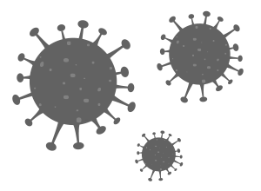
Main community identified priorities
COVID-19 vaccine & response
Homelessness &
housing
Access to healthcare
Chronic disease management
Obesity, cancer, diabetes, heart disease/hypertension
Mental &
behavioral health
Systemic racism
Transportation
Food insecurity
Support for youth & families
Community growth & development
Notes:
This slide shows some of the main priorities/topic areas that emerged from communities across King County. Additional themes that have come up during 2020 (after our review of 48 community engagement/assessment reports throughout 2018-2019) are also included. See 2021/2022 CHNA report, pg 22.
Communities highlight needs related to:
Homelessness & housing
Access to healthcare, including:
Culturally competent providers/language services
Affordable/accessible childcare
Extended hours
Chronic disease management - specifically obesity, cancer, diabetes, heart disease/hypertension
Mental & behavioral health
Transportation
Food insecurity
Support for youth and families, including:
Early learning
Physical activity and sports
Community growth & development, including:
Educational attainment
Economic security/opportunities
Community connectedness/civic engagement
**COVID-19 vaccine & response as well as systemic racism has overarching impacts to communities as well as all of these identified priorities**

Slide 11
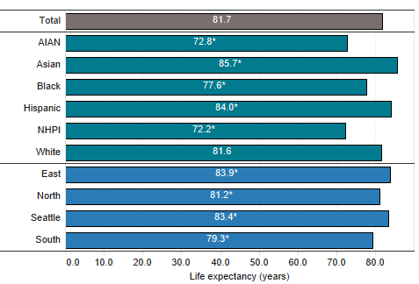
Life expectancy in King County
King County ranks among the top counties in the U.S. on measures of health and wealth
However,
residents continue to experience differences in social and health outcomes by race and place
Life expectancy for South King County residents has declined for
the past 10 years.
There is a 14-year difference between the lowest and highest life expectancies by race/ethnicity in South King County
– Native Hawaiian/Pacific Islanders (69.5) and Asian (83.5).
Life expectancy at birth, King County (average: 2014-2018)
AIAN = American Indian/Alaska Native
NHPI = Native Hawaiian/Pacific Islander
Life expectancy at birth, King County (rolling average: 2000-2018)
Notes:
King County ranks among the top counties in the U.S. on measures of health and wealth, however, there are differences in life expectancy by race and place in King County.
- Life expectancy is lowest among South Region residents (shown by the purple line) and has declined for the past 10 years.
- In South King County, there is a 14-year difference between the lowest and highest life expectancies by race/ethnicity – Native Hawaiian/Pacific Islanders (69.5) and Asian (83.5).
- We also know that many social, environmental, and community factors coupled with the availability of resources and impacts of current & historical systemic racism result in an accumulation of stressors that impact the quality of life for many residents.

Slide 12
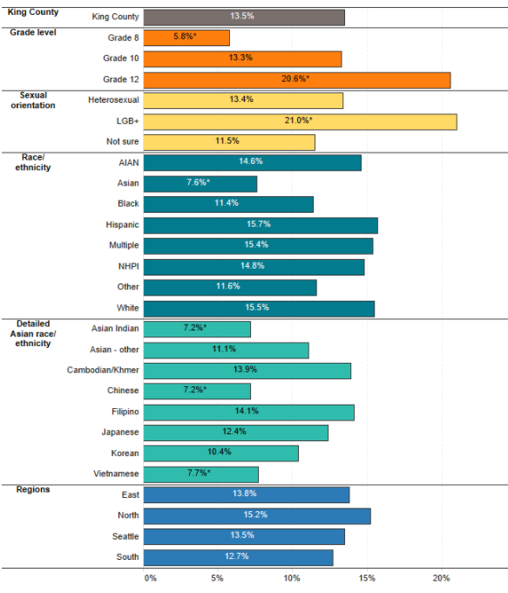
Current e-cig or vape pen use for youth in King County
Current e-cigarette or vape pen use (8th, 10th, 12th grades) , King County (average: 2016 & 2018)
LGB+ youth and 12th graders, were more likely to use e-cigarettes/vape pens compared to the King County average.
While Asian youth reported the lowest rates of e-cigarette use compared to other races/ethnicities, disaggregated data show variation among Asian ethnic groups.
AIAN = American Indian/Alaska Native
NHPI = Native Hawaiian/Pacific Islander
* = Significantly different from King County average
! = Interpret with caution: sample size is small so estimate is imprecise
Notes:
Here is a more detailed view of e-cig or vape pen use among King County youth, where we see some noteworthy differences by sex and race/ethnicity.
- LGB+ youth and 12th graders, were more likely to use e-cigarettes or vape pens compared to the King County average.
- While Asian youth reported the lowest rates of e-cigarette use compared to other races/ethnicities, disaggregated data shows variance exists among detailed Asian races/ethnicities.

Slide 13
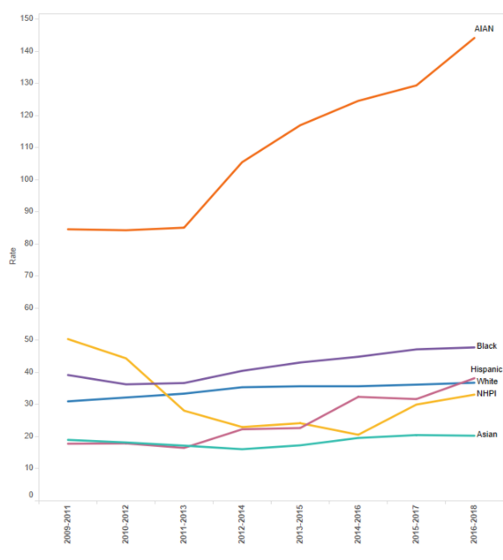
Unintentional injury deaths in King County
Unintentional injury deaths, King County (rolling averages: 2009-2018)
Unintentional injury deaths (incl drowning, falls, fire, firearms, motor vehicle collision, poisoning, and suffocation) have been increasing in King County.
American Indian/Alaska Native and Black populations have significantly higher rates of unintentional injury death compared to the King County average.
AIAN = American Indian/Alaska Native
NHPI = Native Hawaiian/Pacific Islander
* = Significantly different from King County average
! = Interpret with caution: sample size is small so estimate is imprecise
Notes:
- The rate of unintentional injury death has been increasing in King County. This includes deaths by drowning, falls, fire, firearms, motor vehicle collision, poisoning, and suffocation.
- Averaging data from 2014-2018, American Indian/Alaska Native and Black populations have significantly higher rates of unintentional injury deaths compared to the King County average.

Slide 14
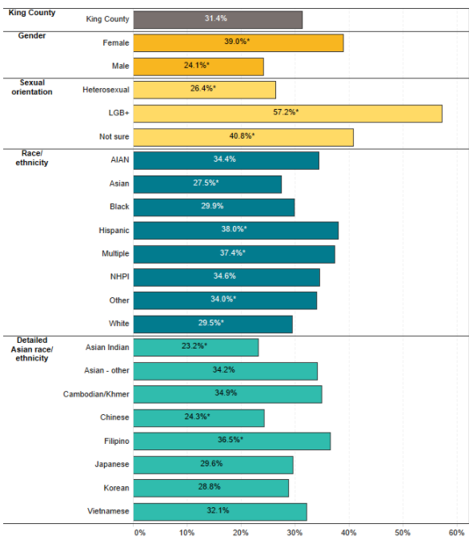
Mental health in King County
Depression prevalence (8th, 10th, 12th grades) , King County (average: 2016 & 2018)
Adults and youth in South King County were more likely than residents in other regions to report frequent mental distress (adults) and depressive feelings (youth).
More than half of LGB+ youth in King County reported depression.
AIAN = American Indian/Alaska Native
NHPI = Native Hawaiian/Pacific Islander
* = Significantly different from King County average
! = Interpret with caution: sample size is small so estimate is imprecise
Notes:
*While most of the data in the report were collected prior to 2020, during the COVID-19 pandemic, some patterns — especially around violence, suicide, and mental health — may be changing.
- Looking at data prior to 2020 (average of 2016 & 2018), adults and youth in South King County are more likely to report frequent mental distress or depressive feelings.
- More than half of LGB+ youth in King County reported depression.
It is also important to emphasize that suicide is an ongoing concern among King County youth. The rate of suicidal ideation among youth (defined as having seriously considered attempting suicide within the past year) and the rate of youth who made a plan to attempt suicide within the past month increased from 2016 to 2018. Rates are alarmingly high among LGB+ youth for both suicidal ideation (42.1%) and suicide plan (35.0%).
Supporting data for point above:
Suicide ideation for youth:16.7% in 2016 to 19.0% in 2018.
Suicide plan for youth: 14.1% in 2016 to15.5% in 2018.

Slide 15
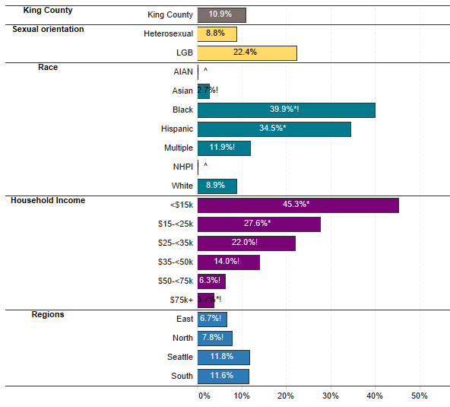
Adult food insecurity in King County
Food insecurity (adults) , King County (average: 2018)
In King County, there are significant disparities in communities experiencing food insecurity.
40% of Black and 35% of Hispanic adults experience food insecurity compared to 9% of white adults.
45% of households with income <$15k experience food insecurity.
AIAN = American Indian/Alaska Native
NHPI = Native Hawaiian/Pacific Islander
* = Significantly different from King County average
! = Interpret with caution: sample size is small so estimate is imprecise
Notes:
There was a huge jump in the disparity gap between white and black food insecure households over a 5-year period from 2013 (10% white, 17% black) to 2018 (9% white, 40% black).
- In 2018, 40% of Black and 35% of Hispanic adults experience food insecurity compared to 9% of white adults.
- 45% of households with income <$15k are food insecure.
- The fact that 2018 was the first year this BRFSS question was asked since 2013 points to the importance of monitoring food insecurity.
Recent data from the Census Household Pulse Survey shows that between August 19-December 21, 2020, Hispanic and Black households in Seattle/Tacoma/Bellevue were more likely to report sometimes or often not having enough food to eat during the last 7 days compared to other race/ethnicities. The impact of COVID-19 on food insecurity for these populations well as the economic & social impacts due to mitigation measures and resulting job losses impact access to food and basic needs as well.

Slide 16
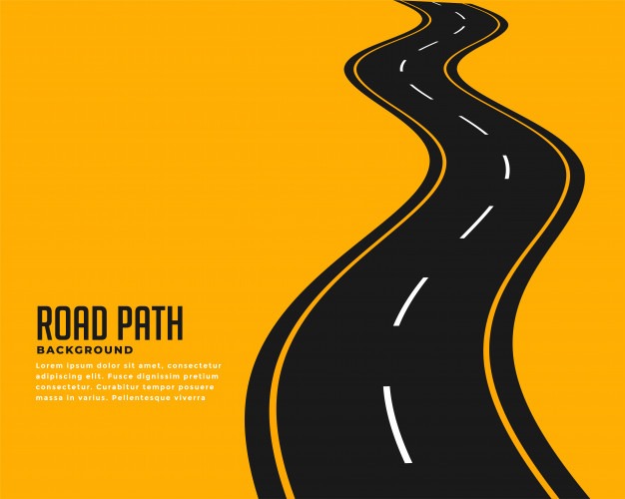
Lifetime adversity and chronic stress
Systemic disadvantages and racism throughout the lifespan lead to chronic stress that adversely affects the health of Black communities and communities of color.
Life expectancy
Environment
The Race Gap in King County: Racism as a Public Health Crisis
Many present day policies and practices continue to build upon and support systems that favor the health and economic prosperity of White individuals at the expense of Black individuals. The effects of systemic racism and chronic stress accumulate over a lifetime for Black individuals and results from generational as well as lifetime experiences of racial discrimination. The data in this presentation provides snapshots across the lifespan to highlight the disproportionate impact of how racial discrimination and systematically oppressive policies and practices continue to have local impacts in the lives of Black residents compared to White residents in King County.
Download the data presentation (PDF)
If you are interested in incorporating content from this PDF presentation into a PowerPoint, we recommend using a screenshot of the relevant PDF page(s) and copying those into your slide deck. This will maintain all of the formatting, data, and content included in the PDF presentation.
Public Health – Seattle & King County is committed to working in stronger and better-resourced partnerships with community organizations and leaders to disrupt and dismantle racism. We recognize that both historically and currently, King County has been complicit in maintaining and perpetuating structural racism, and that as an institution we must be a vital player in dismantling oppressive systems that are grounded in white supremacy. This data serves as a foundation to build upon and invest resources, programs, and policies as we continue our journey towards transformation.
Employment
Housing
Income
Healthcare
Education
Food insecurity
Infancy
Systemic racism, historical trauma
The Race Gap in King County: [this webpage is in English] https://kingcounty.gov/depts/health/data/race-gaps.aspx
Racism as a Public Health Crisis in King County: https://www.kingcounty.gov/elected/executive/constantine/initiatives/racism-public-health-crisis.aspx
Notes:
- We know that systemic disadvantages and racism across the lifespan result in barriers as well as generational & cumulative stressors that create social & health disparities among black, brown, indigenous, and people of color.
- On June 11, 2020, King County declared racism a public health crisis and is committed to implementing a racially equitable response to this crisis that is centered on community engagement.
To learn more about this declaration as well as stay up to date on announcements in King County, see link.
The Race Gap in King County presentation is available online, which highlights some of the racial inequities that exist between white and black individuals in King County. In the presentation, the data and accompanying contextual narrative highlight how structural and systemic racism as well as oppression impact individuals throughout life – covering topics including infant mortality, food insecurity, education, health insurance, household income & wealth, evictions, poverty, unemployment and life expectancy.

