Slide 1
Updated: July 26, 2024

Slide 2
About: King County Hospitals for a Healthier Community (HHC) collaborative
King County Hospitals for a Healthier Community includes:
Public Health – Seattle & King County
10 hospital/health systems
Washington State Hospital Association
Joint Community Health Needs Assessment:
Meets Affordable Care Act IRS requirement for 501c3 hospitals to complete a CHNA report every 3 years
HHC members create their own community health improvement strategies based on CHNA report findings and community engagement
Reduces duplication of efforts and data requests
Creates opportunity to align efforts, learn about best practices, & collectively invest in data, programs, and policies to promote health among King County residents
Notes:
The King County Hospitals for a Healthier Community (HHC) includes 10 hospitals/health systems in King County and Public Health – Seattle & King County (PHSKC) with the fiscal administrative support of the Washington State Hospital Association (WSHA). This collaborative was formed in 2012 to identify the greatest needs and strengths of local communities in order to develop coordinated plans to support the health and wellbeing of King County residents. One of the primary goals of HHC has been to collaborate on a joint community health needs assessment (CHNA) in order to avoid duplication of efforts, which, in turn, helps focus available resources on a community’s most important health needs. HHC has collectively produced four CHNA reports: the 2015/2016 report, the 2018/2019 report, the 2021/2022 report, and the most recent 2024/2025 report.

Slide 3
COVID-19 and impacts in King County
The COVID-19 pandemic has not only disproportionately affected the health and mortality of people of color and residents of South King county, but also had disproportionate impacts on economic and social factors.
Average weekly COVID-19 death rates (March 2020-January 2024)
For most recent COVID-19 data, see dashboard here: www.kingcounty.gov/covid/race
More data on the social, economic impacts of COVID-19 can be found here:
www.kingcounty.gov/covid/impacts
Notes:
Before delving into the results, it is important to set the context for the events of the past few years, namely the COVID-19 pandemic and its multitude of health effects, social, and economic impacts throughout our region.
Communities of color and residents of South King County have been disproportionately impacted by COVID-19 and overrepresented in cases, deaths, and hospitalizations. The uneven impact of COVID-19 heightened many existing inequities, including poverty and unemployment for communities of color.
Communities of color are overrepresented in COVID-19 cases, deaths, and hospitalizations, and are also more likely to be negatively impacted by community mitigation strategies.
Many other vulnerable groups. For example, across several measures, adults with children in their household fared worse compared to overall adults on measures like anxiety, depression, difficulty meeting basic needs, housing insecurity, and food insufficiency: www.kingcounty.gov/covid/wellbeing

Slide 4
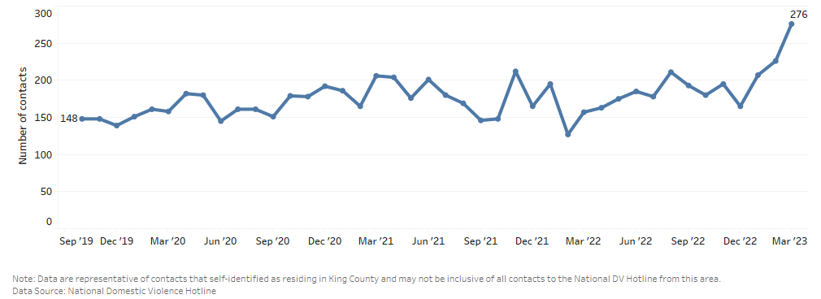
COVID-19 and impacts in King County (continued)
Adults most likely to report not having enough food to eat (March-June 2020)
Low-income households < $25,000
American Indian/Alaska Native, Native Hawaiian/Pacific Islander, Multiple race, Other
Less than high school education
Younger adults 18-44 years of age
Unemployed, self-employed, or working in a family business
The economic, social and health impacts of this multi-year pandemic that started coming to light immediately following the start of mitigation measures, have persisted long after.
National Domestic Violence Hotline contacts among King county residents,
October 2019–March 2023
For most recent COVID-19 data, see dashboard here: www.kingcounty.gov/covid/race
More data on the social, economic impacts of COVID-19 can be found here: www.kingcounty.gov/covid/impacts
Notes:
The data presented in this report provide information about the health and social landscape in King County toward the end of the COVID-19 pandemic and during its transition to an epidemic. COVID-19 health issues and the end of state and federal COVID-19 assistance are likely impacting people’s ability to meet basic needs, especially among communities of color and in South King County. Acknowledging that racism is a public health crisis and noting the importance of understanding and responding to inequities, this report presents key findings by race/ethnicity to highlight disparities, opportunities, and strengths among racial/ethnic groups.

Slide 5
Key Findings CHNA 2024/2025
www.kingcounty.gov/chna
www.kingcounty.gov/chi
Notes:
The next few slides include a recap of key findings from the CHNA report to inform community benefit programs and health improvement strategies. Please visit www.kingcounty.gov/chna [this webpage is in English] to view the full report.

Slide 6
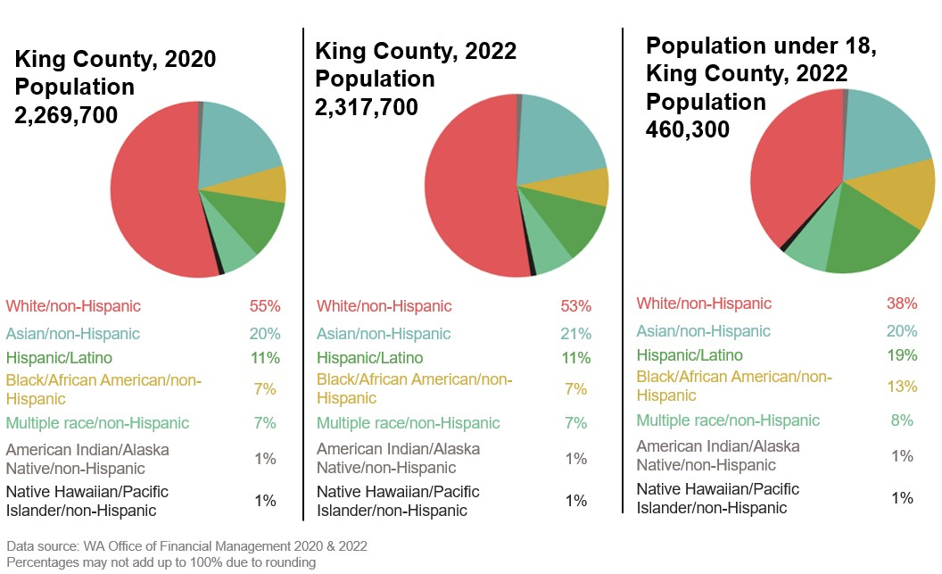
King County’s changing population
The population of people of color in King County continues to rise. King County is now 53% white, compared to 57% in 2018.
Demographic changes are highlighted by increasing racial and ethnic diversity among the King County population of children under age 18, which is now 62% people of color.
Notes:
King County growth brings increasing cultural and linguistic diversity. Demographic changes are highlighted by increasing racial and ethnic diversity among children under age 18, which is now 62% people of color.

Slide 7
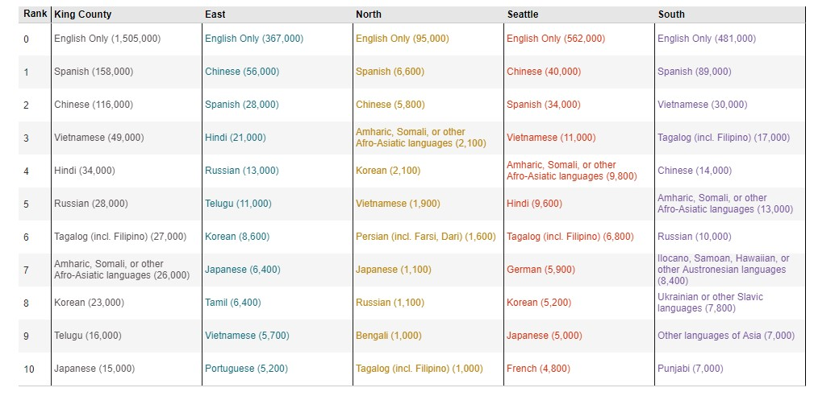
King County’s languages
Top 10 languages by region, King County (2022)
As of 2022, nearly 32% of King County residents live in a household where a language other than English is spoken.
Source: American Community Survey and Public Use Microdata Sample
Additional data is available by smaller geographies online (see ‘Top 10 by PUMA’ tab):
www.kingcounty.gov/top10languages (2022) [this webpage is in English]

Slide 8
What’s improved since the 2021/2022 CHNA report?
Across King County, successes include:
Rate of e-cigarette usage for youth and adult smoking both declined.
Substance use, including marijuana use, continued to decline among youth.
Rate of hospitalizations for falls and attempted suicide declined.
Notes:
This information is included in the Executive Summary of the CHNA report to reflect changes from the last report in terms of both areas that have improved and those where more work is needed.
Based on our review of updated data for selected health indicators
What’s getting better? (key successes)
Youth electronic cigarette use (also called e-cigs or vape pens) and adult smoking
Rate of e-cig usage declined by more than half from 2018 to 2021
Prevalence of adult smoking continued to decrease, including among those identifying as LGBTQ+
Substance use among youth
Rate of youth substance use declined significantly (from 24.5% in 2018 to14.2% in 2021)
This includes a decline in marijuana use specifically
Hospitalizations for falls
Rates have declined county-wide
Notable decline among Native Hawaiian/Pacific Islander residents by nearly half since (2012-2016) compared to recent estimate (2017-2021)
Hospitalizations for attempted suicide
Rate declined across King County (31.3 per 100,000 in 2012-2016) vs. (25.6 per 100,000 2017-1021)
However, the rate is highest among 18 to 24-year-olds (57.4 per 100,000), and more than twice the King County average

Slide 9
Where can we improve?
Across King County, opportunities for improvement include:
Life expectancy declined among Hispanic and Black residents, and disparities continue for AIAN, Hawaiian/Pacific Islander, and South King County residents.
Rate of drug-induced deaths increased.
Rate of maternal or birthing person deaths more than doubled over the past ten years.
The death rate from unintentional injuries continued to increase.
Rates of emergency department visits related to domestic violence increased.
Ongoing areas from 2021/22 report for improvement:
Disparities in rates of food insecurity continued to increase.
Youth depression continued to rise.
Firearm-related incidents increased.
Percentage of youth getting sufficient physical activity has been declining since 2014.
Notes:
This information is included in the Executive Summary of the CHNA report to reflect changes from the last report in terms of areas that have seen improvement and areas where more work is needed.
Based on our review of updated data for selected health indicators
What has not improved or has gotten worse?
Life expectancy
Overall rate in King County decreased significantly (from 81.9 to 81.4) – less than a year, but the first significant decline in nearly a decade (or rolling averages)
Life expectancy decreased by approximately two years for Black and Hispanic residents
Average life expectancy is lowest among Native Hawaiian/Pacific Islander (68.5) and American Indian/Alaska Native (69.1) – more than 12 years less than the King County average and trending down in recent years
Deaths from unintentional injuries (including drowning, falls, fire, firearms, motor vehicle collisions, poisoning, and suffocation).
Rate has increased over past 10 years, especially in Seattle and South King County
Disparities in food insecurity
Although overall rate did not change much, disparities in food insecurity have increased
Food insecurity is highest among Black and Hispanic adults, with rates nearly 3 times the county average
Adults identifying as transgender had nearly 4 times the rate of food insecurity as those identifying as cisgender
Firearm-related injuries and deaths
Rates of firearm incidents have increased since 2019
Death rate among Black residents was higher than the county average
Firearm-related death rates were highest in South King County
Drug-induced deaths
Rate has significantly increased among several groups:
Black and white residents
Those living in Seattle, South King County and North King County
Those living in areas with very high, high, and medium poverty levels
In terms of age groups, adults 45-64 years-old had the highest drug-induced death rate
Maternal or birthing person deaths
The number of birthing person deaths per 100,000 live births more than doubled over the past 10 years
Though not statistically significant, this pattern mirrors national pattern of rising Maternal Mortality Ratio (MMR)
Emergency department visits related to domestic violence
Rates have increased by 48% between 2020 and 2022
Ongoing areas that were identified as opportunities for improvement in the 2018/19 report which have not shown improvement include:
Youth depression
Rates increased from 2018 to 2021
Although hospitalizations for suicide attempts declined overall, the rate of emergency department visits related to suicidal ideation have nearly doubled for Black youth (from 2020 to 2021)
Mood disorder was leading cause of hospitalization for children and youth ages 1 to 17
Insufficient physical activity among youth
Percentage of students meeting recommendations for physical activity has been declining since 2014
In addition, percentage in top 5% for body mass index (BMI) continued to increase in King County over this time period
A significantly higher proportion of Native Hawaiian/Pacific Islander, Hispanic, and Black youth were in the top 5% of BMI relative to the county average
Students in South King County were most likely to be in top 5% for BMI compared to other regions

Slide 10
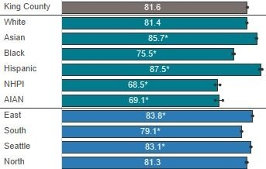
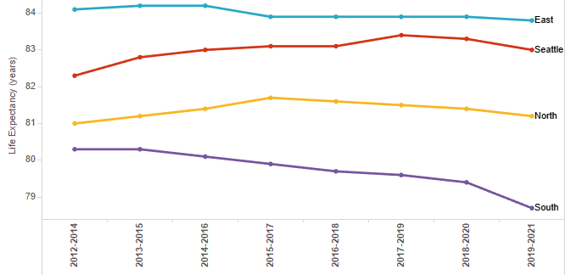
Life expectancy in King County
Life expectancy at birth, King County (average: 2017-2021)
U.S. death rates have risen, and life expectancy declined following the start of the COVID-19 pandemic.
In King County, life expectancy is currently the lowest it has been in several years.
AIAN = American Indian/Alaska Native
NHPI = Native Hawaiian/Pacific Islander
* = Significantly different from King County average
Life expectancy at birth, King County (rolling average: 2012-2021)
Notes:
King County ranks among the top counties in the U.S. on measures of health and wealth, however, there are differences in life expectancy by race and place in King County. In King county, most recent years of data show life expectancy to be the lowest it has been in several years.
Death rates: In King County, at the end of the pandemic’s first year (2020), death rates were found to be 12% higher than during the preceding three years (2017-2019), with certain sub-groups experiencing death rates up to 38% higher.
Disparities are substantial :
15 years between neighborhoods: Auburn south (~75) is 15 years less than University district (~90)
Race/ethnicity is lowest among Native Hawaiian/Pacific Islander (68.5 years) and American Indian/Alaska Native (69.1 years) King County residents – more than 10 years lower than the King County average.
Neighborhood poverty: Life expectancy is lower in high and very high-poverty areas than King County average.
This follows a nation pattern (although King County is doing better than national statistics). Life expectancy started falling in 2020 nationally; COVID-19, drug overdoses, and accidental injury greatly contributing to the decline. The ‘mortality crisis’ nationally has been written about in the media, i.e. worsening overall access to social and environmental determinants of health nationwide.

Slide 11
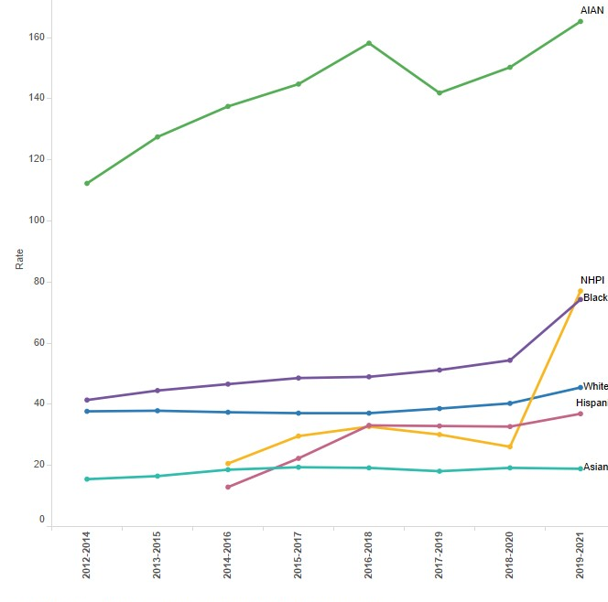
Unintentional injury deaths in King County
Unintentional injury deaths, King County (rolling averages: 2012-2021)
Unintentional injuries (including drowning, falls, fires, firearms, motor vehicle collision, poisoning, and suffocations) were the leading cause of death among King County residents under the age of 45.
The rate of unintentional injury deaths among American Indian/Alaska Native residents is almost nine times the rate among Asian residents and four times the county average.
AIAN = American Indian/Alaska Native
NHPI = Native Hawaiian/Pacific Islander
Notes:
Averaging data from 2017-2021, the death rate of King County residents is 39.8 per 100,000 for unintentional injuries. The death rate has been slowly increasing over the last 10 years.
Among American Indian/Alaska Native residents, the rate of unintentional injury deaths was 160.7 per 100,000, which translates to 99 deaths. This rate is almost nine times the death rate among Asian residents (18.7 per 100,000) and four times the county average. The racial/ethnic group with the next highest death rate was Black residents with a rate of 64.4 per 100,000, which translates to 452 deaths.
The rate of unintentional injury death increases with level of neighborhood poverty, reaching 61.0 per 100,000 residents very high poverty areas.
Unintentional injury death rates have risen in Seattle and South King County in 2019-2021 compared to the prior 2016-2018 time period.

Slide 12
Adult food insecurity in King County
In King County, there are persistent disparities in communities experiencing food insecurity.
Transgender adults were nearly four times as likely as cisgender adults to report food insecurity.
Food insecurity among Black adults and Hispanic adults is nearly three times the county average.
Food insecurity (adults), King County (average: 2018-2021)
AIAN = American Indian/Alaska Native
NHPI = Native Hawaiian/Pacific Islander
^ = Data suppressed if too few cases to protect confidentiality and/or report reliable rates
* = Significantly different from King County average
! = Interpret with caution: sample size is small, so estimate is imprecise
Notes:
Averaging data from 2018-2021 for King County, 10.3% of adults experienced food insecurity. While rates have stayed relative stable over the past several years, disparities persist.
Transgender adults (38.5%) were nearly 4 times as likely as cisgender adults (9.9%) to report food insecurity.
LGB adults (15.0%) have a significantly higher rate than the county average. Food insecurity is highest among Black adults (29.8%) and Hispanic adults (28.4%) and is nearly three times the county average.
Highest rate among households in the lowest income categories: close to 40% of households making less than $20,000, and nearly 30% making between $20,000 and $34,999 were food insecure.
(This WA BRFSS indicator describes the percentage of adults who reported that, during the last 12 months, they bought food that sometimes or often didn’t last, and they didn’t have money to get more.)
The U.S. Census Bureau’s Household Pulse Survey found that food insecurity nearly doubled after COVID-19 mitigation strategies were implemented. Among households with children, food insecurity peaked in 2020 at 16.7% of households and was 13.5% in 2021.

Slide 13
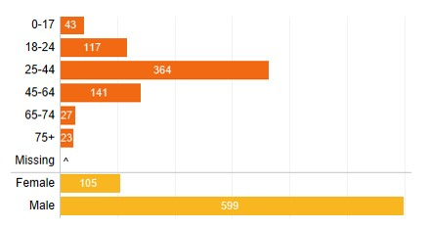
Firearm-related injuries & deaths in King County
EMS responses to firearm incidents (number of incidents), King County (2022)
The number of incidents of assault involving a firearm injury has continued to increase since 2019.
Black residents were more than eight times as likely to die by firearm than Asian residents, who had the lowest rate of firearm deaths compared to other races.
Source: King County Emergency Medical Services
Firearm-related deaths, King County (average: 2017-2021)
AIAN = American Indian/Alaska Native
NHPI = Native Hawaiian/Pacific Islander
^ = Data suppressed if too few cases to protect confidentiality and/or report reliable rates
* = Significantly different from King County average
Notes:
Firearm-related incidents continues to rise
King county EMS data is collected each month and provides a near-current picture of firearm incident responses. These data show that incidents involving firearms (as well as specifically assault involving a firearm), has continued to increase since 2019.
Averaging data from 2017-2021, the firearm-related death rate of King County residents was 8.3 per 100,000 for firearms-related deaths.
Hugely disproportionate impacts continue to be seen across the county.
For firearm deaths, the rate among Black residents (21.7 per 100,000) was more than 2.5 times higher than the King County average and more than eight times the rate among Asian residents (2.5 per 100,000)
Of all King County regions, firearms-related deaths were highest in the South Region, at 12.2 per 100,000. Similarly, the rate of firearm-related injuries in 2022 was highest in southern parts of the county, including North Highline and White Center (112.8 per 100,000), and Tukwila (100.4 per 100,000), as well as in Seattle-Downtown, Belltown, and First Hill (104.9 per 100,000).
Firearm-related deaths were highest among younger and older adults, compared to other age groups: 18.7 per 100,000 adults ages 18-24, and 14.7 per 100,000 adults aged 75 and older. When looking at firearm deaths separated by intent, among suicide firearm deaths, the 65+ group has the highest rate, whereas, for homicide firearm deaths, 18 to 24-year-olds have the highest rate.
While the 18 to 24 age group has seen increasing counts for firearm incidents in previous years, the counts in 2022 decreased from 2021. On the other hand, compared to 2020, the number of incidents involving a firearm injury among middle-aged people 25 to 44 increased by 68% in 2022.

Slide 14
Birthing person mortality in King County
Birthing person mortality, King County (rolling averages: 2008-2021)
While maternal or birthing person mortality in King County is lower than the national average, the number of birthing person deaths per 100,000 live births more than doubled in King County over the past ten years.
Source: WA State Department of Health, Birth and Death Certificate data. Note: Each point shown is the 5-year average birthing person death rate per 100,000 live births. Break in the line indicates suppression of data, in accordance with APDE data suppression and confidentiality criteria.
Notes:
*Break in the line indicates suppression of data, in accordance with APDE data suppression and confidentiality criteria due to small numbers.
Averaging data from 2017-2021 for King County residents, 19.1 birthing people per 100,000 live births died from pregnancy-related causes, representing 23 deaths.
During this same time frame, there were 106 deaths across the state of WA.
Compared to the national average (23.5 maternal deaths per 100,000 live births from 2018-2021), maternal or birthing person mortality was lower in King County over a similar period (19.1 per 100,000 live births from 2017-2021).
Birthing person mortality more than doubled in King County over the past ten years, reaching an average of 19.1 maternal/birthing person deaths per 100,000 live births in 2017-2021 compared to 8.8 deaths per 100,000 live births in 2011-2015. Though these differences are not statistically significant, the pattern mirrors national patterns and warrants further monitoring.
Underlying causes
Related data from Washington state (2014-2020) shed light on the most common underlying causes of pregnancy-related deaths, which include behavioral health conditions (i.e., mental health conditions and substance use, excluding instances of substance overdose), hemorrhage, and infection. This is similar to national data.
Although local data cannot be parsed out by race/ethnicity, we know from national data that Black birthing people experienced death rates (69.9 deaths per 100,000 live births) more than 2.6 times the rate for white birthing people (26.6 deaths per 100,000 live births).
National data also show that more than half (52%) of pregnancy-related deaths occur after delivery, emphasizing the need for clinical and policy interventions to embrace a life course perspective by supporting birthing people before, during, and after birth.

Slide 15
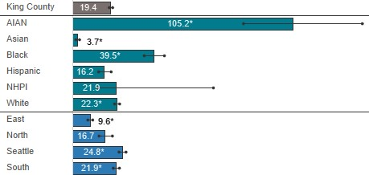
Drug-induced deaths in King County
Drug-induced deaths , King County (average: 2017-2021)
Drug-induced deaths (overdose or other drug-related causes) among King County residents have increased in recent years. The rate among American Indian/Alaska Native residents was more than five times the county average.
The number of drug overdose deaths approximately doubled between 2020 and 2022 in King County. The rapid increase in drug overdose deaths reflects a sudden pervasiveness of fentanyl in the local drug supply.
AIAN = American Indian/Alaska Native
NHPI = Native Hawaiian/Pacific Islander
* = Significantly different from King County average
Drugs Involved in Confirmed Overdose Deaths
(Note: A decedent may be represented in multiple lines)
From: www.kingcounty.gov/overdose/data
Source: King County Medical Examiners Office as of 1/2/2024
Notes:
DEATHS DUE TO DRUG OVERDOSE OR OTHER DRUG-RELATED CAUSES
Drug-induced deaths include overdose deaths but are not limited to these. It includes deaths with an underlying cause of death based on ICD-10 diagnostic codes signifying drug poisoning/overdose and other medical conditions caused by the use of legal or illegal drugs, excluding alcohol.
Averaging data from 2017-2021, the drug-induced death rate of King County residents was 19.4 per 100,000.
Comparing recent 3-year rolling averages, the rate of drug-induced deaths among King County residents has increased from 14.8 per 100,000 (2016-2018) to 22.0 per 100,000 (2019-2021). During this period, the rate of drug-induced deaths significantly increased among Black residents, white residents; residents in Seattle, South Region, North Region; residents living in very high-, high-, and medium-poverty areas.
DEATHS DUE SPECIFICALLY TO DRUG OVERDOSE
Data from our King County Medical Examiner’s Office includes overdose deaths, defined by searching across ‘cause of death’ text fields for key words indicating acute drug intoxication or poisoning.
The number of drug overdose deaths approximately doubled between 2020 and 2022 in King County. The rapid increase in drug overdose deaths reflects a sudden pervasiveness of fentanyl in the local drug supply, with fentanyl involved in over 70% of overdose deaths that occurred in 2022. Over half of the drug overdose deaths that occurred in 2022 involved both opioids (e.g., fentanyl, heroin, and/or prescription opioids) and stimulants (e.g., methamphetamine and/or cocaine), up from approximately 30% prior to 2018.
Tremendous disparities in overdose incidence exist in King County, most notably for King County residents who are American Indian/Alaskan Native or Black or African American, experiencing homelessness or living at a facility managed by a social service agency, living in central Seattle or South King County, between the ages of 45 to 64, or Male.

Slide 16
Domestic violence in King County
Emergency department visits involving domestic violence, King County (2022)
Since the start of the pandemic in 2020, the rate of domestic violence emergency department visits in King County has increased by 48%, with noteworthy differences by race and region.
AIAN = American Indian/Alaska Native
NHPI = Native Hawaiian/Pacific Islander
* = Significantly different from King County average
Notes:
During the pandemic, there has been a steep and significant rise in domestic violence emergency department (ED) visit rates. Between 2020 to 2021 there was a 20% increase (from 64.3 visits per 100,000 to 76.6 per 100,000). That was followed by an even steeper 25% increase the subsequent year, 2022, at 95.4 visits per 100,000. This represents a 48% rise in domestic violence ED visits in 2 years since the pandemic began.
Demographic breakdowns
The rate of ED visits involving domestic violence was highest among residents ages 18 to 24 (200.0 per 100,000).
Females (128.3 per 100,000) were twice as likely as males (64.4 per 100,000) to visit the emergency department due to domestic violence.
By race, American Indian/Alaska Native residents were 22 times as likely (364.2 per 100,000), and Black residents (240.3 per 100,000) were 14 times as likely as the group with the lowest rate (‘multiple-race’ residents) to visit the emergency department due to domestic violence.
Geographically, emergency visits involving domestic violence were highest in the South Region (168.3 per 100,000). The two ZIP codes with the highest rates were 98002 (344.8 per 100,000) and 98047 (250.3 per 100,000), which includes the Auburn and Pacific areas, respectively.

Slide 17
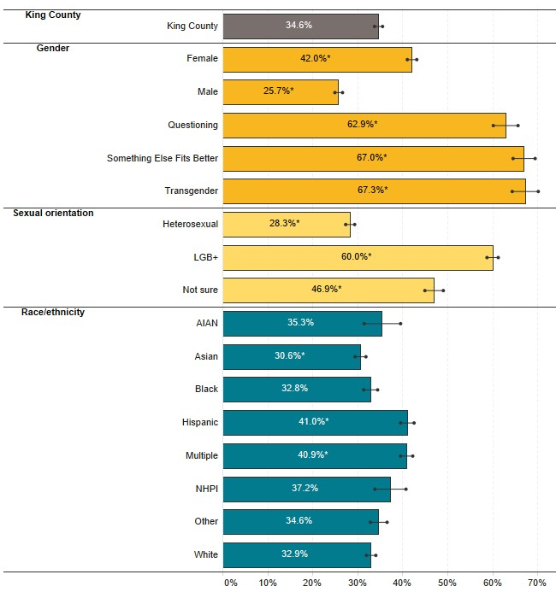
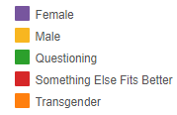
Youth mental health in King County
The prevalence of depression among King County students increased between 2018 (32.9%) and 2021 (36.4%).
Compared to male students, females and students with other gender identities were significantly more likely to experience symptoms of depression.
These groups also had the steepest rises between 2018 and 2021: a 12% rise for female students, and 25% increase among transgender students.
Depression prevalence
(8th, 10th, 12th grades),
King County (average: 2018 & 2021)
Depression prevalence by gender
(8th, 10th, 12th grades),
King County (2004-2021)
AIAN = American Indian/Alaska Native
NHPI = Native Hawaiian/Pacific Islander
* = Significantly different from King County average
Notes:
Ongoing areas from 2021/22 report for improvement:
Youth depression continues its steep rise since 2016
Depression among King County students rose 11% from before to after the pandemic years, from 32.9% in 2018 to 36.4% in 2021.
Differences by gender are stark.
Steep rises in depressive symptoms among female, gender non-confirming, transgender and gender questioning students. Female students saw a 12% rise in depressive symptoms between 2018 and 2021, while for transgender students it was a 26% increase.
Compared to male students (26%), females had a much higher prevalence of depressive symptoms (42%). Moreso, transgender students, students who reported that ‘something else fits better’, and students who were questioning their gender reported depression rates that were more than 2.5 times as high as male students’ depression rates.
National data released by the CDC paints a similar picture, with adolescent girls reporting high rates of sadness, suicidal thoughts and sexual violence, as did teenagers who identified as gay or bisexual. www.cdc.gov/healthyyouth/data/yrbs/pdf/YRBS_Data-Summary-Trends_Report2023_508.pdf
Locally, disparities continue with higher rates among LGB students, those living in the south region, certain Asian subgroups (Filipino), and Hispanic students.

Slide 18
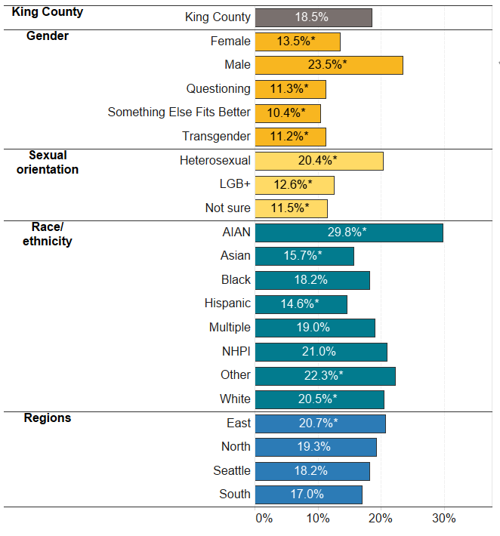
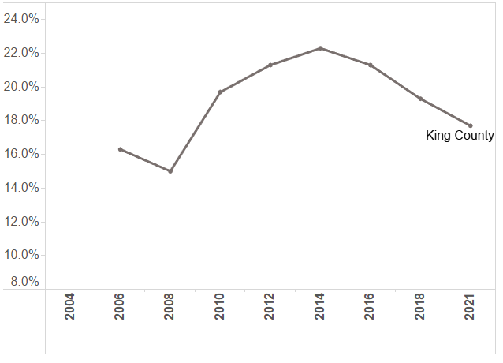
Physical activity in King County
Physical activity, over time
(8th, 10th, 12th grades),
King County (2004-2021)
Physical activity (8th, 10th, 12th grades), King County (average: 2018 & 2021)
The percentage of youth getting sufficient physical activity has been declining in King County since 2014.
American Indian/Alaska Native and white students were significantly more likely to meet physical activity recommendations than the average King County student.
AIAN = American Indian/Alaska Native
NHPI = Native Hawaiian/Pacific Islander
* = Significantly different from King County average
Notes:
Ongoing areas from 2021/22 report for improvement:
The previous (2021/22) CHNA reported that fewer than 1 in 4 adults and youth were getting the recommended amount of physical activity/exercise.
The percentage of King County students who meet physical activity recommendations has declined with each survey year since 2014. Averaging data from 2018 and 2021, 18.5% of King County 8th, 10th, and 12th graders participated in physical activity for 60+ minutes each day for the past seven days.
American Indian/Alaska Native (29.8%) and white (20.5%) students were significantly more likely to meet physical activity recommendations than the average King County student (18.5%).
Hispanic (14.6%) and Asian (15.7%) students were significantly less likely to meet physical activity recommendations than the average King County student (18.5%).
Male students (23.5%) were most likely to meet physical activity recommendations compared to all other gender identities.
As grade level increases, student participation in physical activity declines. By 12th grade, only 15.1% of students met recommendations compared to 22.8% of 8th graders.
The percentage of King County students who meet physical activity recommendations was 17.7% in 2021 compared to 21.3% in 2016, representing a 17 percent decline.
Similarly, the percentage of youth in the top 5% for Body Mass Index (BMI) by age and gender has increased in King County over time from 8.8% in 2014 to 12.3% in 2021. The percentage of Native Hawaiian/ Pacific Islander (37.2%), Hispanic (20.7%), and Black (15.9%) youth in this BMI category was significantly higher than the King County average (11.4%). Students in the South Region were most likely to be in the top 5% for BMI compared to all other regions of the county.

Slide 19
Main community identified priorities
Communities continue to describe challenges accessing basic needs like food and housing, and in many cases describe how the COVID-19 pandemic worsened the social conditions that were already challenging peoples’ ability to thrive in King County.
Equity and social determinants of health
Housing access and quality
Healthcare access and delivery
Food insecurity and access
Children and youth
Notes:
To assess community-identified priorities, we did two things:
We reviewed over 30 community reports produced between 2021 and 2023. (linked in Appendix A of the full report).
We conducted listening sessions with community groups (on next slide)
This slide shows some of the main priorities/topic areas that emerged from our review of community reports across King County. We acknowledge and appreciate the countless community members who contributed their voices, perspectives, and personal experiences to these reports, and the community-based organizations that gathered this data to elevate those voices and experiences. We encourage readers to refer to the original reports linked in Appendix A for more information about the concerns and needs outlined by specific King County communities and organizations.
Communities highlighted needs related to:
Equity & social determinants of health: communities highlighted inequitable access to services and resources, as well as the impacts of racism, bias, and discrimination on diverse communities. – access to employment, pandemic-related economic and job losses, discrimination in community, schools.
2. Housing access and quality
Access to affordable housing (esp. after pandemic impacts of lost income, evictions, family disruptions, etc.)
Homelessness – addressing chronic illness while homeless, more low-income housing needed, inability to navigate system to access housing resources
3. Healthcare access & delivery
Access to mental & behavioral health services (not enough providers, substance use among youth, family needs support to help their kids social-emotional development)
4. Food insecurity & food access
Access to healthy, high-quality, and cultural foods
Need access to financial resources (e.g., SNAP, Fresh Bucks, grocery vouchers)
Need to improve quality of food served in schools
Need for low-cost or free meal delivery options
Need for more support for urban agriculture and gardening
Food banks and meal programs
Cost of transportation to food banks
Lots of programs centered in Seattle
Red tape involved in accessing food banks
Many fearful of government systems (e.g., due to immigration status) or don’t qualify based on income thresholds
5. Children & youth
School system support (food, nutrition education, COVID closure impacts, access to summer meals, eliminate lunch debt)
Childcare and early learning (affordability, COVID closures, funding for early learning programs)

Slide 20
Key Themes from Listening Sessions with King County Communities of Color
Access to Food and Nutrition Information
Communities want more opportunities to learn about how to eat well to protect their health, including how to choose healthier ingredients and how to shop for more affordable healthy options.
Access to High-Quality, Fresh, and Cultural Foods
Community members identified that rising food costs, proximity to grocery stores, and transportation availability were barriers to accessing healthy food.
Access to Mental and Behavioral Health Services
Barriers to accessing mental and behavioral health services include cost, cultural alignment of providers, timeliness and availability of appointments, and stigma associated with discussing mental health.
Climate Change Impacts on Food Security and Mental Health
Extreme weather events impact the emotional health and well-being of the whole family and make it difficult to access food.
Community Protective Factors
Communities shared examples of how they support one another, including providing transportation for those seeking care or access to food, sharing food, and support during stressful times.
Notes:
Secondly, we completed nine listening sessions partnering with Black, NHPI, AIAN, Hispanic, Cambodian, and Filipino serving community groups
Key themes emerged around, several similarities between what we found between listening sessions and the review of reports.
Access to food and nutrition information
Access to high-quality, fresh, and cultural foods
Access to mental & behavioral health services
Climate change impacts on food security & mental health
Community protective factors
Participating community members identified that rising food costs, proximity of food sources (such as grocery stores, food banks), and transportation availability were barriers to accessing healthy food. They also mentioned wanting more opportunities to receive nutrition education in community settings.
Community members identified cost as a barrier to accessing mental and behavioral health services, in addition to cultural alignment and timeliness of appointments
Across all groups, the top priority after cost was having a mental health provider that shares a similar cultural background or identity (race/ethnicity, gender, age, etc.)
Language access is important for personal expressions, but more important is someone that not only speaks the language but understands their culture – language access is not the whole picture
Climate change: Extreme weather events impact the emotional health and well-being of the whole family and make it difficult to access food. Not everyone had a reflection about the impacts of climate change, but those reflections that were shared are summarized in this section of the report.
Regarding mental health: Kids go stir crazy, overuse electronic devices, miss out on exercise opportunities – (indoor play options can be costly)
Regarding food access: Symptoms like asthma and allergies can be aggravated, heat stroke among kids and elder adults, transportation disruptions, limited food inventory and increased food costs as a result of climate change
Protective factors: Several communities shared examples of how they deal with gaps in access or extreme weather events
communities support one another by sharing food, providing transportation for one another to seek care or access food, and supporting one another stressful times

Slide 21
Areas to Monitor
Overdose Deaths
Firearm Violence
Homelessness & Housing
Climate & Health
Access to Care
Mental & Behavioral Health
Food Insecurity
Pistol icons created by Freepik
Notes:
Based on trends in the data, emerging and existing threats to the public’s health, and existing county initiatives, the following are notable areas to monitor: mental and behavioral health, firearm violence, overdose deaths, homelessness, and climate-related health impacts.
Additionally, we recommend monitoring specific areas where we anticipate effects resulting from the end of COVID-19 related assistance: Access to Care, Mental and Behavioral Health and Food Insecurity.
A number of COVID-19-related types of assistance ended in 2023, including the pause on student loan payments, suspension of work requirements for food assistance, emergency assistance for childcare centers, and the automatic continuation of Medicaid coverage. These changes in assistance are anticipated to affect some residents more than others, underscoring the need for continued monitoring of key determinants of health impacted by the pandemic by race, place, and identity.
Access to healthcare: As of March 31, 2023, the continuous enrollment provision for Medicaid eligibility was suspended, which is likely to result in substantial loss of Medicaid coverage over the next year. As of 2022, Hispanic (19.3%) and American Indian/Alaska Native (19.1%) adults had the highest rate of uninsurance. Rates of uninsurance and incomplete vaccination among children 19-35 months of age were highest for those below the federal poverty line or living in very high-poverty areas.
Food insecurity: Starting September 1, 2023, work requirements as a precondition to receiving food assistance were reinstated, for the first time since the pandemic. Listening sessions with communities of color identified that rising food costs, proximity of food assistance and transportation availability were barriers to accessing healthy food.

