Slide 1
P-card Holders iExpense Status
Troubleshooting Guide

Slide 2
Avoid Card Suspension
Let’s Chat!
(206) 263-9251
P-CardTeam@Kingcounty.gov
P-Card Processing Best Practices:
Process Transaction Weekly
Send Documentation to Approvers
Check Status of Submitted Reports
F/U with Approvers to approve reports over 5 days
Contact P-Card Team for Delays
*Cardholders that are Non-Compliant 45 days will result to card suspension!
Notes:
Go into iExpense and check the submitted report Status and follow up if left unapproved for more than a week.
Team Email : P-CardTeam@Kingcounty.gov
Call Us: 206-263-9251
Retention: 6years, 2years onsite (Receipts, Invoice, Approvals, etc)

Slide 3
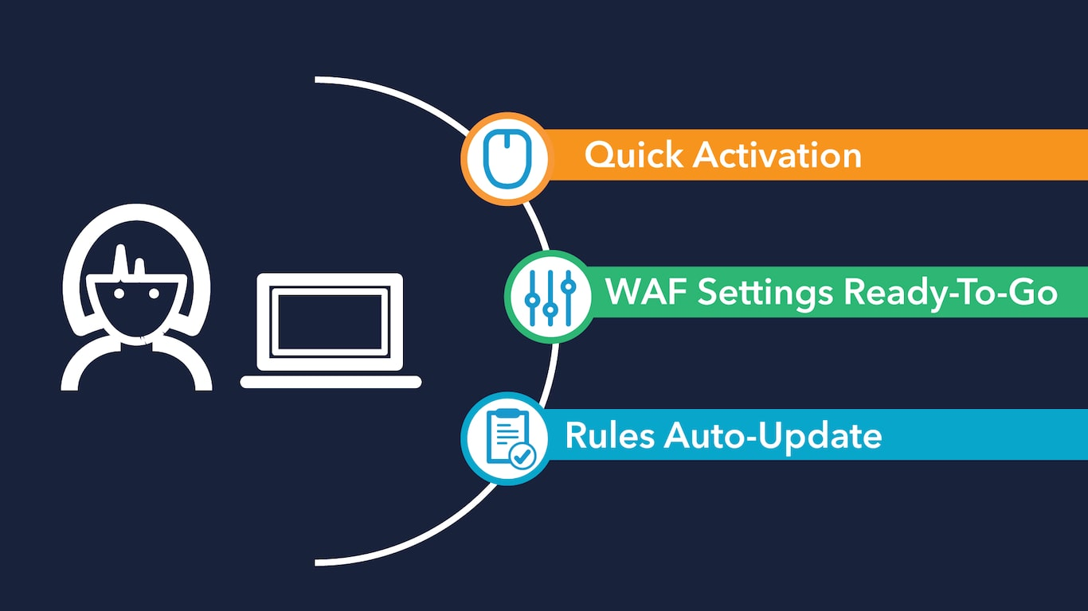
After you make a purchase
3-4 days to populate
Access iExpense
Departments have delegates
Notes:
All transactions will populate in Oracle iExpense within 3-4 business days after the transaction post in US Bank. Send all documents to your delegate for processing.

Slide 4
EBS – iExpense Status Definitions
Pending Manager Approval – The expense report needs to be approved by one or more approvers
Pending Payables Approval – Wrong template has been selected must start over and select Pcard
Partially Paid – Payment is currently processing and should change to “Paid” status shortly
Paid – Expense has been Paid
Pending Your Resolution – Preparer has mistakenly included receipt-based expense or an Approver has used the “Requested more information” workflow to get details on an expense report.
Withdrawn – The preparer has withdrawn an expense report or preparer withdraws and resubmits an expense report for a proxy who no longer has an active EBS account.
Pending System Administrator Action – (PSAA) Indicates issue with submitted expense report.
Disputed – The preparer has disputed the transaction in iExpense for Fraud or Partial Order Received.
Three most common causes of this status are:
The expense report was not fully approved within 30 days of being submitted.
The expense report was created for a proxy who does not have an active EBS Proxy User account.
The POETA and/or template used on the expense report does not have approvers set up.
Notes:
Withdraw the report. Update Expense Reports click pencil icon. Next to continue through end of report to submit.
Complete and send a Proxy/Delegate Request Form to your proxy approver SPOC list BRC Site.
Double check your POETA, Open expense report and click Expense Allocation Tab if correct have approvers or agency SPOC/AME designee review approvers for the task owning org.
Last if all steps done and it remains in PSAA create a help ticket for other less common issue.

Slide 5
Pending System Administrator
You’ll get an error if the expense report isn’t approved within 30 days
Solution Withdraw the expense report and resubmit (all approvers must re-approve)
PRO TIP
Submit separate expense reports for each POETA
Notes:
*NOTE – If the status remains as PSAA after it has been withdrawn and resubmitted:
Create a help ticket to https://helpdesk.kingcounty.gov/CherwellPortal/ to know why in error status. There could be other reasons like Approvers not associated to POETA etc.
EBS iExpense User Guide (sharepoint.com) See slide 73 for PSAA error status.
Follow BRC instructions in resolving the expense.
“Most likely you will need to create a new report by withdrawing then deleting that report and create a new one.”
******* Also follow these same steps if you have a report that has been in PENDING MANAGER APPROVAL over 30+ days. Report is likely stuck. See Slide 7.

Slide 6
Rejected
The expense report has been rejected due to incorrect POETA or Justification
Solution Click the link to the rejected expense report to see why it was rejected. Update and make necessary changes to the report. Re-submit.
Notes:
Withdrawn Status- The preparer has withdrawn an expense report or preparer withdraws and resubmits an expense report for a proxy who no longer has an active EBS account.
*If withdrawn and resubmitted and the same status remains, create a help ticket to have EBS profile reactivated temporarily.

Slide 7
Pending Manager Approval (*over 30+ days)
Occurs when approvers fail to approve reports within 30days.
Solution *If over 30days since last approved date: Withdraw the expense report and resubmit (all approvers must re-approve)
Note: *Check to see if it has been 30+days since the last approver had approved report.
Notes:
* Note: If the report submit date over 30days and still showing as Pending Manager Approval:
Check to see if report has multiple POETA string. Look at approver tab to see what date the last approver had approved the report. If over 30days, then likely in error status.
Proceed by withdrawing and resubmitting report.
3. If report goes into PSAA status after resubmitting, Withdraw, Delete and create a new report.
This is similar to PSAA Status.
See iExpense User Guide: EBS iExpense User Guide (sharepoint.com) see slide 73 for common causes of PSAA status

Slide 8
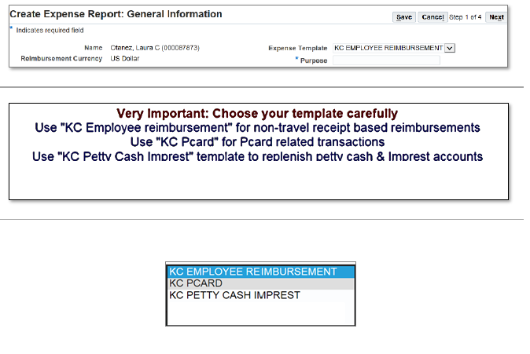
Pending Payables
Occurs when wrong template has been selected - DEFAULT “ KC Employee Reimbursement”
Solution Go back and select correct Template “KC PCARD” Remove any entries made on Cash And Misc Expense section.

Slide 9
Quick Links
P-Card Website
Oracle EBS Knowledge Center
EBS- iExpense Status Definitions
EBS- Resolve Pending System Administrator Action (PSAA)
Proxy/Delegate Request Form
SPOC –EBS Approvers and SPOC list
P-Card Dashboard
Create Help Desk Ticket!
Notes:
Pcard Reports and Dashboard Reports & Metrics - King County
Pcard Website: Purchasing Cards (P-Cards) - King County
Pcard Transactions 2023 Updated daily
TIER 3 US Bank Reports
BI Dashboards “Casual User Training” https://kc1.sharepoint.com/sites/DES/BRC/Pages/Oracle%20BI/BI-Training.aspx
County Agency Metrics
BRC iExpense User Guide: EBS iExpense User Guide (sharepoint.com) Slide 73 for PSAA status

Slide 10
Thank You!
$
Notes:
Contact US: P-CardTeam@Kingcounty.gov
Phone: 206- 263-9400
Procurement & Payables Website: http://www.kingcounty.gov/procurement

