Slide 1
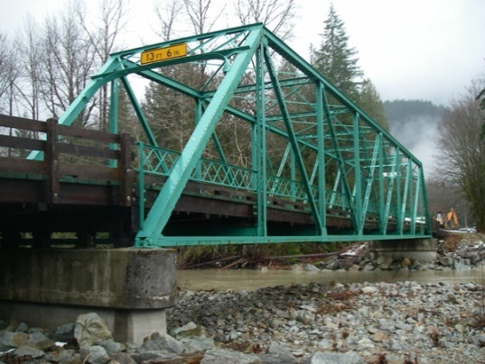
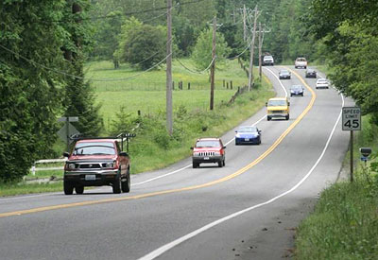
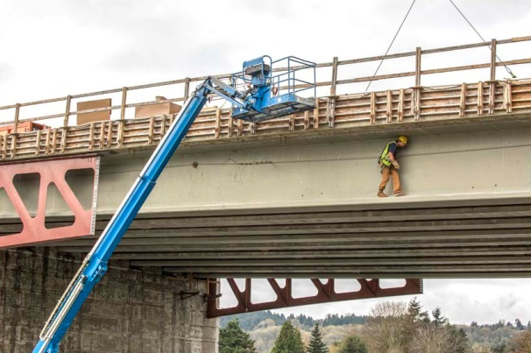
King County Bridges and Roads Task Force
Summary of Interviews
with Task Force Members
Presented by Triangle Associates, Inc.
For King County and the Bridges and Roads Task Force
August 12, 2015

Slide 2
Purpose of Task Force Interviews
To provide King County a better understanding of:
Expectations for this process
Member familiarity with certain bridges and roads issues
Individual perspectives on bridges and roads issues
Commonalities and differences among members
Status of existing member relationships

Slide 3
Interview Summary Details
Based on 18 phone interviews
Conducted between July 22 and August 11 2015
Interview guide/questions and two background reports provided in advance
Strategic Plan for Road Services and Road Services Division (RSD) Line of Business Plan
Detailed interview summary available electronically
Includes a complete interviewee list and interview questions

Slide 4
Major Takeaways
Emphasis and focus on revenue sources
Reducing infrastructure responsibilities
Additional efficiencies
Emphasize fairness and equity of impacts
Collaboration/involvement with other jurisdictions
Education/information-sharing for the public

Slide 5
Information Desired from King County
Funding sources and limitations of use
Impact of 2015 State transportation package
Alignment of Task Force schedule with 2016 State legislative session
RSD strategic priorities
Data comparing maintenance costs for specific bridges and roads
Long-term RSD revenue trend

Slide 6
Information Desired, Continued…
Bridges and roads RSD has considered for closing and criteria used
Current and projected future revenue and sources
Components of current funding gap
Determining road tiers
Snow removal priorities
Organizational efficiencies

Slide 7
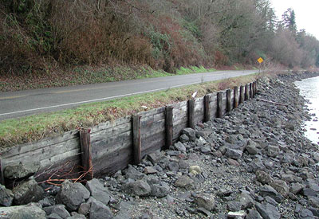
Specific Issues to Explore
Funding/matching funds
Multiple travel modes
ADA accommodations
Bike/pedestrian safety
Natural hazard mitigation
Flooding and earthquakes
Levee/revetment maintenance
Union agreements
Job training and job opportunities

Slide 8
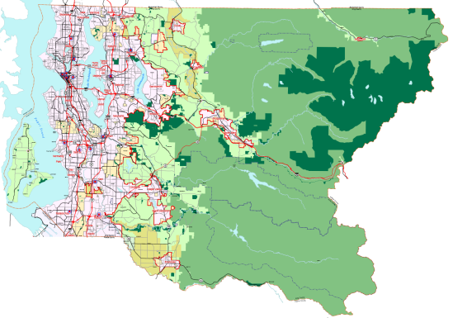
Specific Issues to Explore, continued…
Traffic concurrency
GMA implementation consistency
Design standards – county vs. city roads
Relationship between roads, access, and housing affordability
Aging infrastructure and impacts
Updates to State statutes for public-private partnerships
Signage consistency
Social equity and social justice in decision making

Slide 9
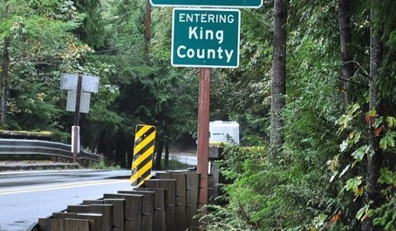
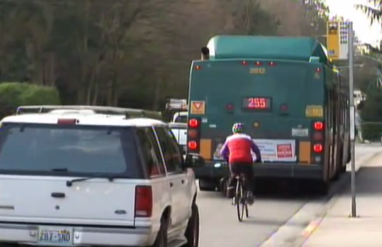
Potential Concerns
Urban vs. rural perspectives
Cross-jurisdictional disputes
Urban growth and development perspectives
How/where roads are maintained
Equity of revenue-based solutions
Long-term housing needs
Traffic concurrency implementation
Balancing needs of cars, bikes, and public transportation

Slide 10
Desired Task Force Outcomes
Consensus on funding priorities
Coalition building for leveraging more state resources
Identification of stable funding sources
Increased internal efficiencies – without sacrificing safety
Improved messaging to public
Better understanding of how bridges and roads are used
Greater emphasis on maintenance
Data-driven decision making

Slide 11
Solution Categories
Greater internal efficiencies – less of a focus; more information needed
Less infrastructure – some consideration but account for equity, unintended consequences; more information needed
Increased revenue – primary task force focus

Slide 12
Potential Solutions
Build partnerships
Leverage for more state funding
Build city support for county roads funding
Alternative funding
Changing King County responsibilities

Slide 13
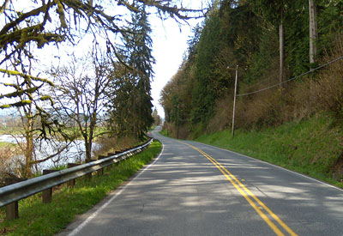
QUESTIONS?

