Slide 1
Road Services Business Reset
What has been done to respond to the funding crisis?
Bridges and Roads Task Force
September 16, 2015

Slide 2
2010 - 2015
Focused on core services
Reduced and reorganized staff
Consolidated facilities
Decreased overhead
Leveraged technology
Implemented process improvements
Formed partnerships
Reducing road inventory

Slide 3
Focus On Core Services
What We Deliver
Prevent & respond to immediate operational life safety and property damage hazards
Meet regulatory requirements and standards in cooperation with regulatory agencies
Maintain and preserve the network
Enhance mobility
Address roadway capacity to support growth
How We Deliver
Exercise responsible financial stewardship
Enhance the use of risk assessment in decision making
Provide responsive customer service and public engagement
Support the effectiveness of our workforce in a rapidly changing environment

Slide 4
Focus on Core Services
Reduced contract work
Eliminated less essential services
County Roads

Slide 5
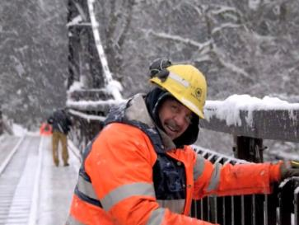
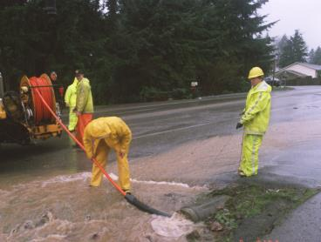
Staff Reduction and Reorganization
Reduced workforce 45%
Downsized 7 sections to 3
Realigned teams
Adjusted classifications
Worked with unions
Adjusted schedules
Providing critical training
Notes:
Eliminated over 45% of workforce by combining or eliminating jobs
Reorganized 7 sections into to 3
Reduced management 57%
Realigned teams and adjusted job classifications
Worked with unions for efficiencies
Adjusted core work hours and use of flex schedules
Training/retraining staff

Slide 6
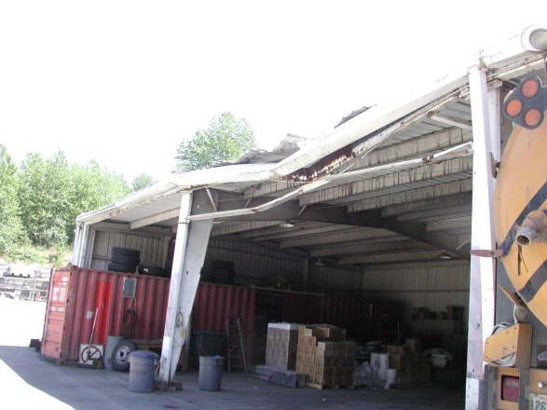
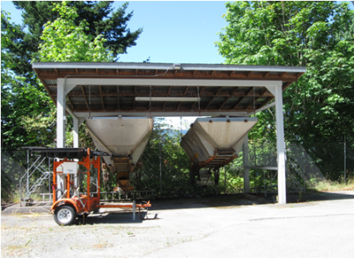
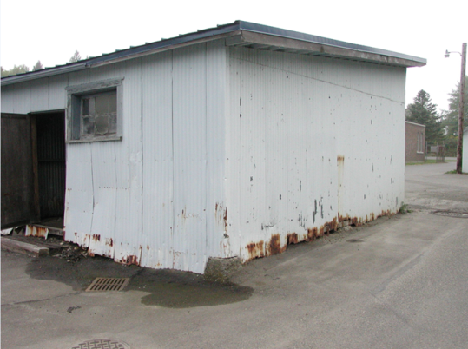
Maintenance Facility Consolidation
Facility Master Plan
New service boundaries
Closed 3 facilities
Reduced energy consumption
Improving facilities to better deliver service
Notes:
Developed facilities master plan
Re-organized maintenance division boundaries to improve travel time and crew compliments
Closed 3 facilities - consolidated staff, equipment and supplies in remaining 6
Reduced energy consumption associated with field operation
Improving facilities to increase operational efficiency
Selling surplus properties – reduces liability and provides revenue to develop efficient facilities

Slide 7
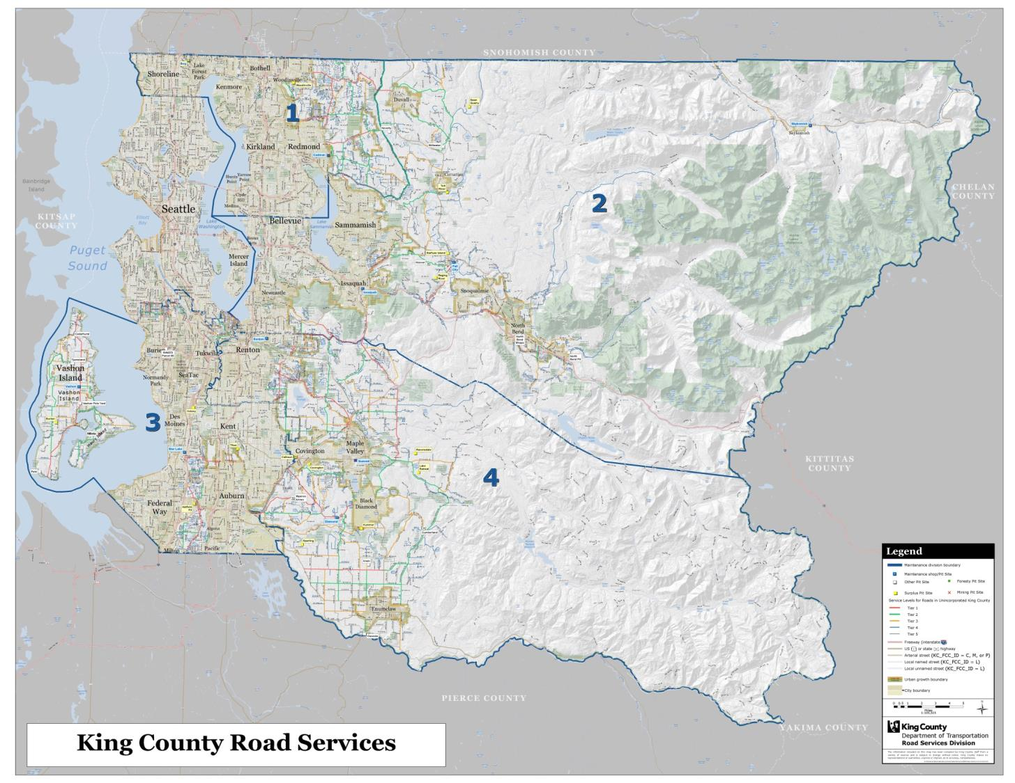
Before redistricting and facilities consolidation

Slide 8
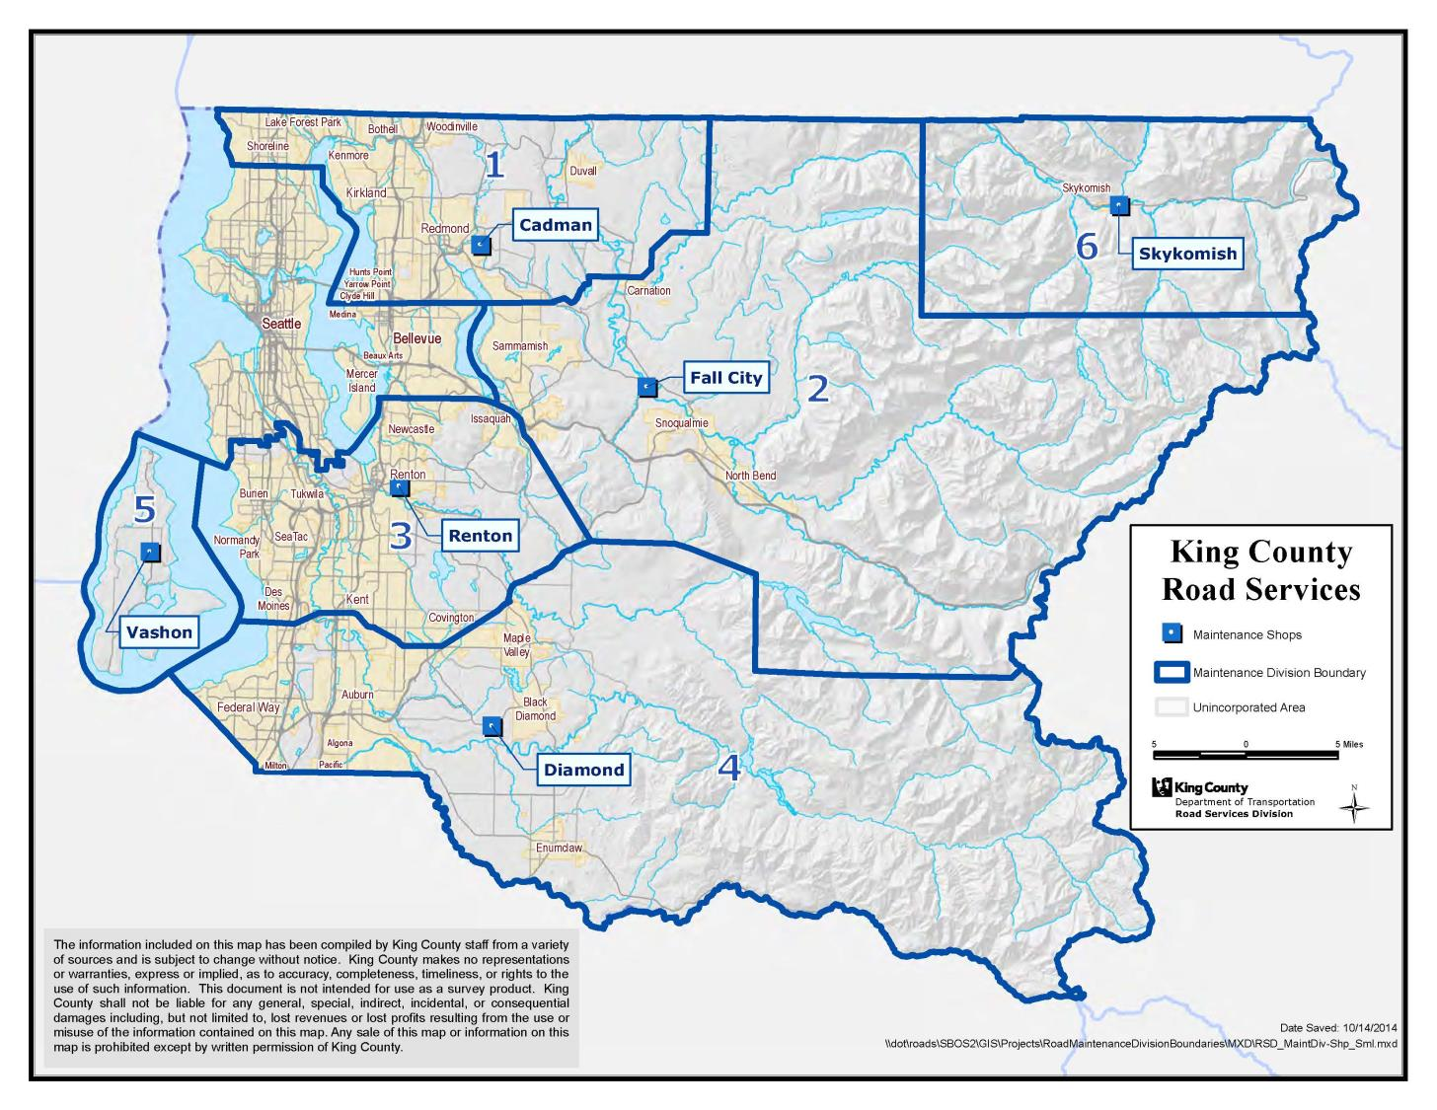
After redistricting and facilities consolidation

Slide 9
Decreased Overhead
Consolidated office space
Reduced fleet by 20%
Reduced computers, phones, etc.
Converting street lighting to LED
Selling surplus properties
Notes:
Consolidated downtown office space on three floors to half a floor
Reduced fleet inventory by more than 20 percent
Reduced radios, computers, phones and other operating equipment
Converting county-owned street lighting to LED technology for reduced energy costs

Slide 10
Leveraged Technology
Asset management
Automated vehicle location
Standardized software
Notes:
Implemented state-of-the-industry Asset Management and Work Order system - creating $1.2 million/year in efficiencies
Implementing automatic vehicle location technology for more efficient dispatch, better fleet management, and more efficient data collection
Standardizing software systems for more efficiency and reliability
In 2014, the Road Services Division successfully implemented Roadworks, a state-of-the-industry asset management system to manage its tens of thousands of maintenance service requests and work orders, replacing paper-based processes.
Roadworks, our new system, is saving about $1.2 million per year through efficiencies including the following:
Replacing paper records with a searchable relational database (e.g., much faster claims research);
Avoiding travel to obtain paper information on asset condition and status;
Mapping service requests and work orders to determine the most efficient daily dispatch routes;
Avoiding repeat investigative work.
In addition, Roadworks has eliminated thousands of hours of lag time between customer calls and dispatch--service requests are now logged and mapped in real time and are accessible to legitimate users system-wide.

Slide 11
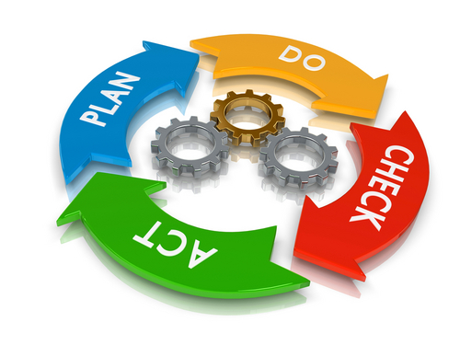
Process Improvements
Data collection
Permit consolidation
Traffic counts
Road closures alerts
Notes:
Examples:
Maximized asset data collection capabilities by centralizing staffing resources and eliminating the duplication of data collection
Consolidated maintenance clearing and grading permitting from three to one
Incorporating traffic counts into existing signal technology
Improving road closure alert process for more timely and accurate data to public

Slide 12
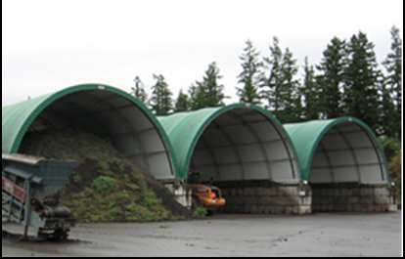
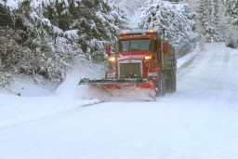
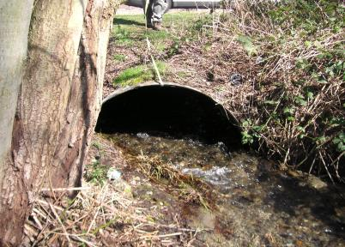
Partnerships
Street waste
Snow and ice
Regional drainage
Shared facilities
Notes:
Solid Waste Division to take organic street waste material to Cedar Hill Landfill in lieu of costly processing
Labor unions and other agency partners to supplement snow and ice response staff
Water and Land Resource Division to assess the condition of regional drainage systems in the right-of-way
WSDOT to share maintenance facilities

Slide 13
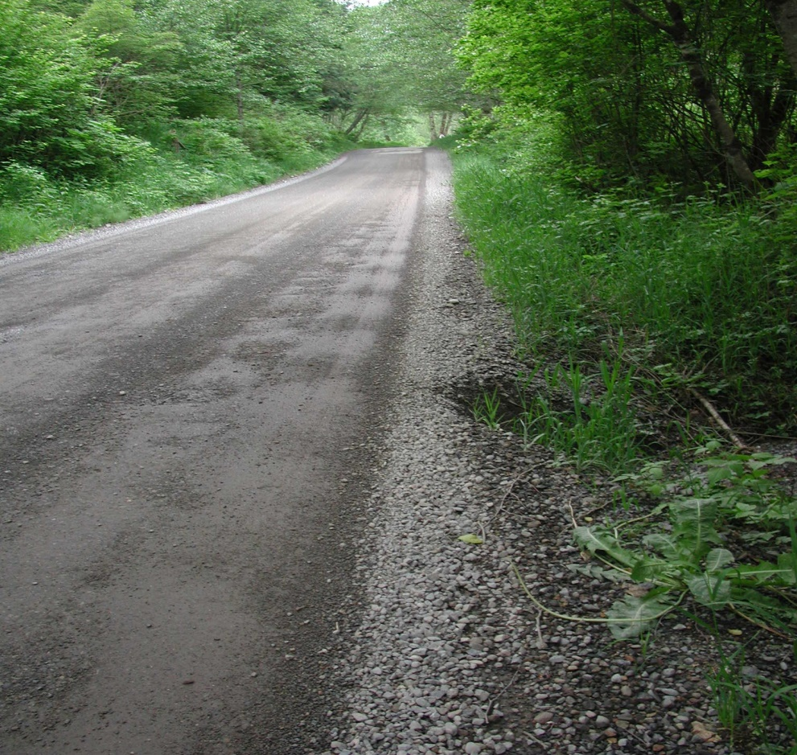
Reducing Road Inventory
Transfer orphaned road segments
Vacating rights-of-way
Limiting new roads
Notes:
Transferring orphaned roads to adjacent cities
Over 65 (67 actual) orphan road ROW segments – comprised of road ROW islands, half-streets, and UGB boundary roads
Approximately 24 centerline miles
Adjacent to or within 21 cities
Vacating roads to other agencies and property owners
Stopped converting private roads to county-maintained roads

Slide 14
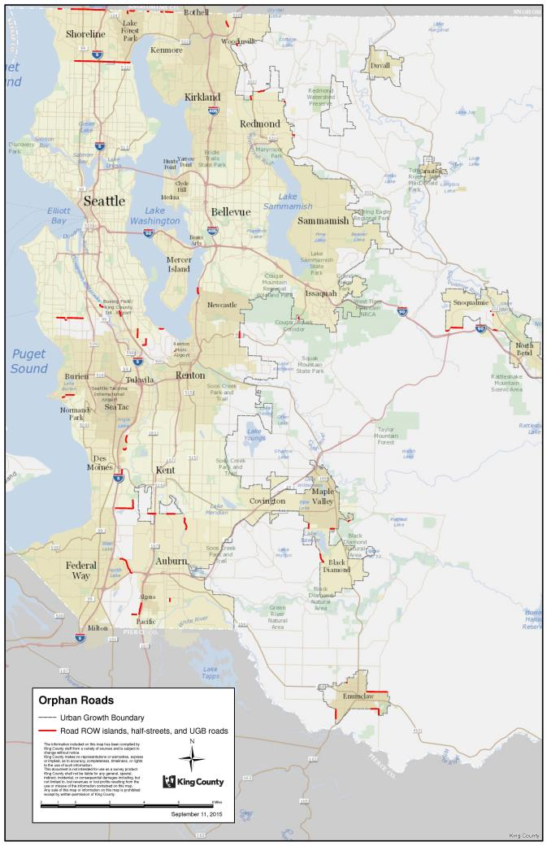
Orphan Roads
Over 65 segments
21 cities

Slide 15
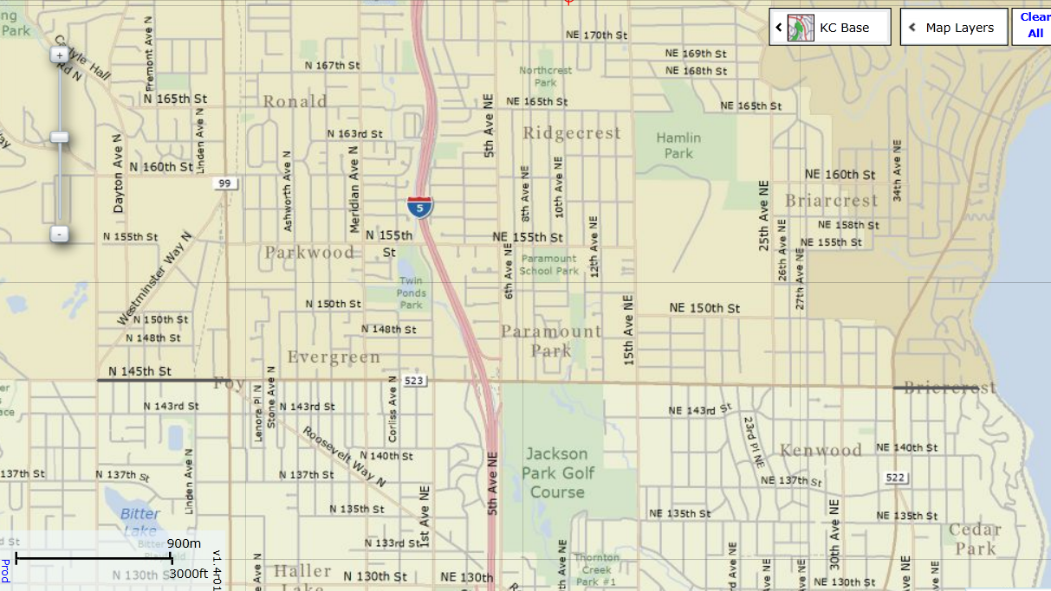
Seattle - N 145th St. Half Street Segments
Shoreline
Lake Forest Park
Seattle
Notes:
Also issue with underlying ROW for SR 523 should WSDOT remove from Hwy system.

Slide 16
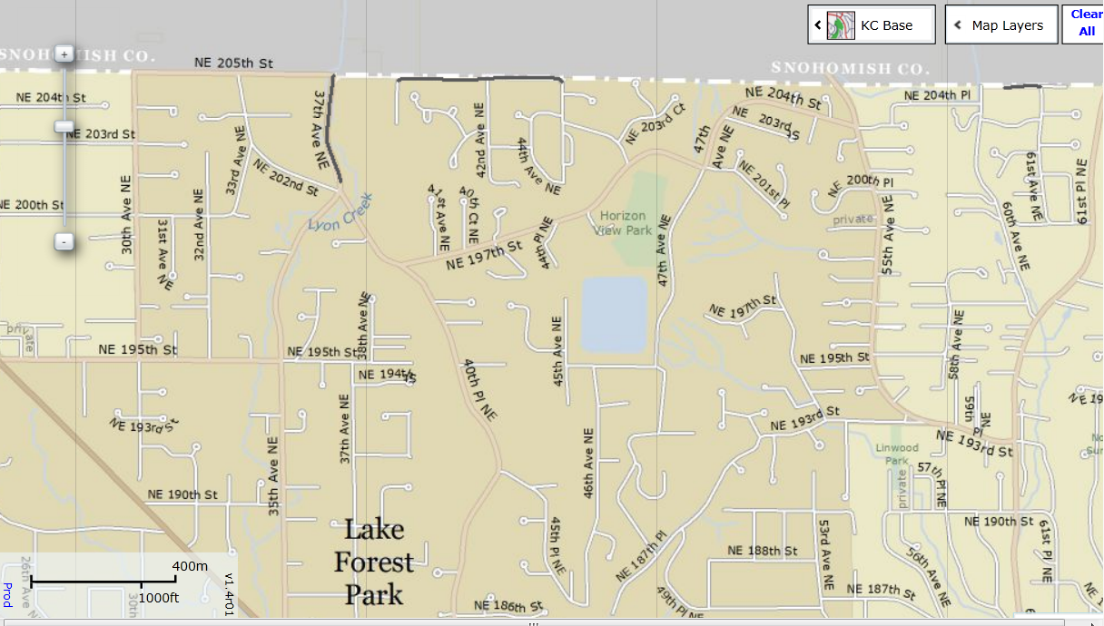
Lake Forest Park - Orphaned Road & County Line Half Streets

Slide 17
Next Steps
Create cross training opportunities with labor
Increase use of Lean
Increase productivity through mobile technology
Facility projects that create more efficient services

