Slide 1
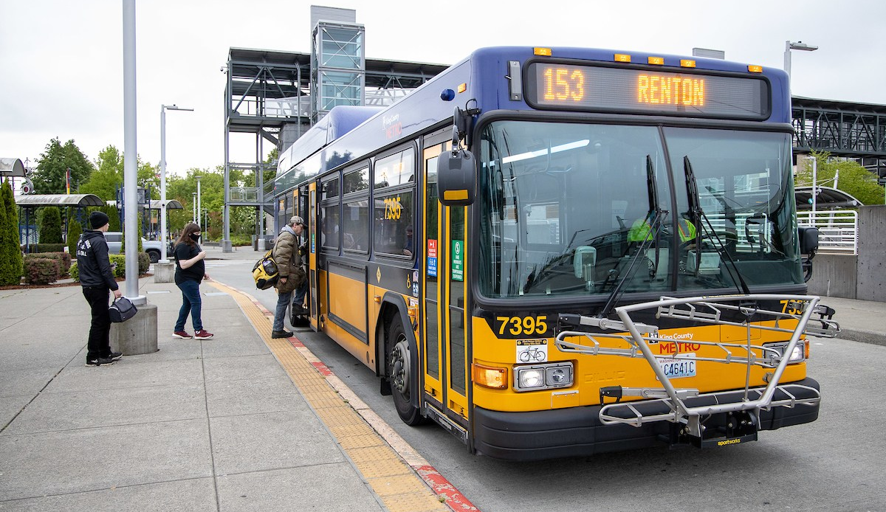
Get to Know Metro
Notes:
Introduce King County Metro – “The organization in our government that provides bus and other transportation services” and the Free Youth Transit Pass program (“riders 18 and younger can take transit for free”)
Explain to students that they will be learning about how to ride their local buses and the light rail train

Slide 2
What is Public Transit?
Notes:
Discussion opportunity:
Ask students if they have heard of public transit before, and if they have, what they know about it. Students can share out as a class, in small groups, or with partners. This is a good opportunity to check for misconceptions (e.g., “airplanes are public transit”) or gauge student interest (e.g., “I want to know more about how to drive a bus”).
Explain that public transit is a service to help people move around their communities.

Slide 3
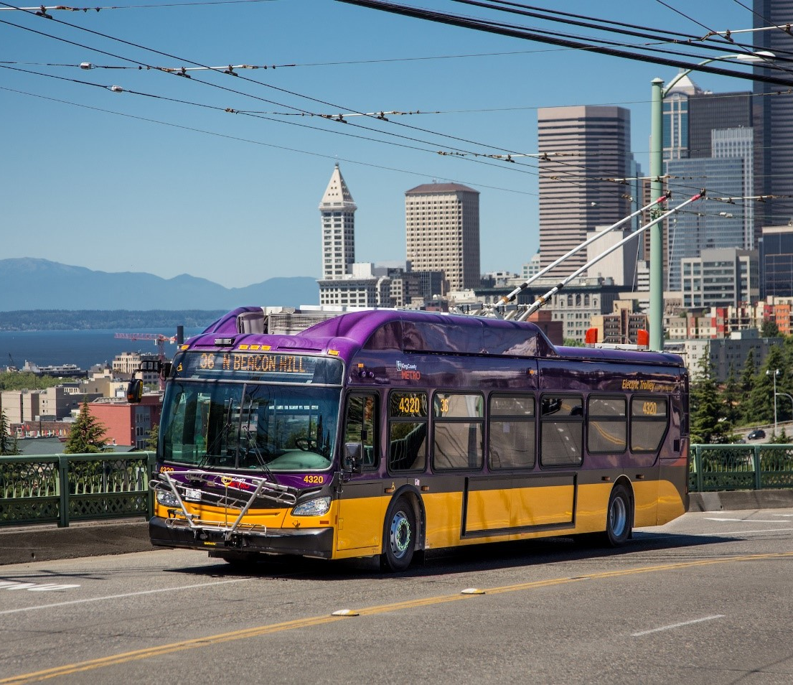
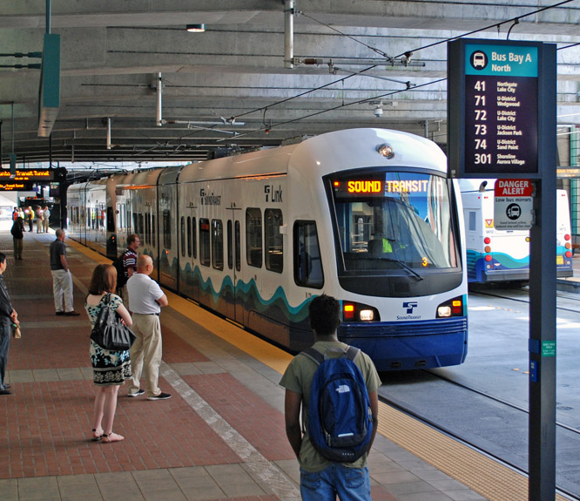
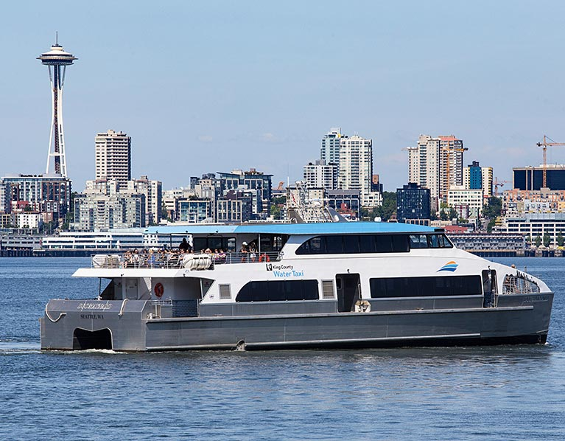
Types of Public Transit
Notes:
Explain that public transit can take many forms. Here in King County, some primary forms of transit are buses, light rail trains, water taxis, and ferries.
Discussion opportunity:
Ask students what kinds of transit they have seen in their communities. Have they ever ridden any of these forms of transit? Have they seen forms of transit in other places?

Slide 4
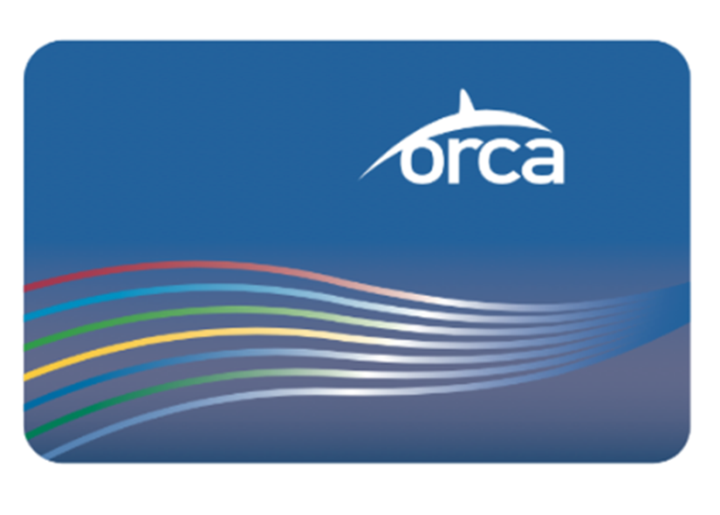
Which Card is Correct?
Coho
Porpoise
This card still works!
Notes:
Explain that here in King County, to use transit you can use a transit pass (students might be more familiar with the term ‘bus pass’).
Ask students to guess which transit card name is correct (ORCA).
Explain that if students or their family members have a blue orca card, the pass still works.

Slide 5
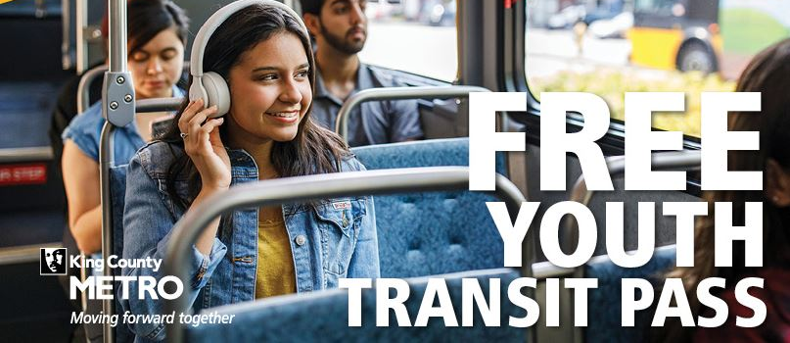
You Can Ride Transit For FREE!
Notes:
Explain to students that the ‘Free Youth Transit Pass’ program means that anyone 18 years old and younger will be able to ride all transit, including the bus and light rail, for free. (The program is statewide, and an ORCA card can be used around the Puget Sound region).
Explain to students that the goal of this lesson is to help them feel confident traveling with their friends or family on public transit by learning the basics of how to ride the bus or train.
Discussion Opportunity:
Ask students to name one place they would want to travel to using a bus or light rail train.
Instructor Information: To see an overview of the ‘how to ride’ sequence, go to https://kingcounty.gov/depts/transportation/metro/travel-options/bus/how-to-ride.aspx

Slide 6
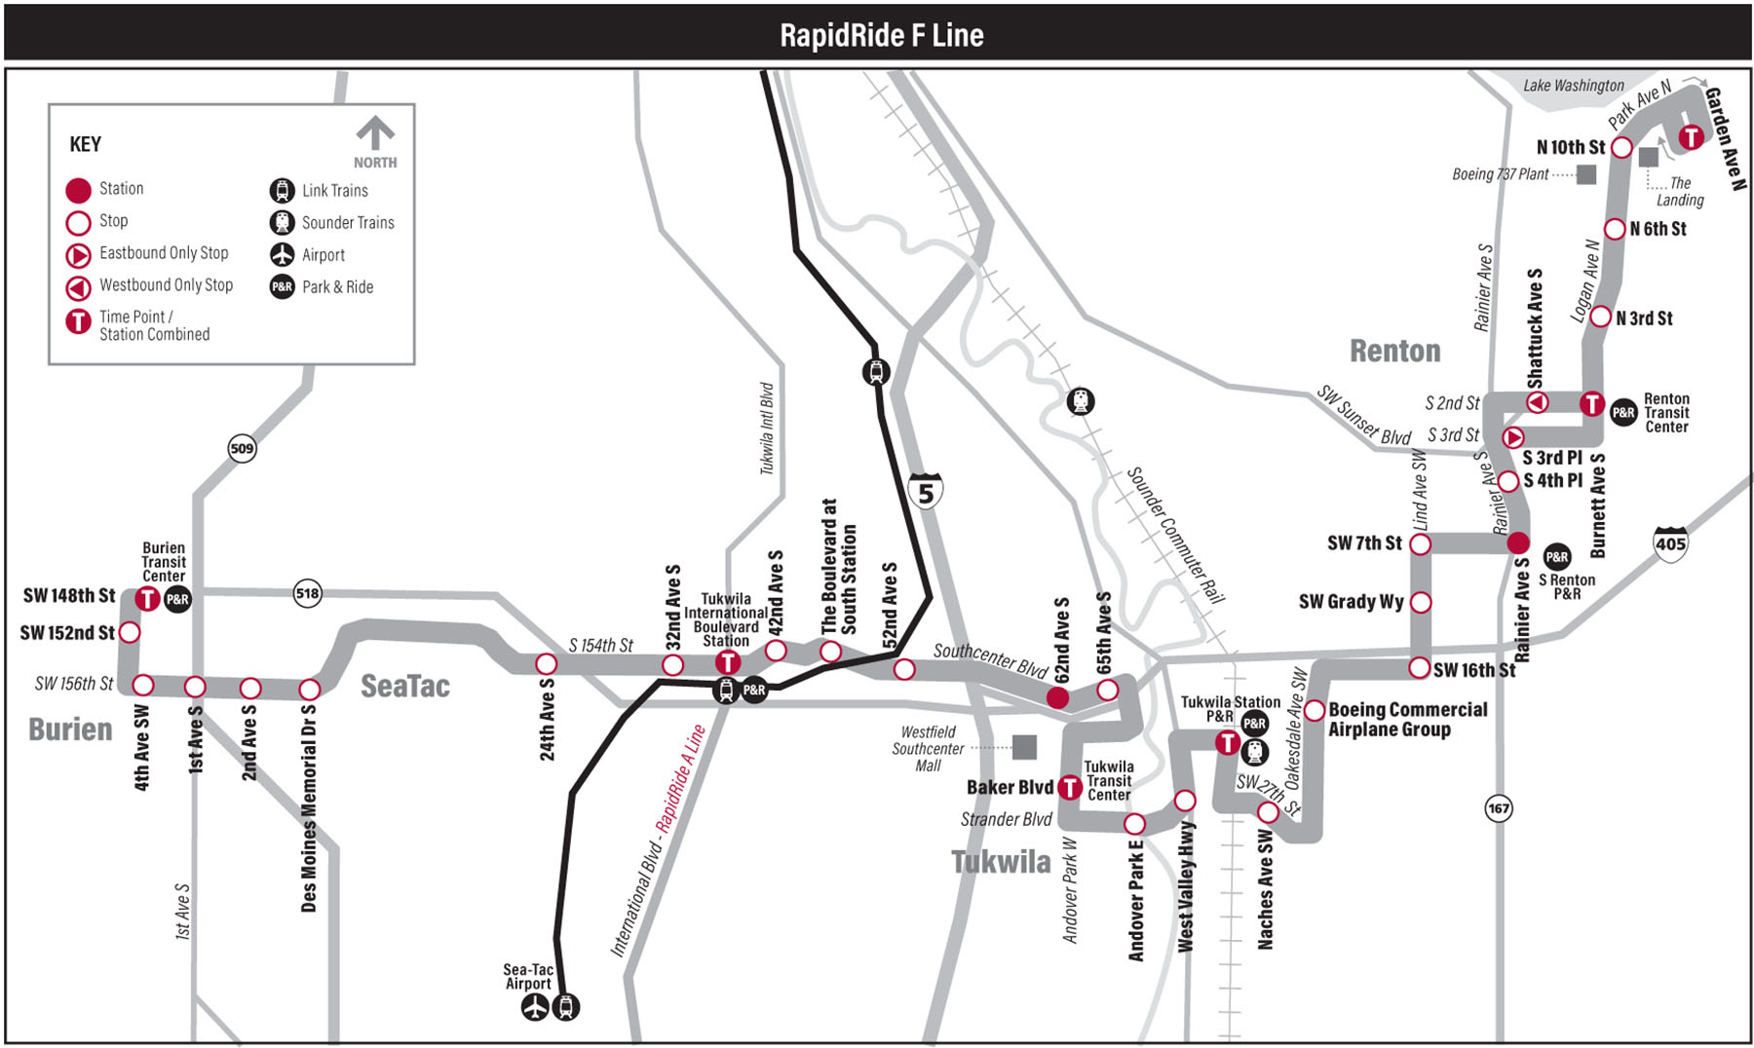
Plan Your Trip
Where are you going?
Who are you riding with?
Which route are you taking?
Notes:
Explain to students that once they have their ORCA cards, the first step to riding transit is to plan their trip.
As students will likely be riding with families or other adults, let students know it’s okay to depend on their adults for this, but that it’s a good idea to know where they are going, who you are riding with, and what route you are taking. This is an important safety practice, especially for elementary age students.
Discussion Opportunity:
Ask students to imagine they were going to take a trip. Have them tell a partner where they are going, what time of day they would want to leave, and what kind of transit they would take.

Slide 7
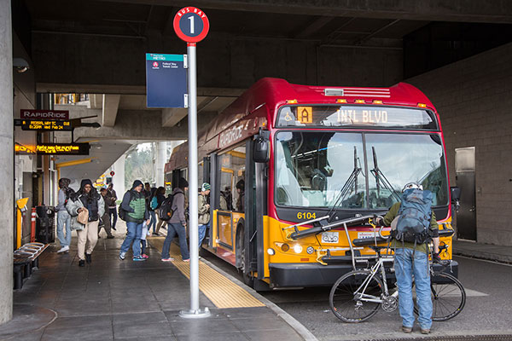
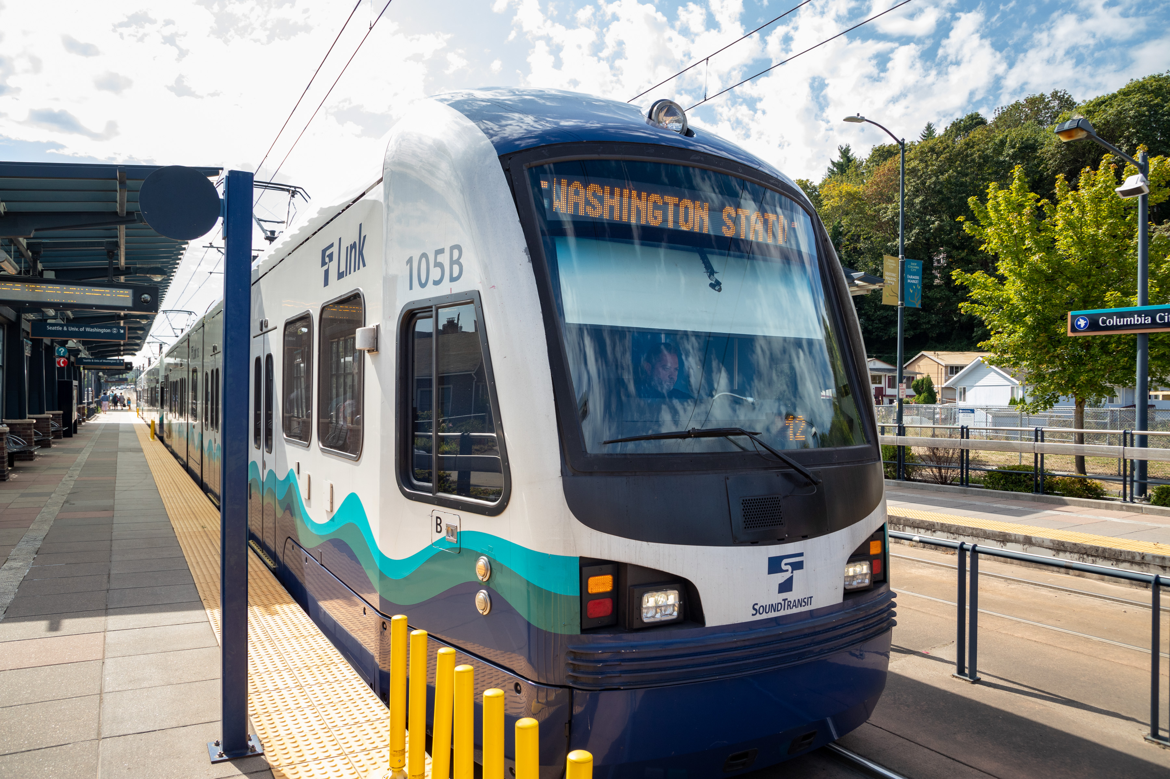
Bus Stops and Link Light Rail Stations
Notes:
Once students know where they are going, they will go to a bus stop or light rail station to board transit. They should bring their ORCA card with them.
Explain that buses and trains have ‘routes’ that go different places. If students want, they can practice checking to make sure they are getting on the right bus or train by checking the route number or name at the bus stop or station. For elementary students, this is optional.

Slide 8
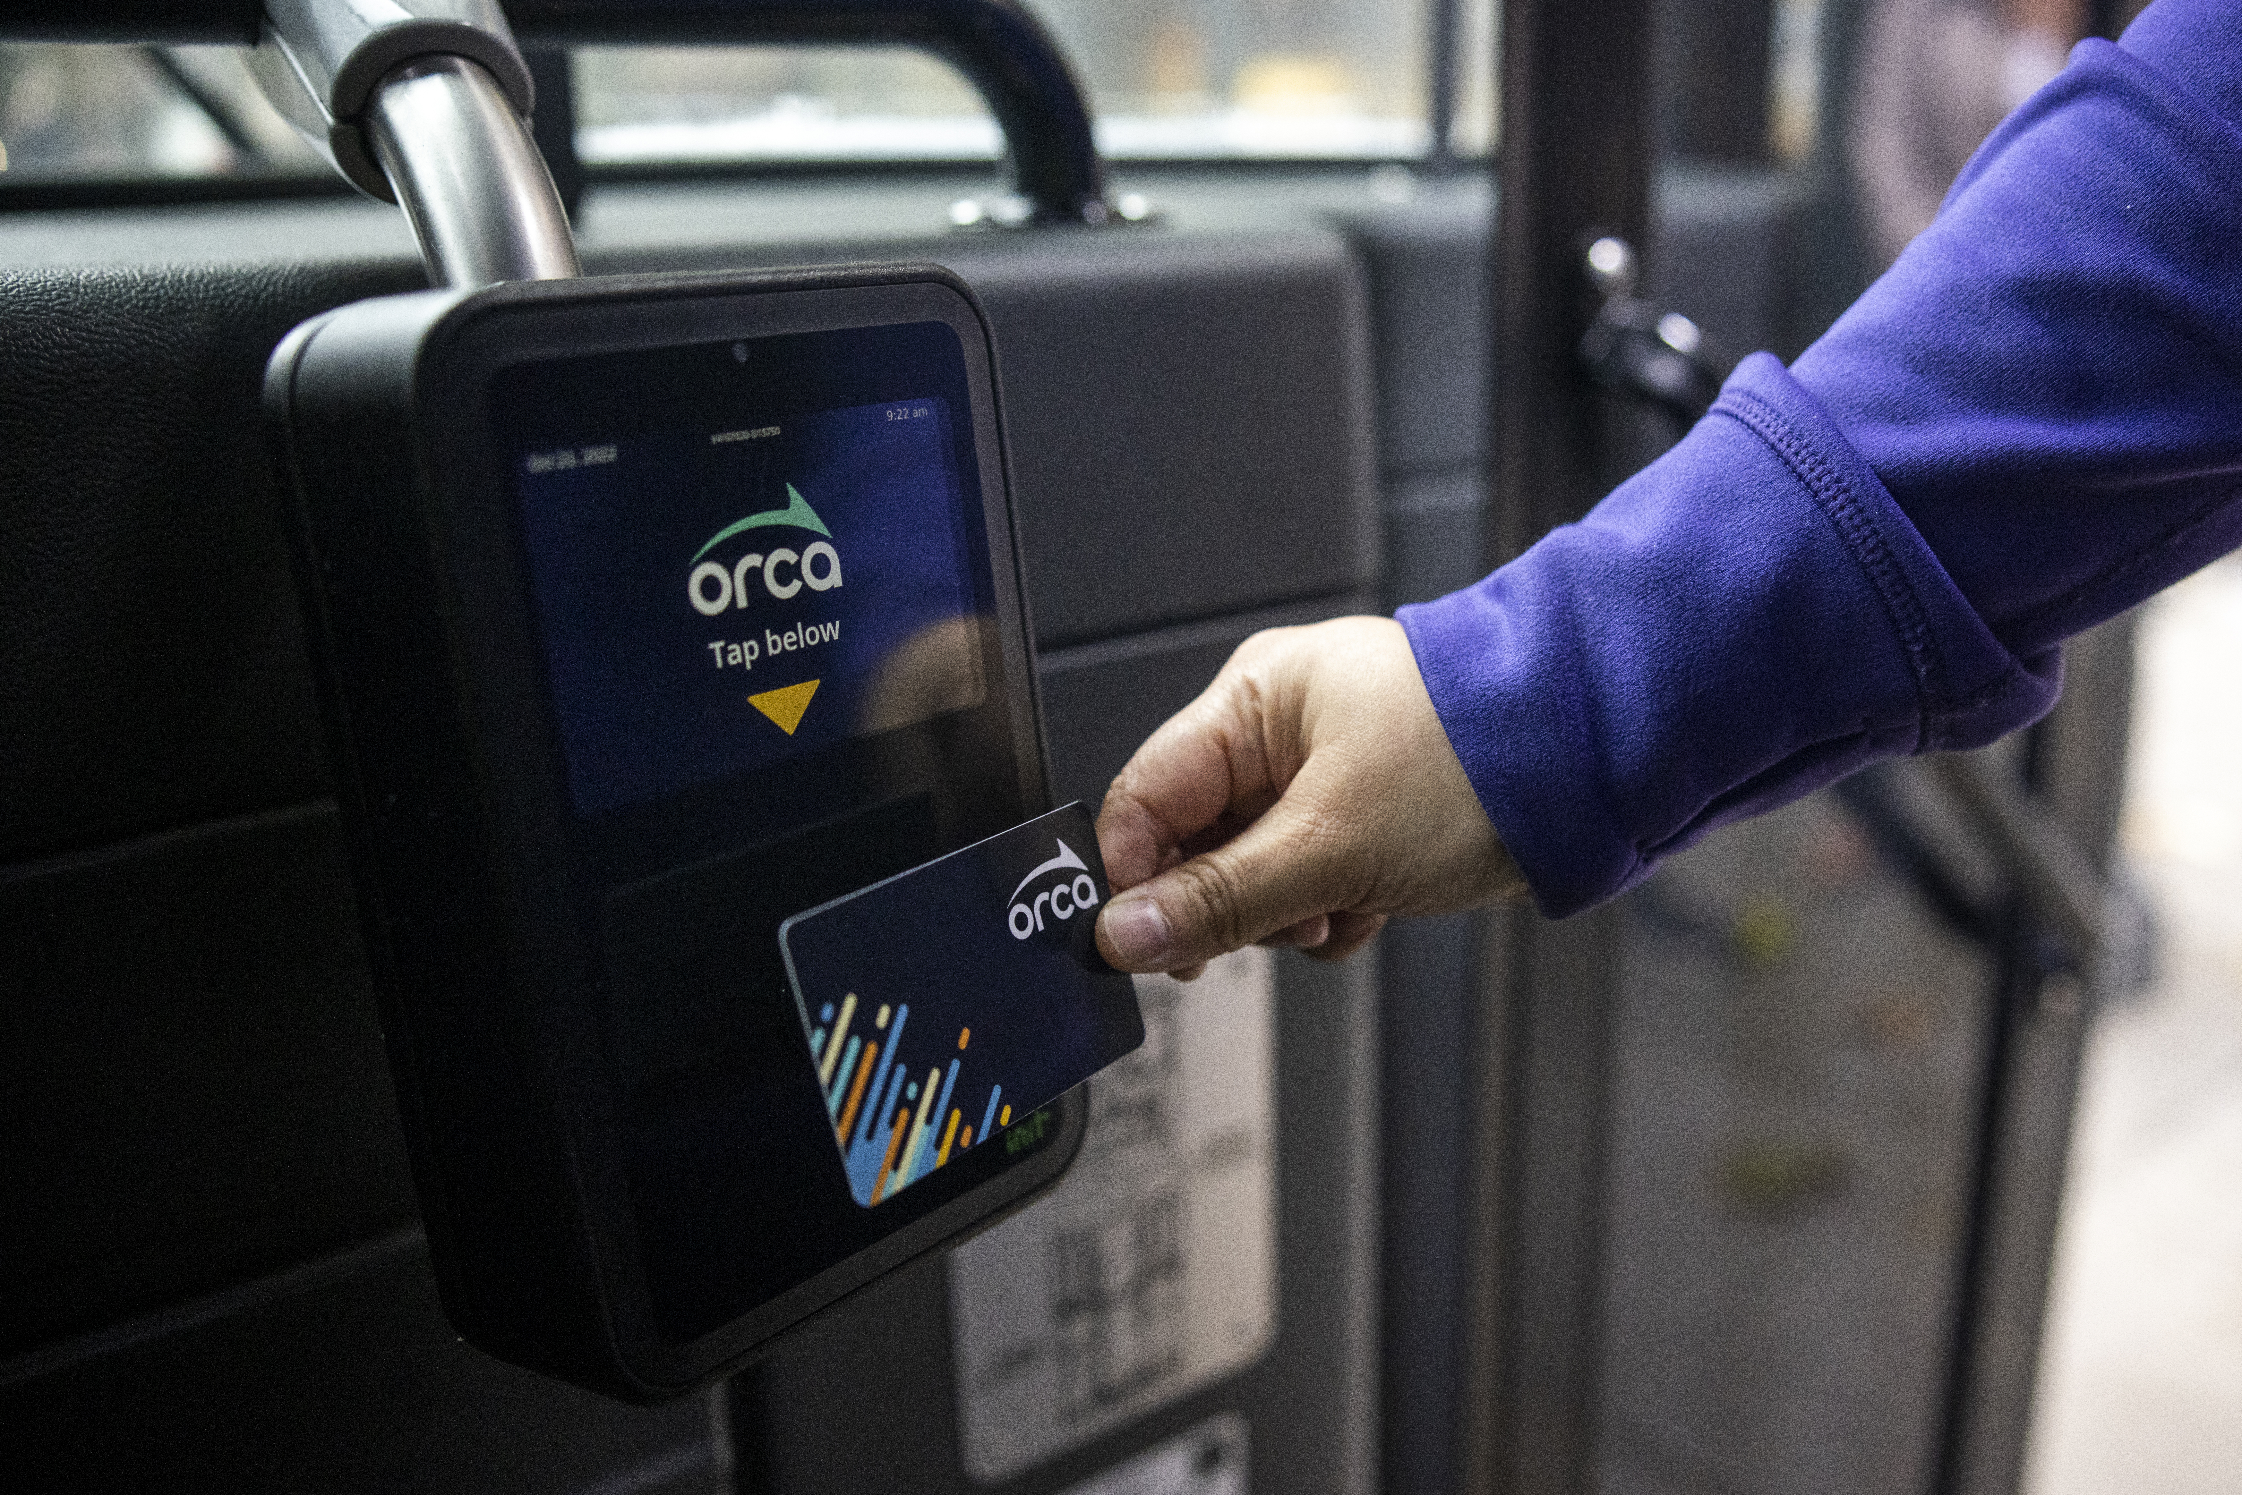
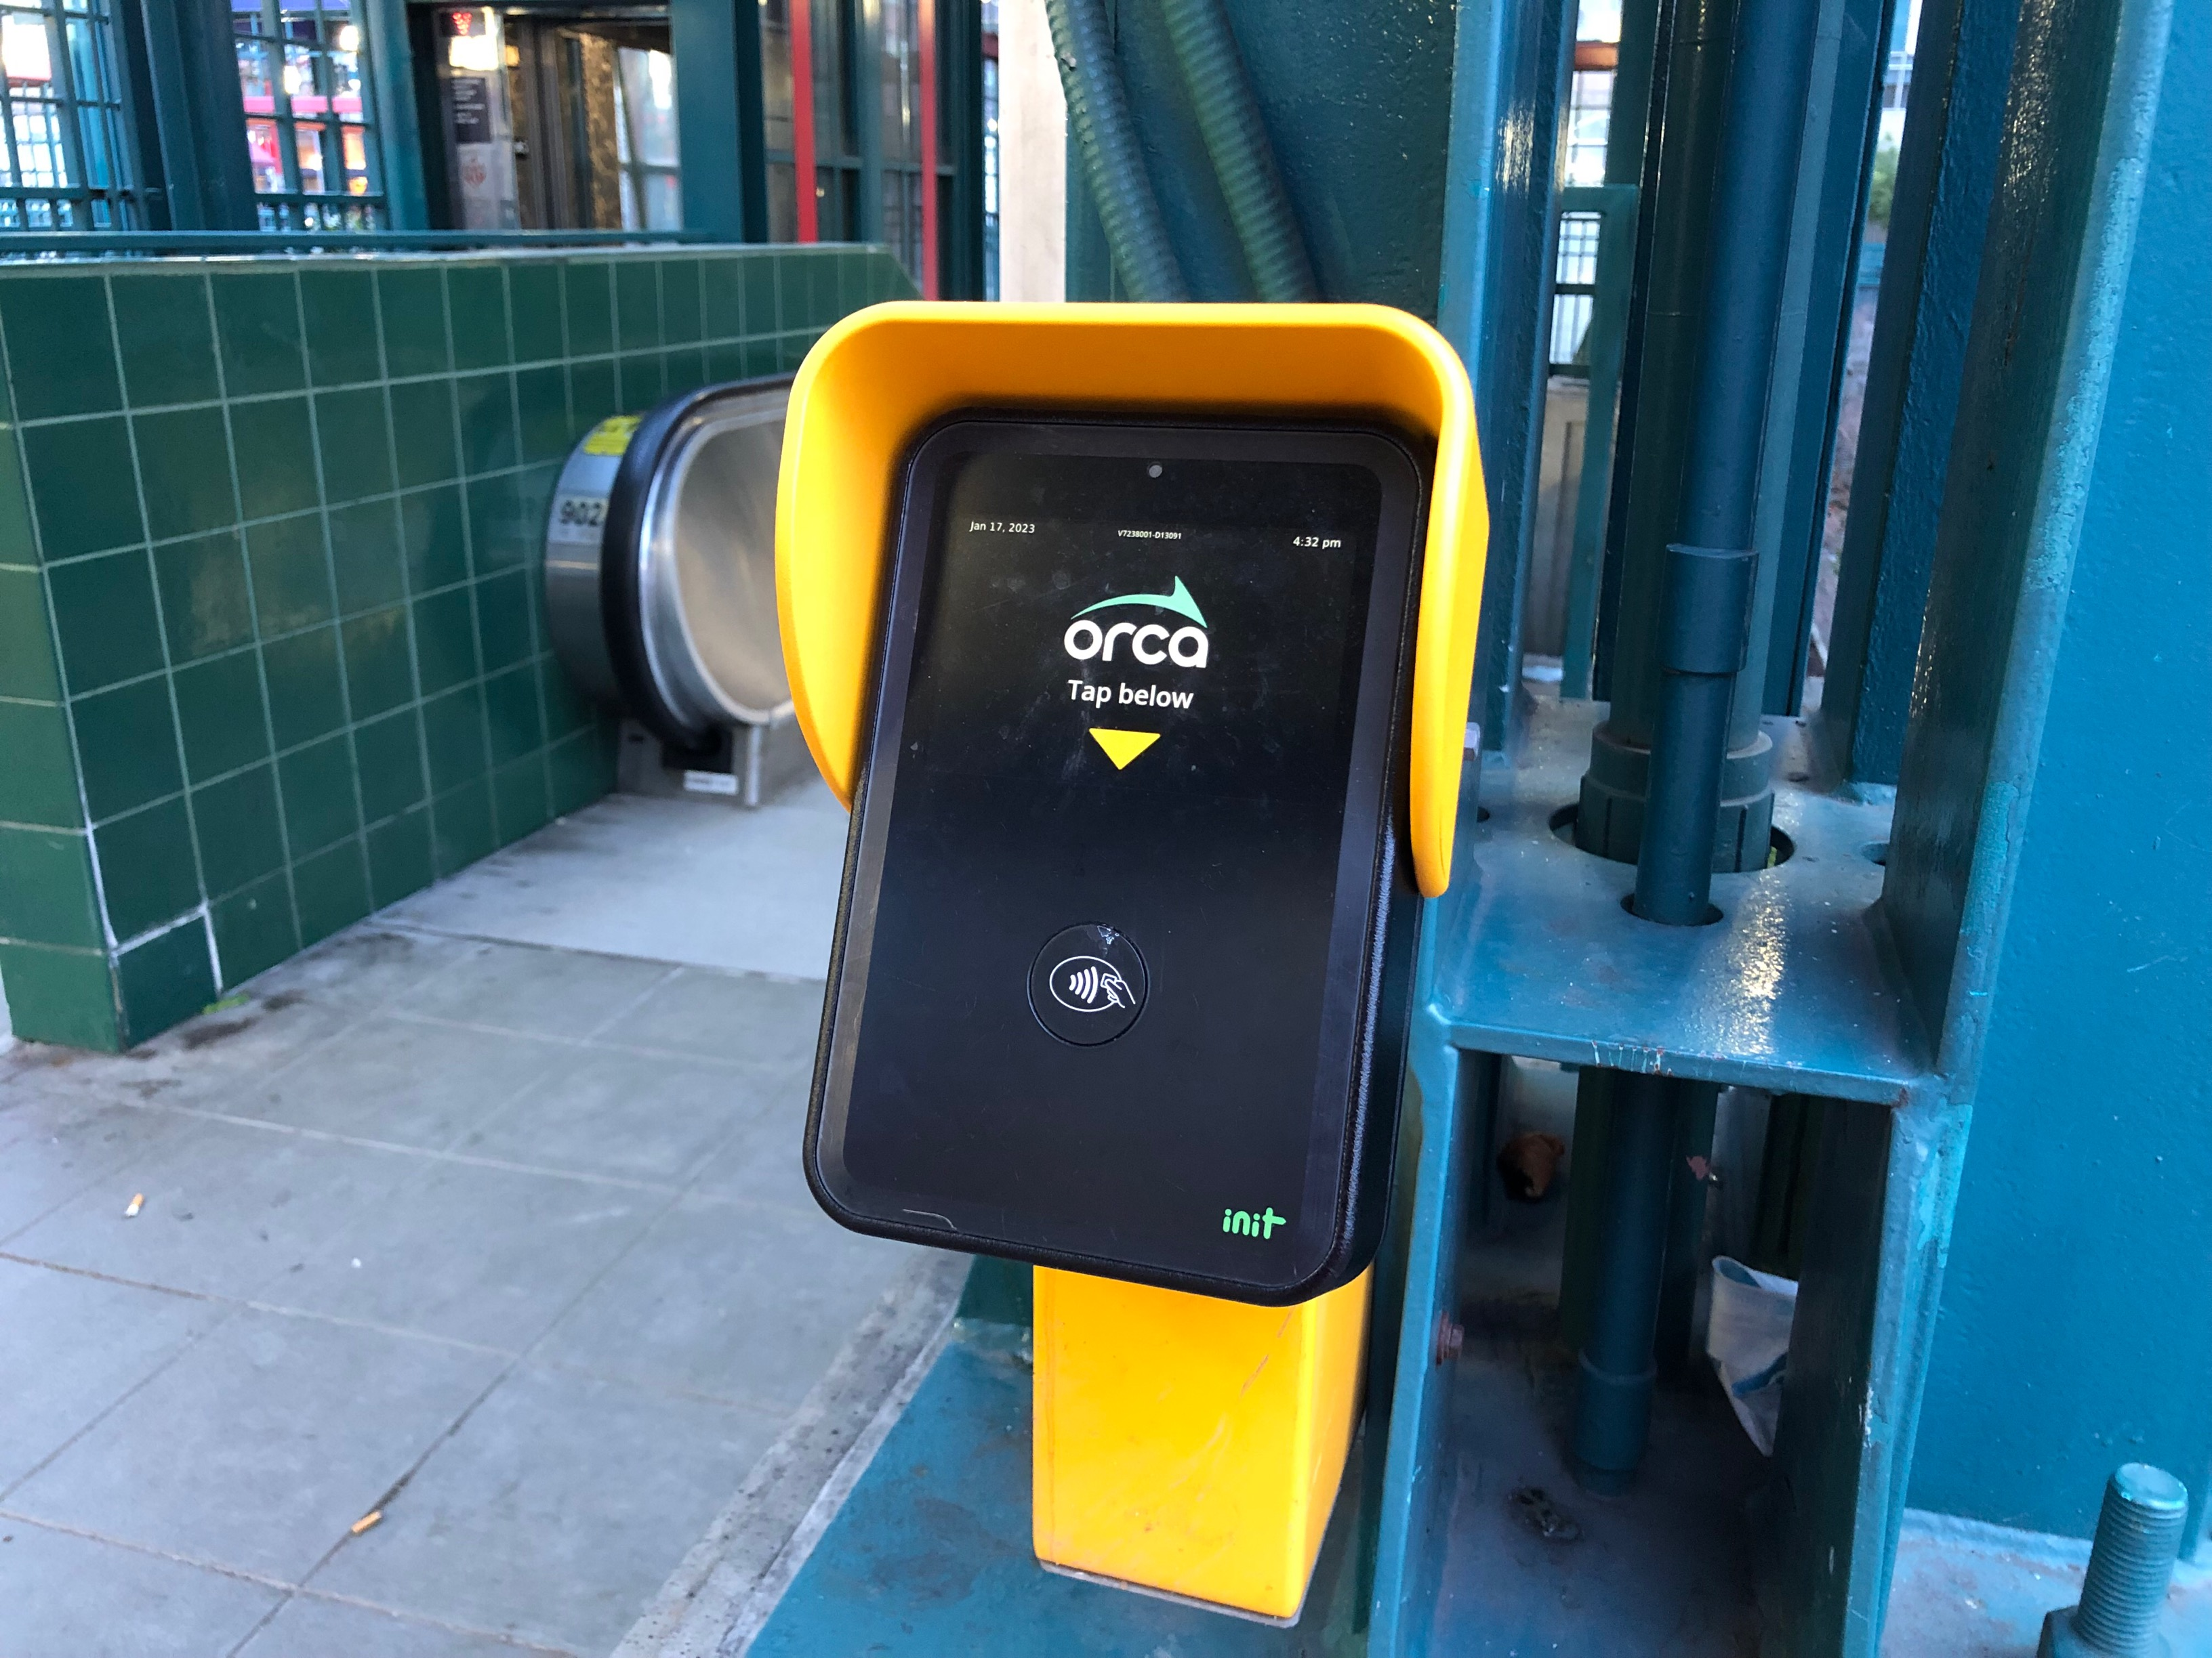
How Does the ORCA Card Work?
“Tap on buses”
“Tap on, tap off light rail”
Notes:
Once students are at the station, they can use their ORCA cards to get on a bus or a train. Note that while using an ORCA card is not required for youth to ride free (they can also show a student ID or just get on board), it is encouraged so transit agencies can better understand how many youth are riding and where). The Seattle Monorail is the only service that requires a Youth ORCA card for free youth fare.
For buses, students will tap their card as they get on at the front of the bus (or offboard or at any door if a RapidRide route).
For light rail trains, students will tap their card on the card readers at the station both before they board and when they get off the train.

Slide 9
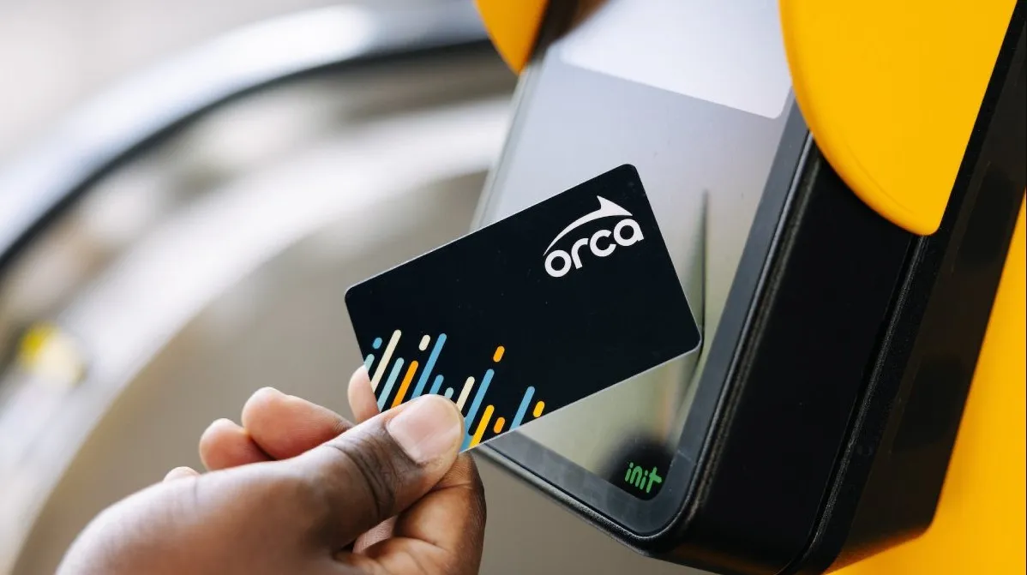
How Does the ORCA Card Work?
Tap on One beep
Tap off Two beeps
Notes:
Students will know that they tapped the card correctly when they hear a beep from the reader.
Explain to students that because ORCA cards are now free to youth, it’s more important than ever to remember to tap on and off. This helps Metro and other organizations track how much a route or system gets used, helping them improve our transit systems.

Slide 10
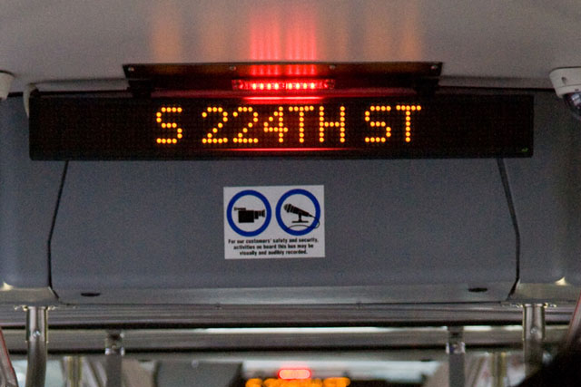
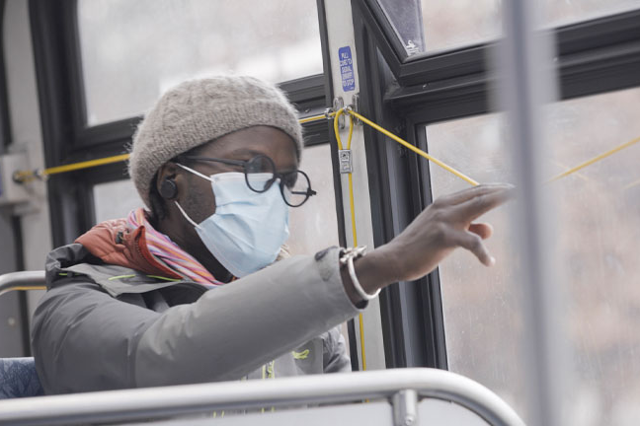
Riding the Bus
Notes:
Once students have boarded the bus, they should stay alert and make sure they are looking and listening for their stop name to be announced.
When their stop is next, they can ask the driver to stop by pulling the yellow cord or pressing a red “stop” button.
To get off the bus, students should exit through a side or back door unless they need to use the ramp at the front. Remind students to make sure to be careful if they need to cross the street after, because traffic around buses can be dangerous.

Slide 11
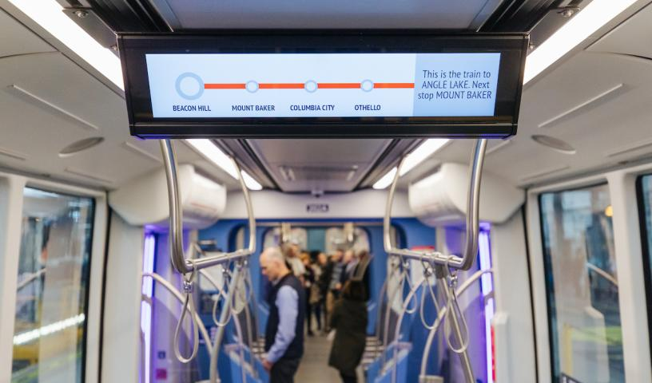
Riding Link Light Rail
Notes:
Riding the light rail is similar, but a little bit different. After tapping their card at the station, students will wait until the train has arrived and opened its doors.
Unlike when riding the bus, riders do not need to ask the light rail operator to stop. They can practice navigating with their adults by looking and listening for their stop to be announced.
Once they leave the train, don’t forget to tap your card again!
Instructor Note: For older students (4th-5th grade), you can explain that this can also help adults save money. Even though students ride for free, the people they are riding with don’t—tapping off at the stop can sometimes mean a shorter, less expensive trip.

Slide 12
Travel with Confidence!
Notes:
4 rules for confident travel on transit:
Plan your trip! Know where you’re going and how you are going to get there.
Travel with family or friends.
Tell someone where you are going.
Pay attention—watch and listen to make sure you know where you are.

Slide 13
To learn more, visit FreeYouthTransitPass.com
Notes:
Supplemental opportunity:
It may be helpful to show students the website so they can share information with their families.
Show students how to navigate the website to get a new Youth ORCA card or register an existing card.
Extra information can be found at: https://kingcounty.gov/depts/transportation/metro/travel-options/bus/how-to-ride.aspx

