Slide 1
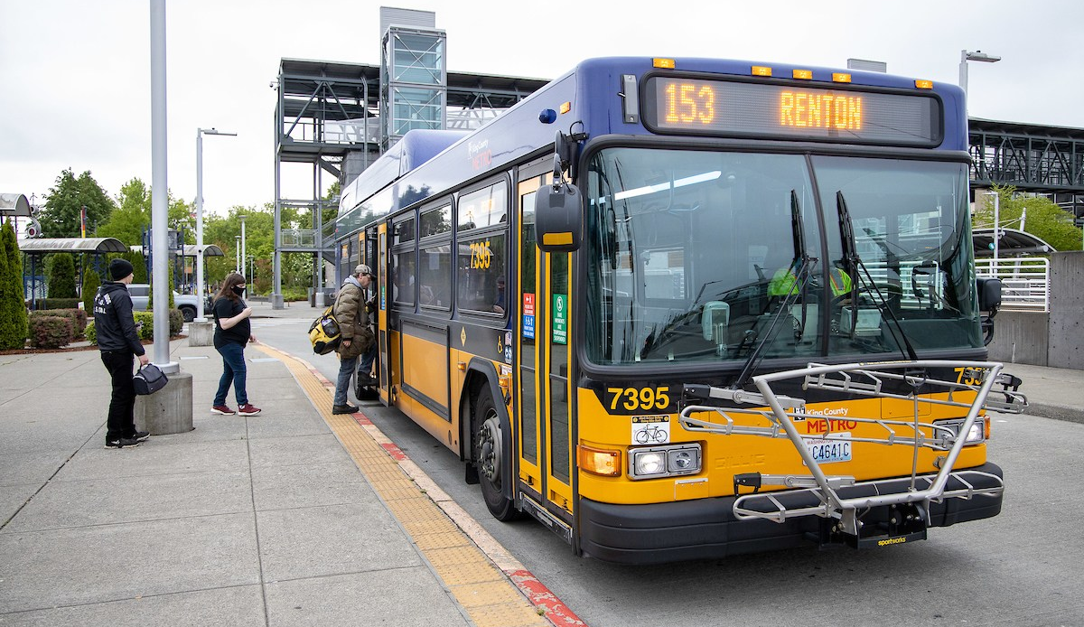
Get to Know Metro
Notes:
Introduce King County Metro – “The organization in our government that provides buses and other transportation services.”
Explain to students that they will be learning strategies to ride their local buses and the light rail train.

Slide 2
Metro Transit Began in?
1899
1926
1960
1973
2001
2012
Notes:
Trivia question to start, and feel free to take a guess.
Answer is--- 1973!
Presenter Notes: The bus system was known as Metro Transit and began operations on January 1, 1973. Its operations subsumed the Seattle Transit System, formerly under the purview of the City of Seattle and the Metropolitan Transit Corporation, a private company serving suburban cities in King County.

Slide 3
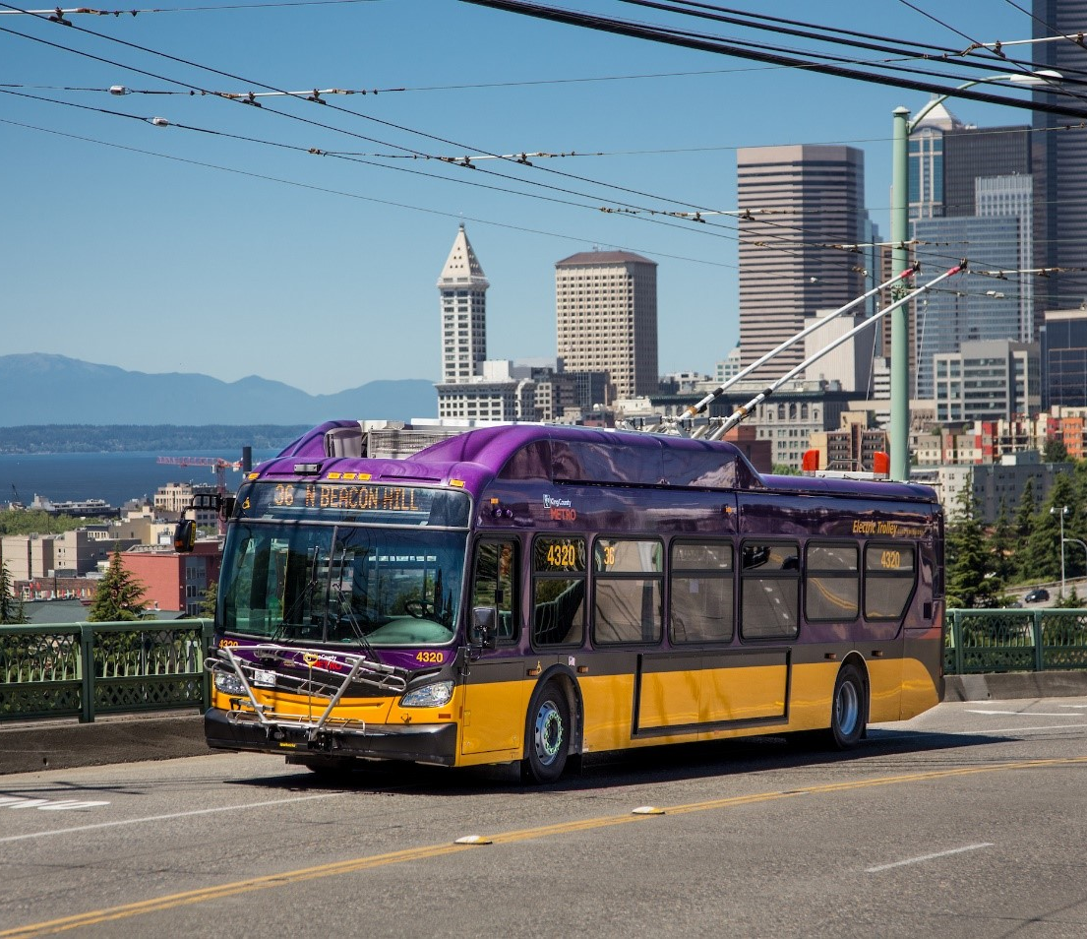
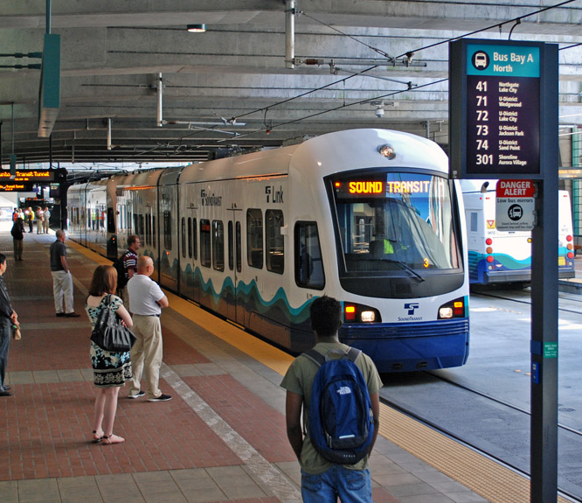
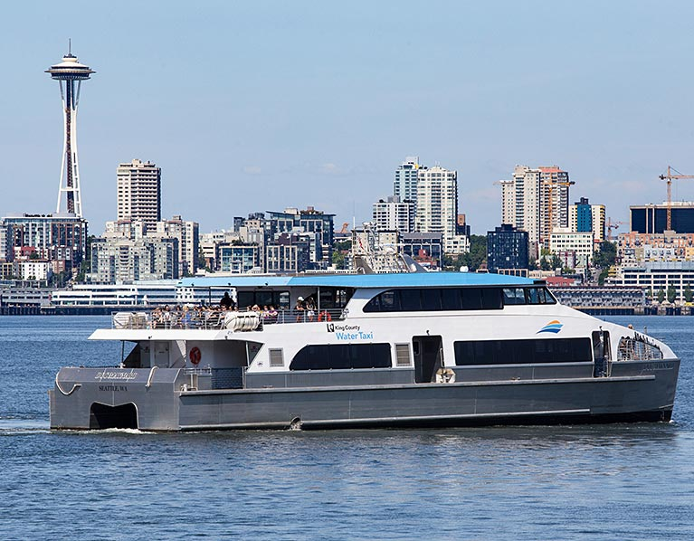
Types of Public Transit
Notes:
Explain that public transit can take many forms. Here in King County, some primary forms of transit are buses, light rail trains, water taxis, and ferries.
Discussion opportunity:
Ask students if they have ridden any of these forms of transportation? Where were they going?

Slide 4
Transit Agencies
*free for youth walk-on passengers
*free only with valid youth ORCA card
Notes:
All of these regional transit agencies and organizations provide different types of public transit. Youth can ride free on all of them!

Slide 5
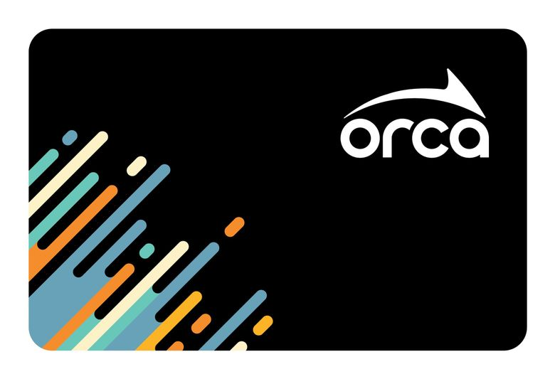
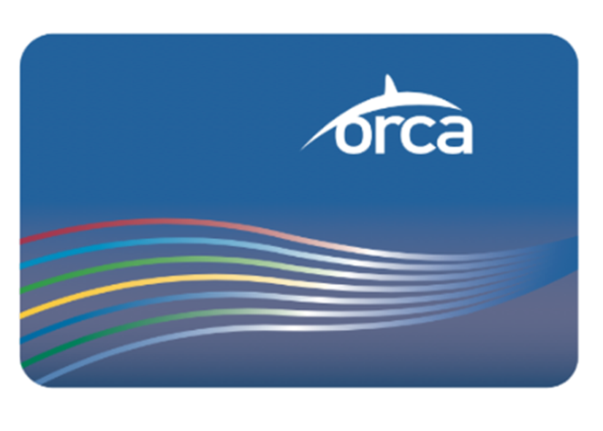
Which Card is Correct?
Coho
Porpoise
This card still works!
Notes:
Explain that here in King County, to use transit, you can use a transit pass (students might be more familiar with the term ‘bus pass’).
Ask students to guess which transit card name is correct (ORCA).
Explain if students have a blue card, it will still work.

Slide 6
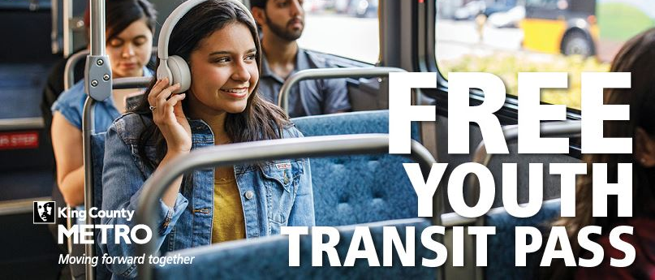
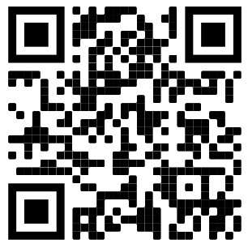
You Are Eligible for a FREE ORCA Card!
Sign up for your
FREE youth card!
How to Ride
Notes:
Explain that all youth 18 years or younger can ride public transit for free. They are encouraged to get an ORCA card, although it is not required to ride free (except on the Seattle Monorail). You can do this online!
Explain to students that once they get to the landing page to order a new card, they may have to show proof of age (i.e. student ID or state ID).
If under 18, please check with a parent/guardian before signing up.
Presenter Notes: To see an overview of the ‘how to ride’ sequence, go to https://kingcounty.gov/depts/transportation/metro/travel-options/bus/how-to-ride.aspx

Slide 7
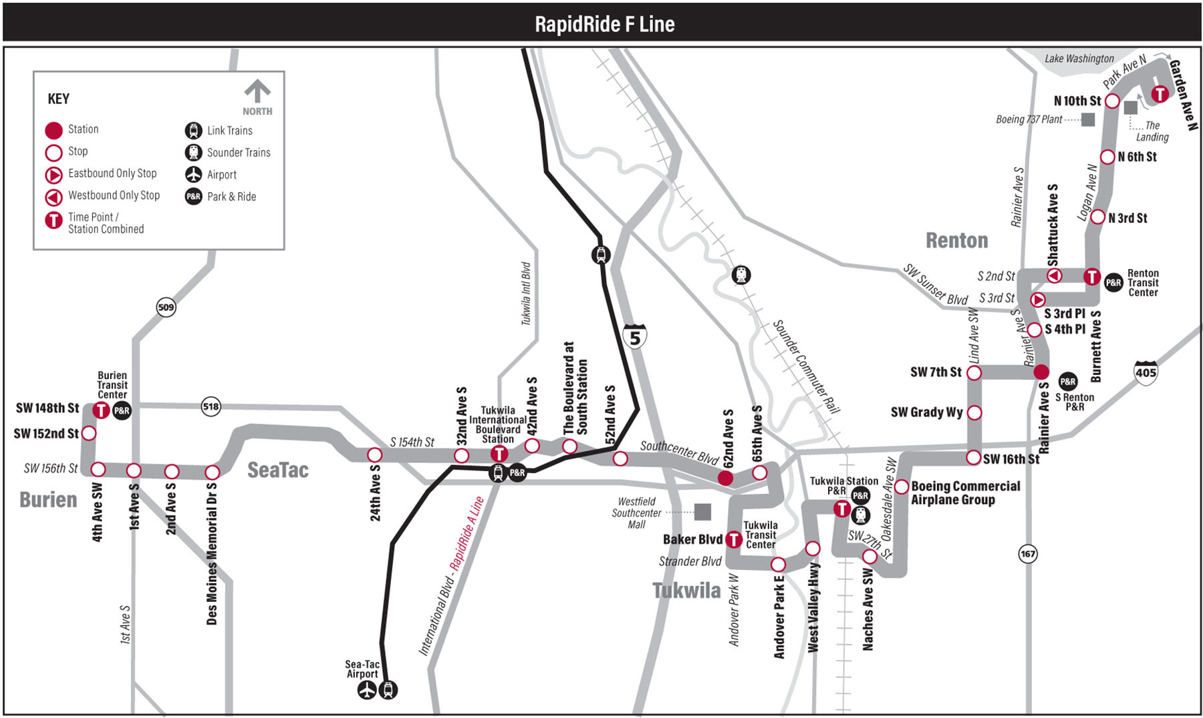
Plan Your Trip
Where are you going?
Who are you riding with?
Which route are you taking?
Notes:
Explain to students that once they have their ORCA cards, the first step to riding transit is to plan their trip.
We encourage students to ride with other people, especially on their first time.
Discussion Opportunity:
Ask students if they feel comfortable riding public transit with the knowledge that they have. Then ask students what they want to know in order to feel like they have the tools to ride public transit.

Slide 8
Plan Your Trip
Concert
School
Sporting event
Where are you going?
Work
Airport
Park
Friends
Notes:
Discussion Opportunity:
Name a place that you might go using public transit.
Ask students if they have ever struggled with parking at these places.

Slide 9
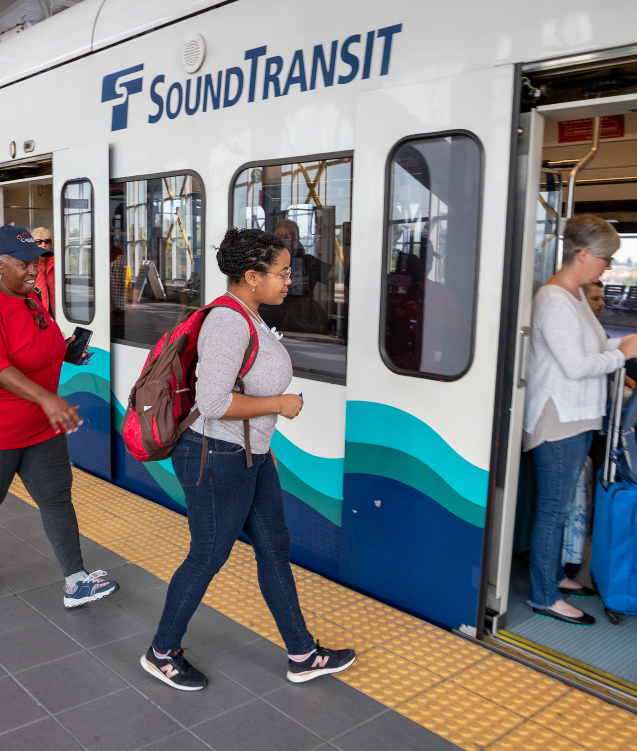
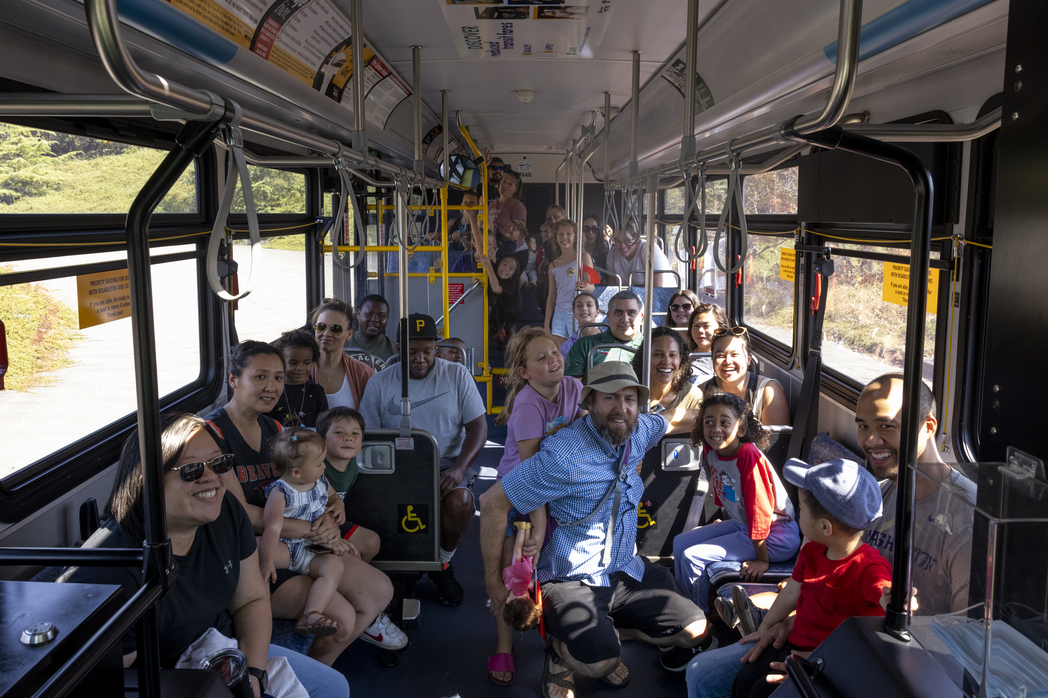
Plan Your Trip
Who are you riding with?
Notes:
When students are planning their trip, they should be thinking about who will be with them. Will they be with other adults? Friends? Younger family? These are critical questions because it can help the students determine what routes will be the easiest for their group.

Slide 10
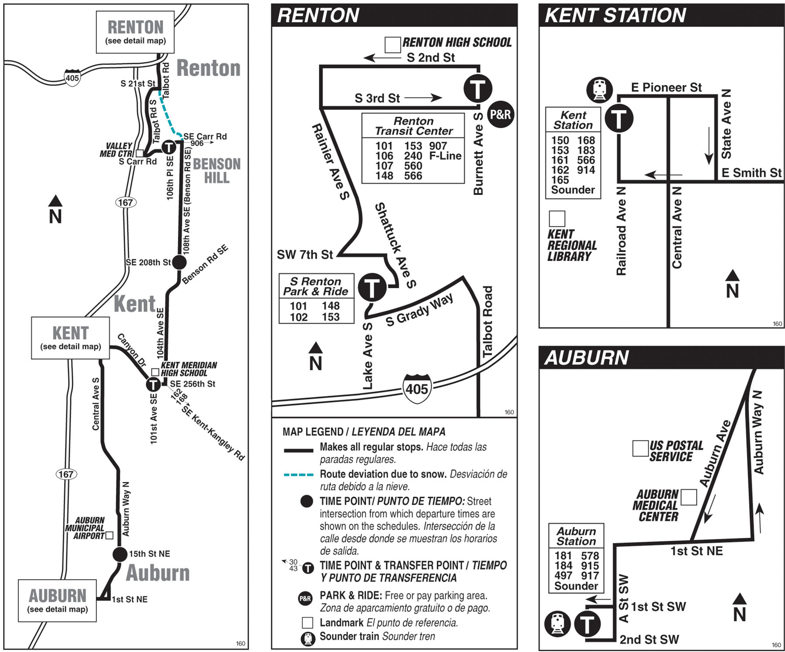
Plan Your Trip
Which route are you taking?
Notes:
Explain to students that these are bus route maps. These can be used to understand where buses go and how they relate to other bus routes.
Have students point out things on the map as a warm-up to their first activity.
Things to point out: legend, landmarks, transfer points, arrows that show which direction the bus will go.
Presenter notes:
You can pause the presentation here to start the Planning Your Trip Activity (in the curriculum packet)

Slide 11
tripplanner.kingcounty.gov
Online Tools
King County Metro Trip Planner
Notes:
Explain to students that we do not always use the route maps and schedules and that often we are using different online tools. King County Metro’s Trip Planner is one of these tools.
Presenter Notes:
Things you should tell students if they are doing the Plan Your Trip Digital Extension at this time (in the curriculum packet):
Days matter: Buses and light rail run at different times on weekdays versus weekends.
If the worksheet says that they are leaving on a Saturday, make sure that they have the upcoming Saturday selected.
Time matters: You can change the setting to “arrive by” a time or “depart by” a time and this can allow students to know when they have to leave or what time they will get to a place depending on their needs.

Slide 12
Transit Apps
Do you have a favorite?
Google Maps
Transit app
One Bus Away
Notes:
There are other online tools and apps you can use to plan a trip.
Some apps can help you plan future trips (e.g. Google Maps), and some are better for if you are already out and want to catch a bus (e.g. One Bus Away).

Slide 13
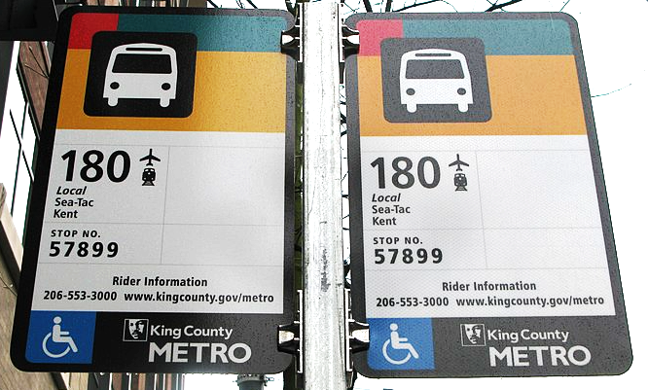
When is the next bus?
Text for Departures
Text your stop ID to 62550
Notes:
Explain to students another way to get current information is to “text for departures”.
TEXT your stop ID to 62550 to get the next departure times for transit service at that stop.

Slide 14
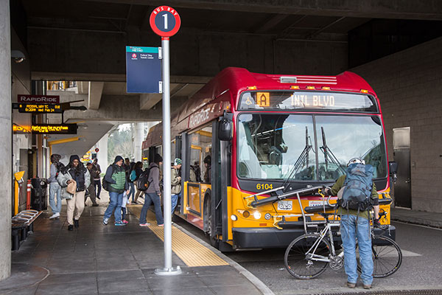
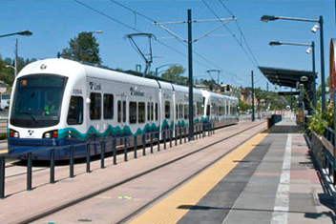
Bus Stop and Light Rail Stations
Notes:
Once students know where they are going, they will go to a bus stop or light rail station to board transit. They are encouraged to bring their ORCA card with them.
Make sure to check you are getting on the correct route. The route number or letter is displayed on the outside of the bus. For Link light rail, make sure you are going in the right direction, either towards Northgate or Angle Lake.

Slide 15
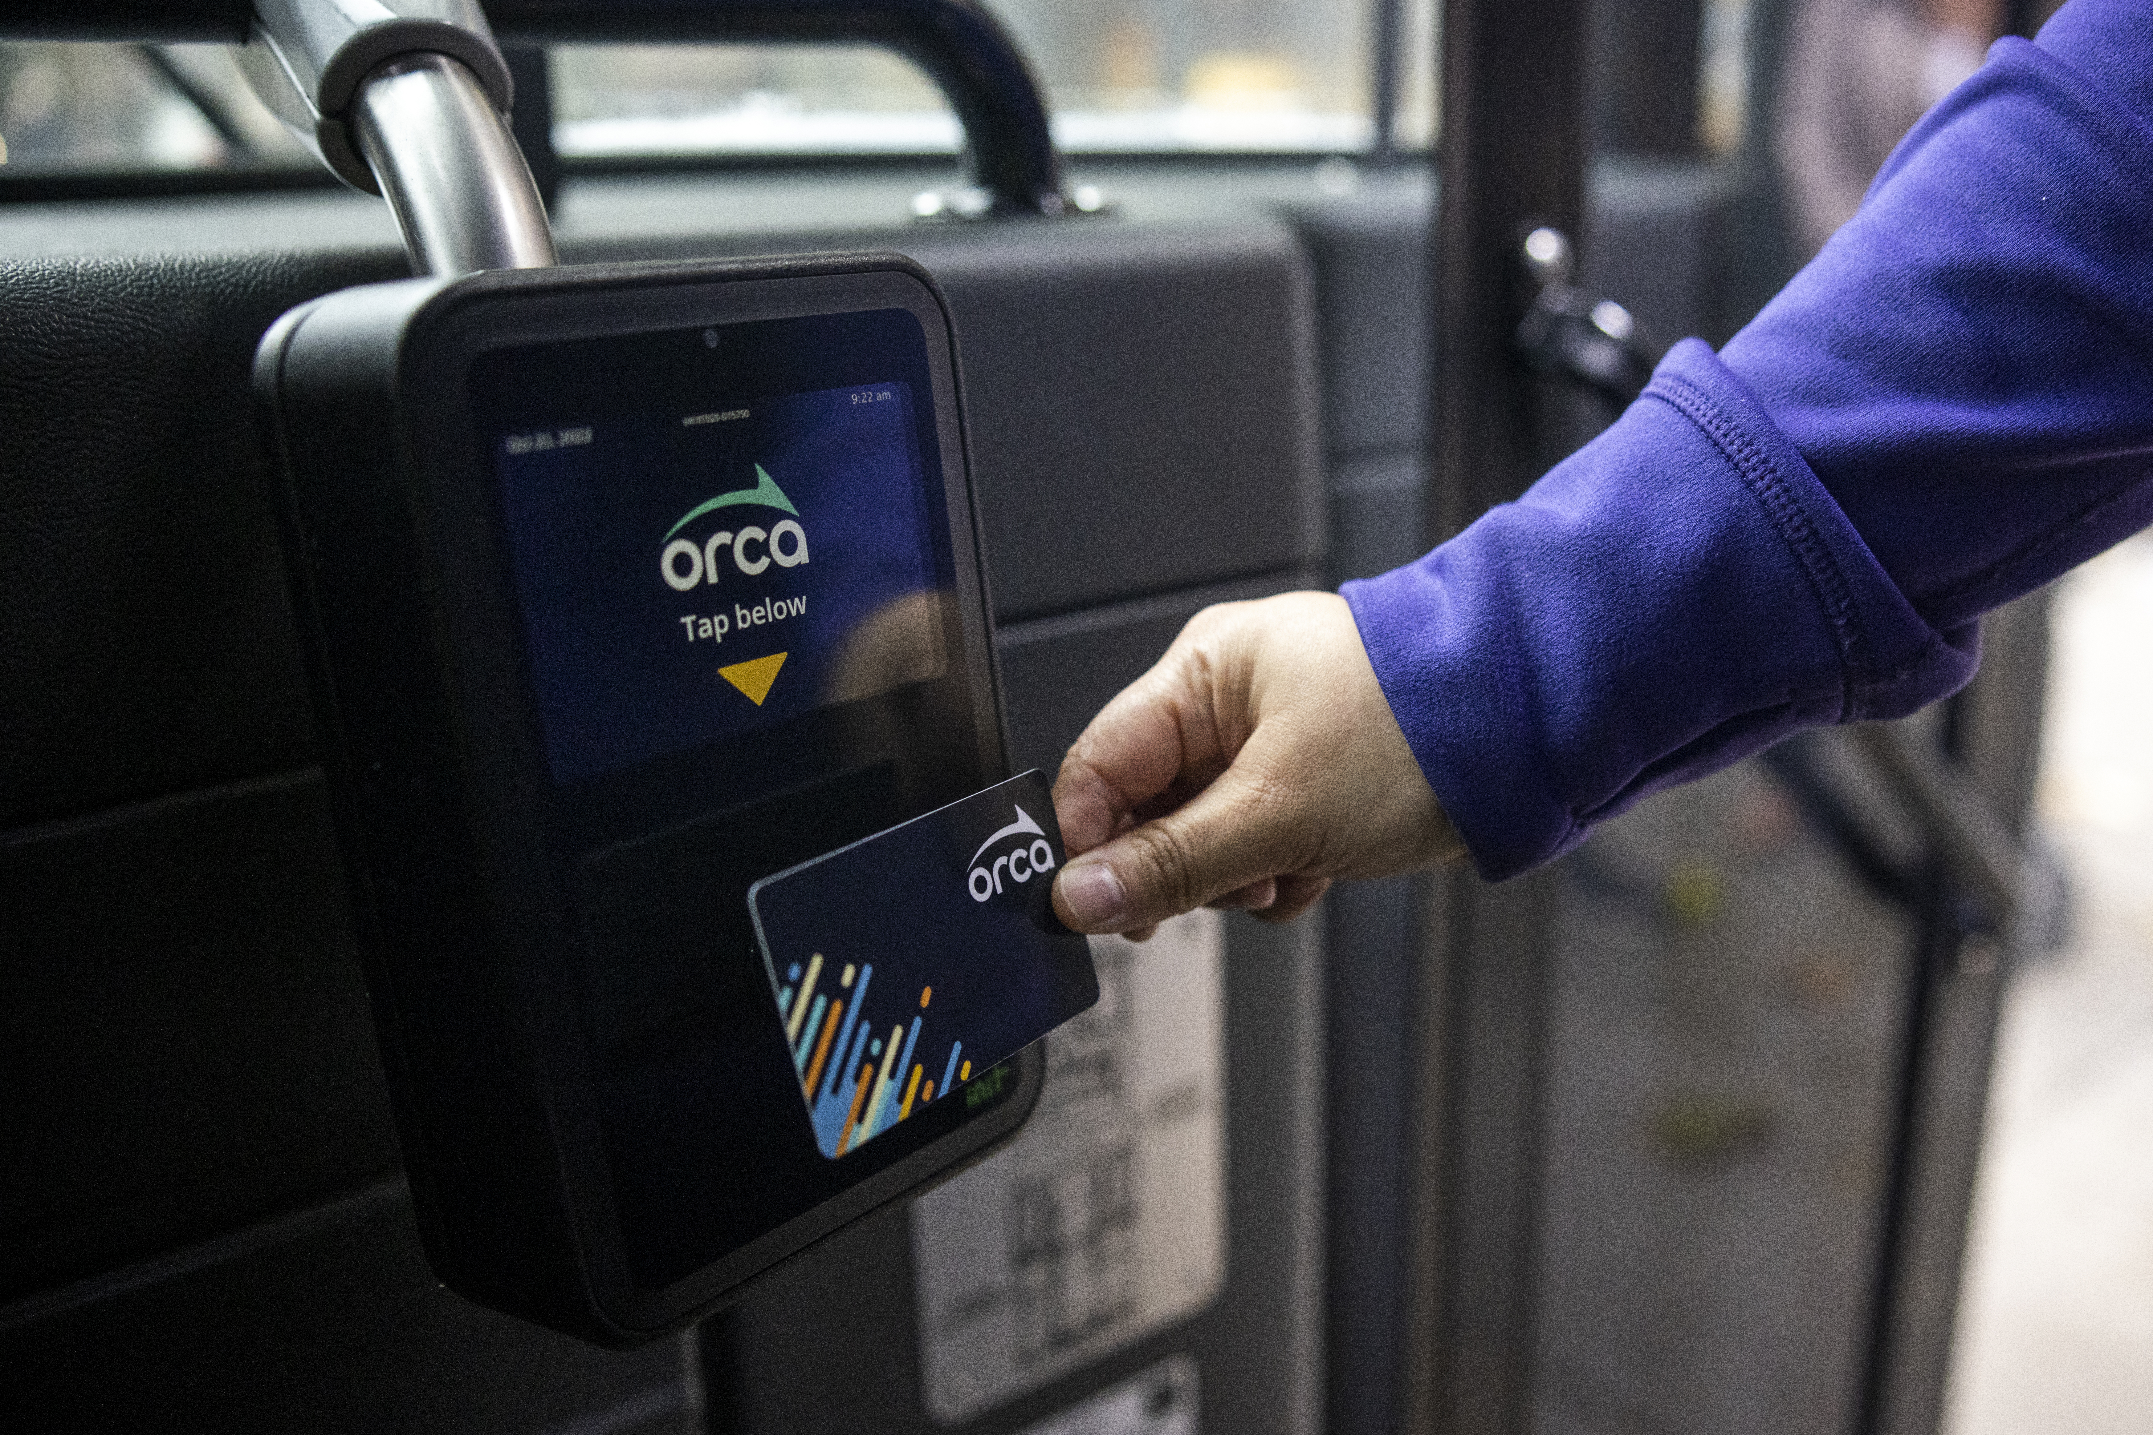
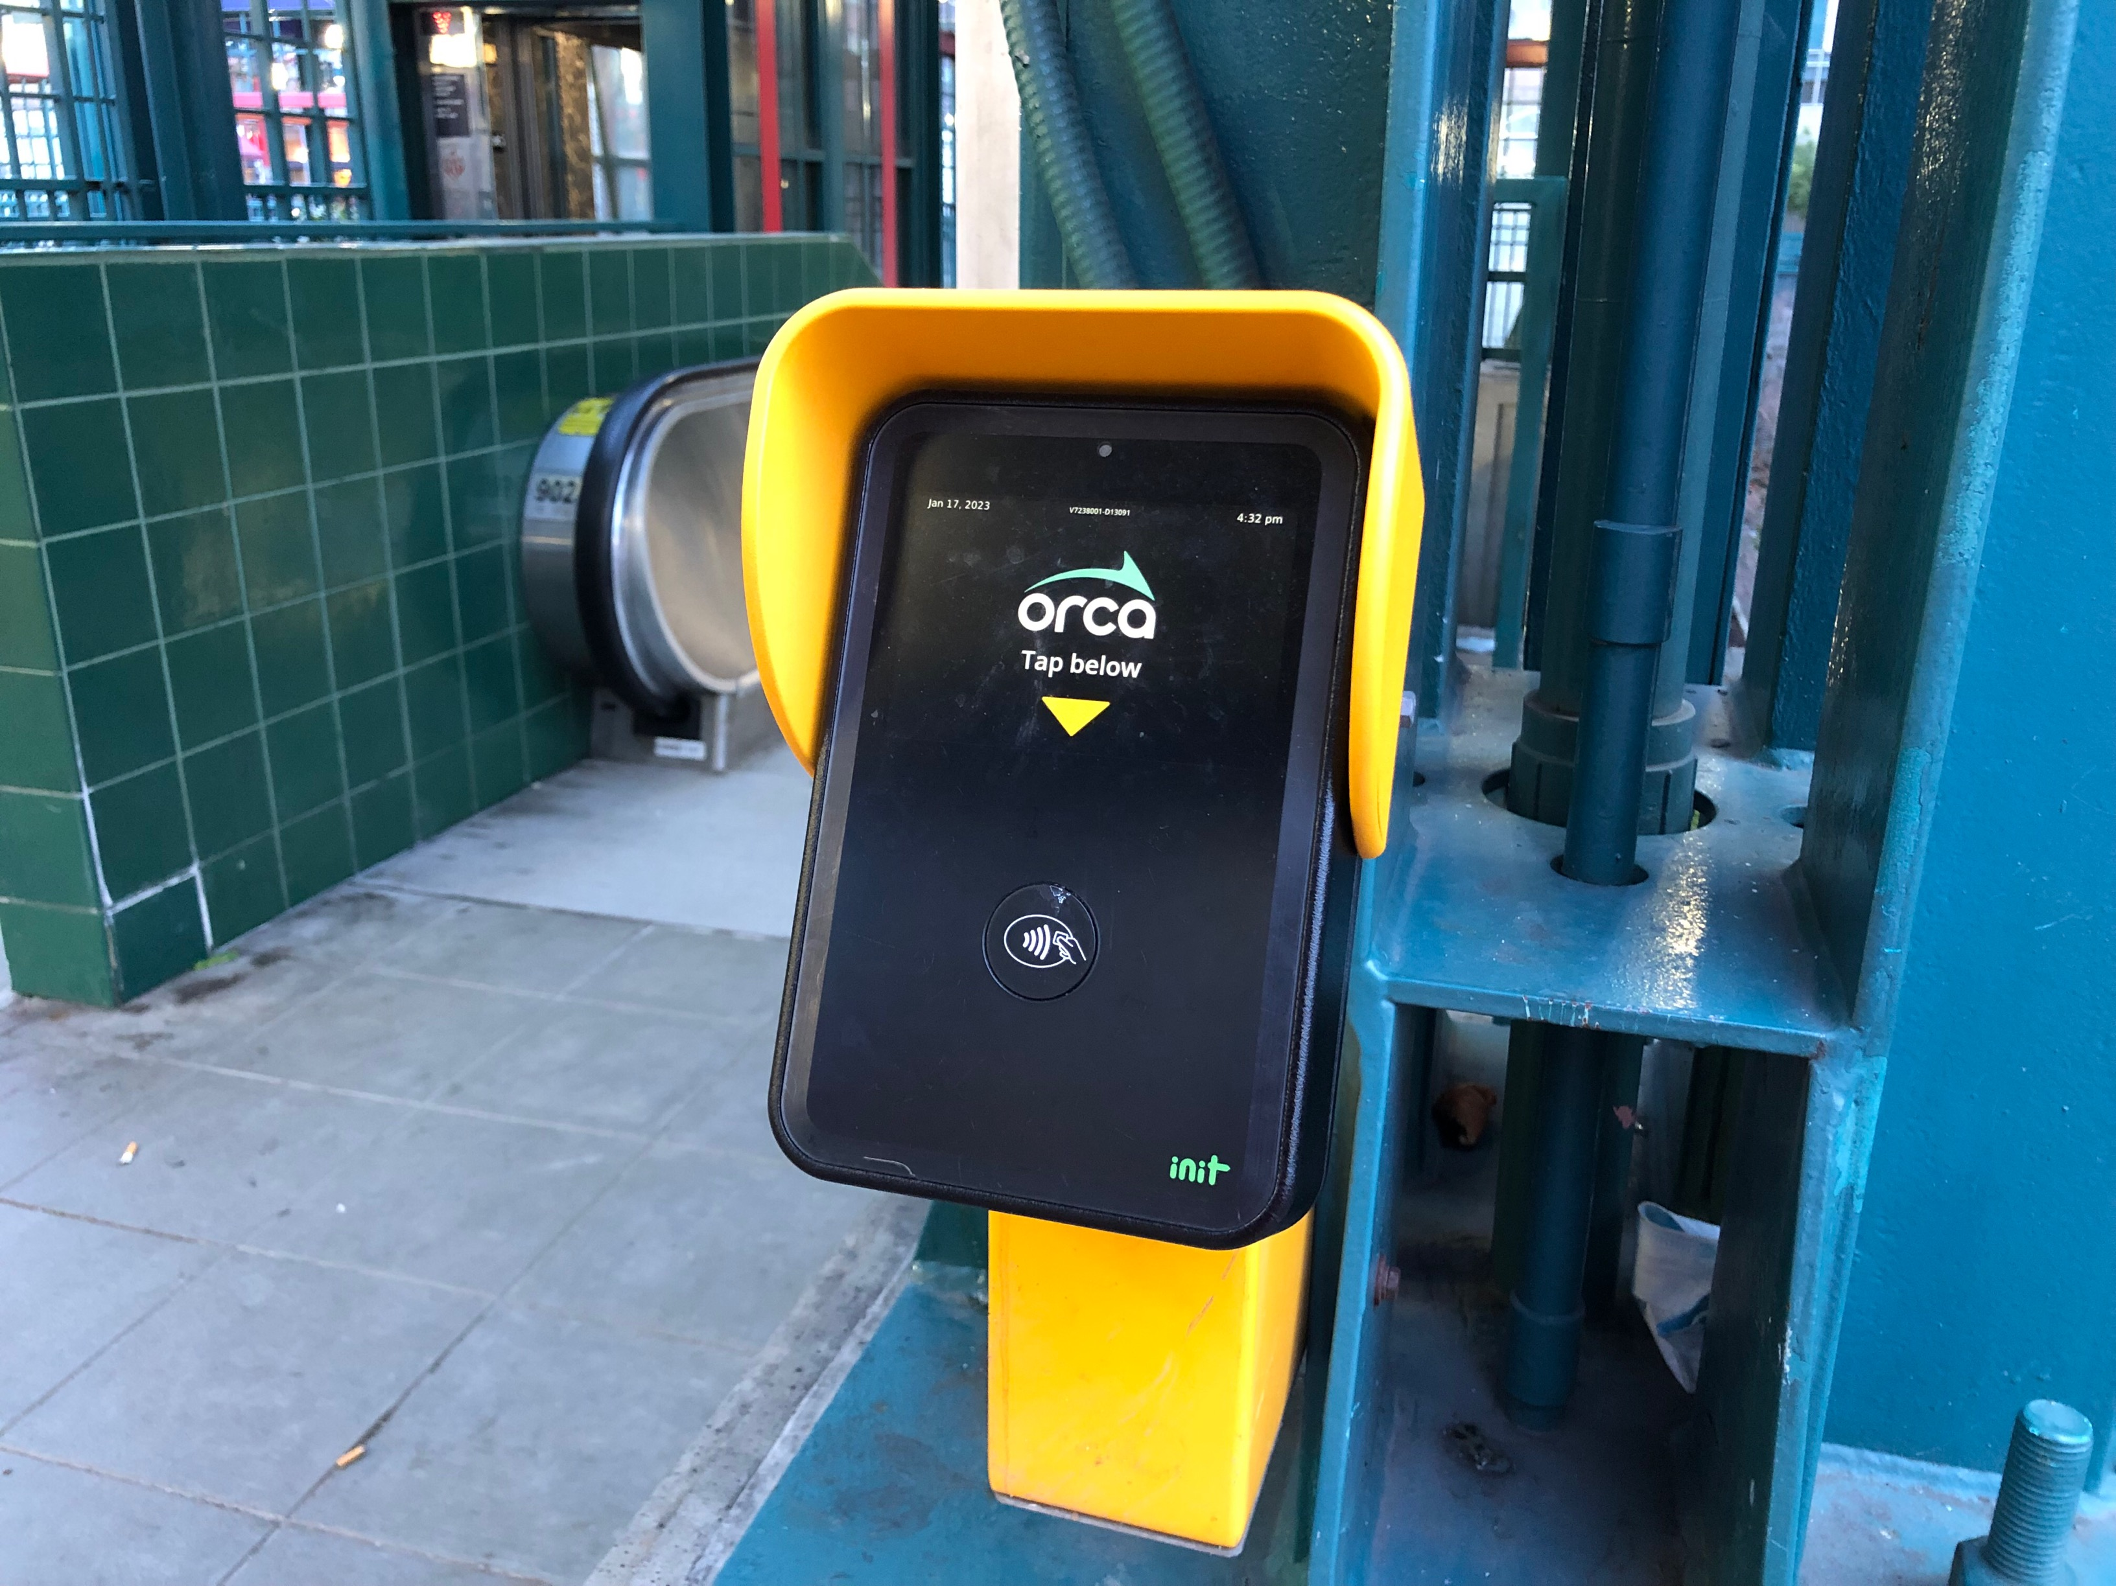
How Does the ORCA Card Work?
“Tap on buses”
“Tap on, tap off light rail”
Notes:
Once students are at the station, they can use their ORCA cards to get on a bus or a train.
For buses, students will tap their card as they get on at the front of the bus (or offboard or at any door for a RapidRide bus).
For light rail trains, students will tap their card on the card readers at the station both before they get on and when they get off the train.

Slide 16
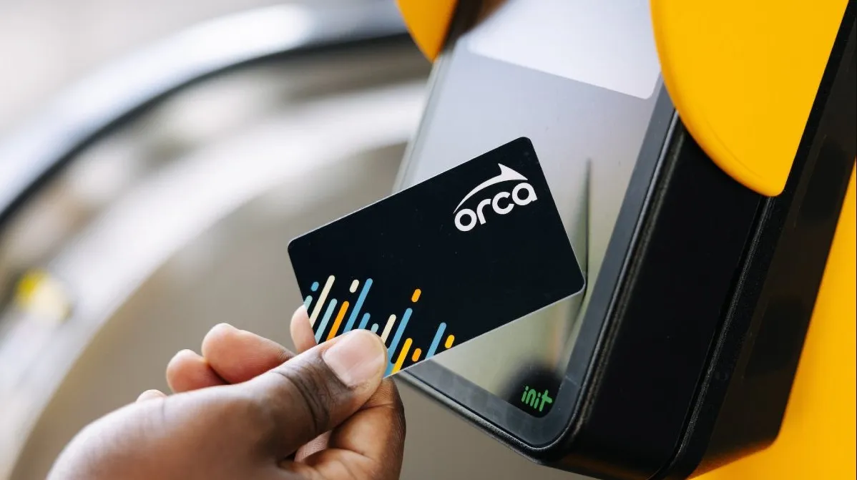
How Does the ORCA Card Work?
Tap on One beep
Tap off Two beeps
Notes:
Students will know that they tapped the card correctly when they hear a beep from the reader.
Explain to students that because ORCA passes are now free to youth, it’s more important than ever to remember to tap on and off. This helps Metro and other organizations track how much a route or system gets used, helping them improve our transit systems.

Slide 17
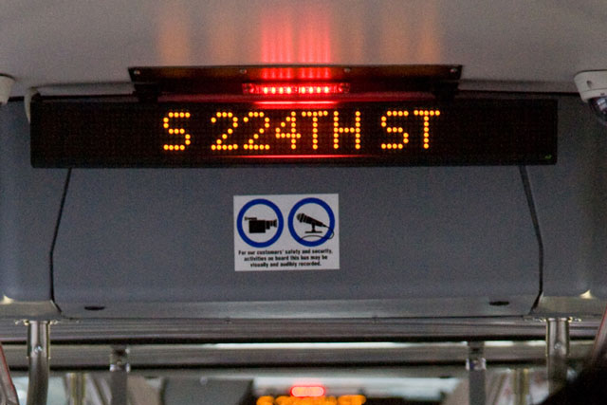
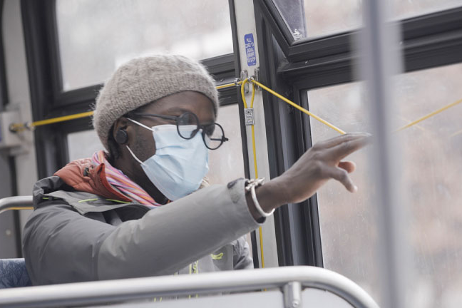
Riding the Bus
Notes:
Once students have boarded the bus, they should stay alert and make sure they are looking and listening for their stop name to be announced.
When their stop is next, they can ask the driver to stop by pulling the yellow cord or pressing a red stop button.
To get off the bus, students should exit through a side or back door unless they need to use the ramp at the front. Remind students to make sure to be careful if they need to cross the street after, because traffic around buses can be dangerous.

Slide 18
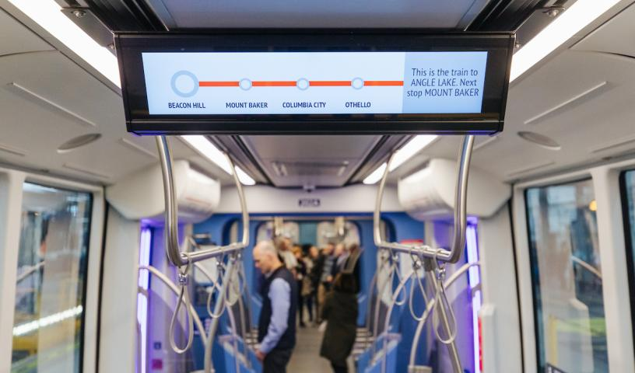
Riding Link Light Rail
Notes:
After tapping their card at the station, students will wait until the train has arrived and opened its doors.
Once they leave the train, don’t forget to tap your card again!
Presenter Notes: Remind students that they are building habits and that tapping on and tapping off of the light rail is important. If they forget to tap off once they are an adult, it charges them more.

Slide 19
Travel with Confidence!
Notes:
4 rules for confident travel on transit:
Plan your trip! Know where you’re going and how you are going to get there.
Travel with family or friends.
Tell someone where you are going.
Pay attention—watch and listen to make sure you know where you are.

Slide 20
To learn more, visit FreeYouthTransitPass.com
Notes:
Supplemental opportunity:
It may be helpful to show students the website so they can share information with their families.
Show students how to navigate the website to obtain a new Youth ORCA card or register an existing one.
Extra information can be found at: https://kingcounty.gov/depts/transportation/metro/travel-options/bus/how-to-ride.aspx

