Slide 1
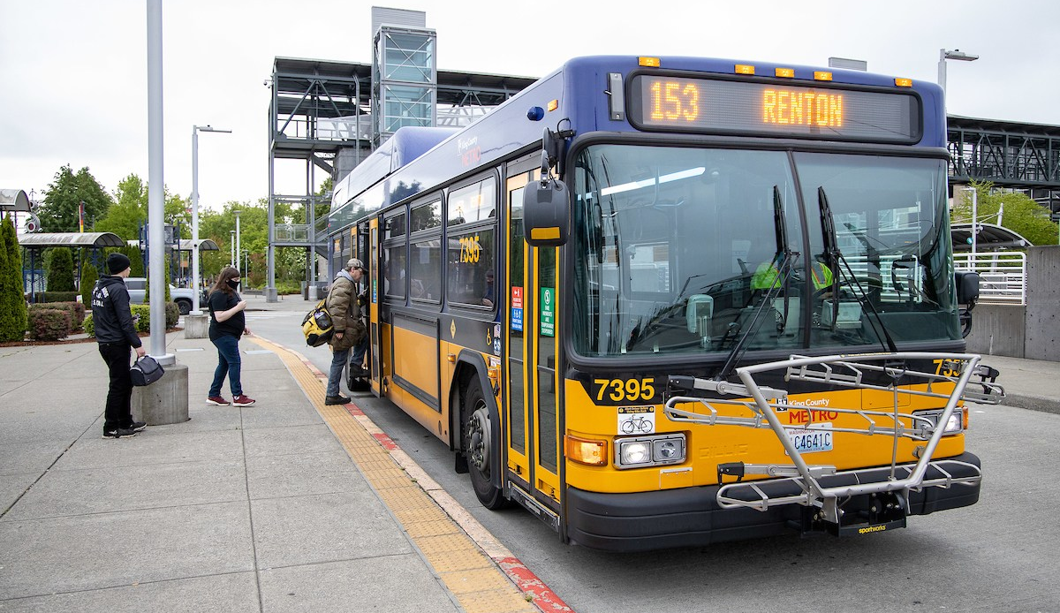
Safety and Riding Right
Notes:
Introduce King County Metro – “The organization in our government that provides bus and other transportation services” and the Free Youth Transit Pass program (“riders 18 and younger can take transit for free”)
Explain to students that they will be learning about how to be safe and considerate riders on their local buses and transit systems.

Slide 2
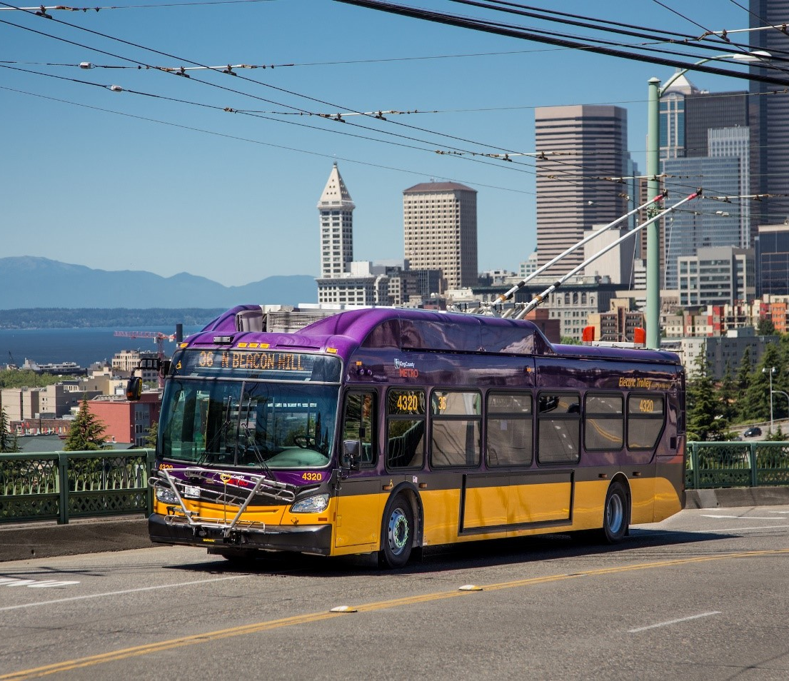
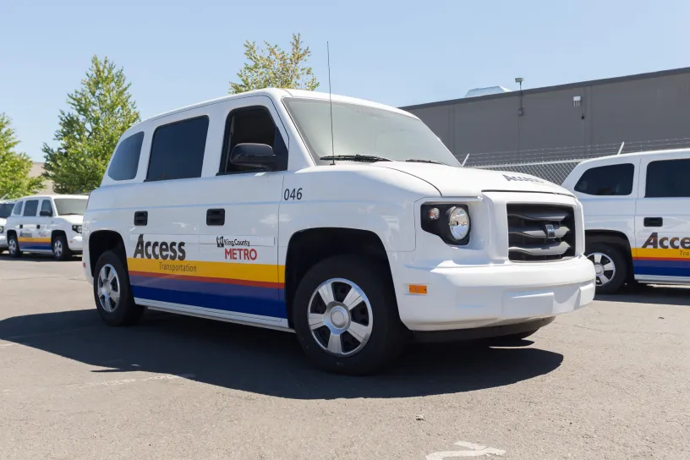
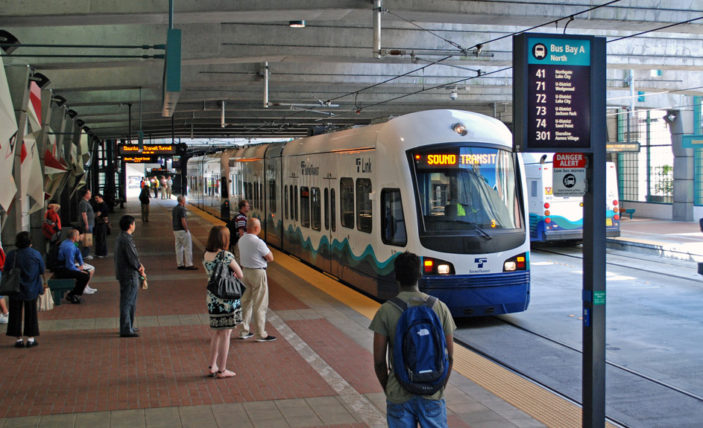
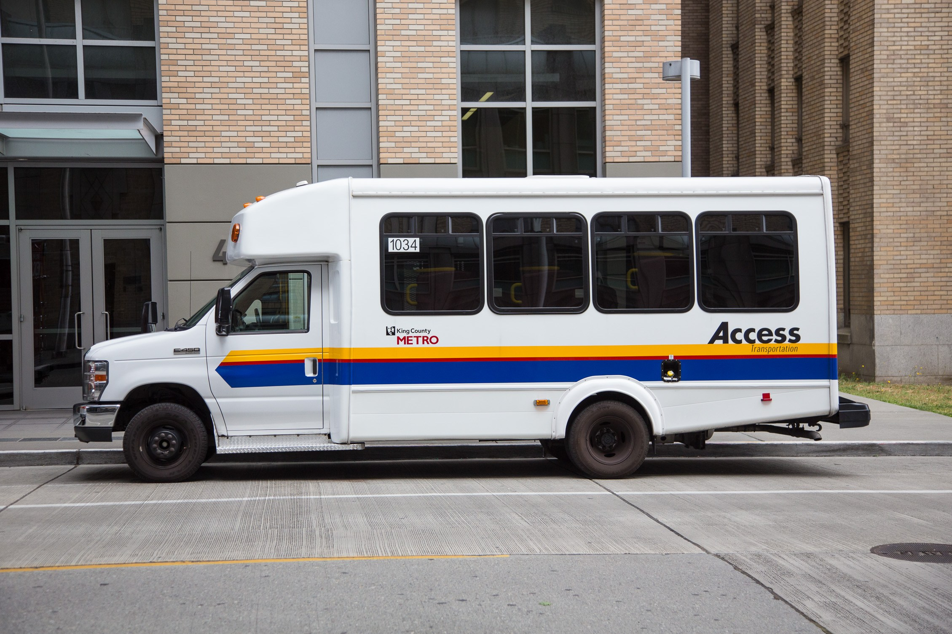
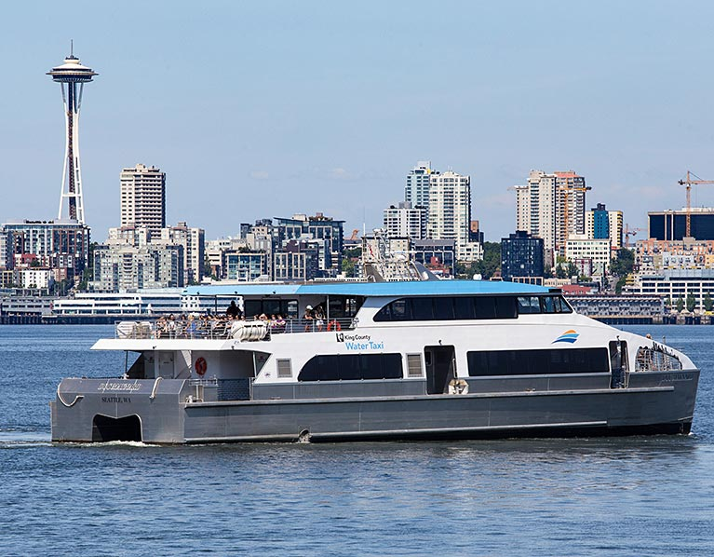
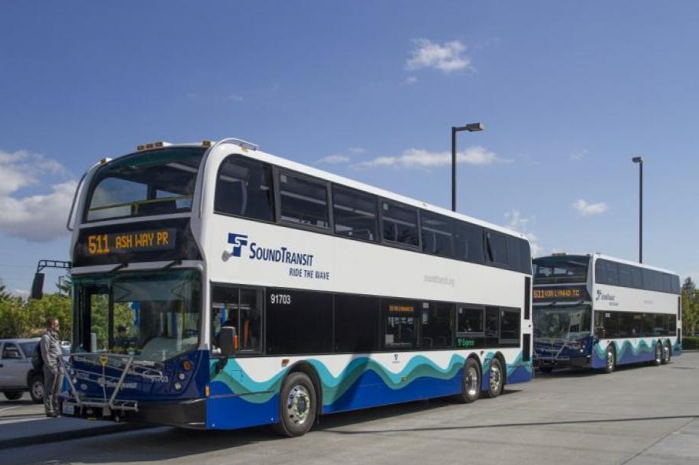
Public Transit
Notes:
Explain that public transit can take many forms. Here in King County, some primary forms of transit are buses, light rail trains, water taxis, and ferries.
Discussion opportunity:
Ask students what kinds of transit they have seen in their communities. Have they ever ridden any of these forms of transit? Have they seen forms of transit in other places?

Slide 3
What does it mean
to be safe on public transit?
Notes:
Discussion opportunity:
Ask students, What does it mean to be safe on public transit? What might that look like?

Slide 4
Before You Ride Transit
Plan
Communicate
Travel Together
Be Alert
Notes:
Explain there are things a person should think about before boarding transit, including the following:
Plan your trip ahead of time (Where will you get on and off transit? How long will it take you to travel?)
Communicate your plans with friends or guardians.
Ride with a friend.
Make sure to be alert while walking to and/or waiting at a transit stop, and on transit.

Slide 5
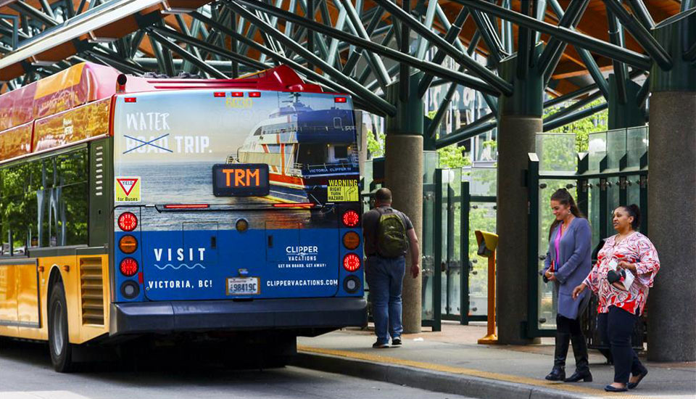
Waiting for & Boarding the Bus
Notes:
Explain there are rules everyone should follow to stay safe while waiting for a bus including the following:
Never run after a bus, or alongside a bus. They may not be able to see you, and you could be putting yourself and others at serious risk by distracting the driver.
Look up for safety. Be aware of what’s going on around you, especially when you are crossing the street. Make sure drivers see you.
Do not cross in front of a Metro bus at a bus stop. Wait until the bus leaves the stop, and then cross carefully.
Please allow passengers to exit the bus before you board.
Discussion opportunity:
What do they notice in these picture? What are some safe behaviors and what are some behaviors that could be safer?

Slide 6
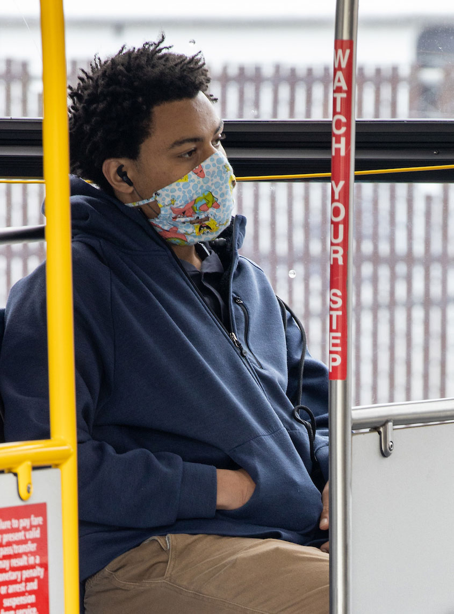
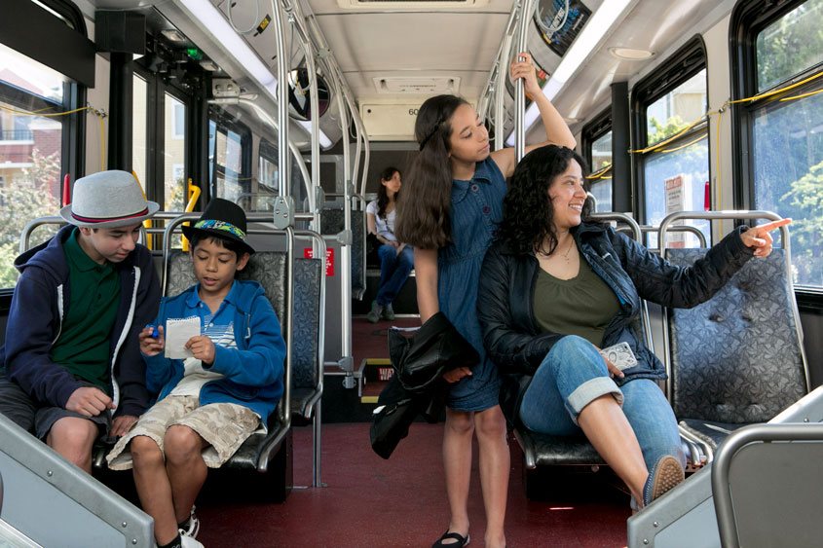
Riding the Bus
Notes:
Explain there are rules everyone should follow to stay safe while riding the bus.
Have students list some of the safe behaviors they see in the pictures:
If you are standing, hang onto the handrails provided in the event the bus makes a quick stop.
Stand behind the yellow line on the floor by the front of the bus. This helps give drivers as much visibility as possible.
Stay clear of the doors.
Keep your head, arms, and all objects inside bus windows.
Others include:
On crowded buses, please move to the back of the bus to make room for others.
Avoid standing in the doorways.
Keep the aisles clear. Do not put your backpack in an aisle.

Slide 7
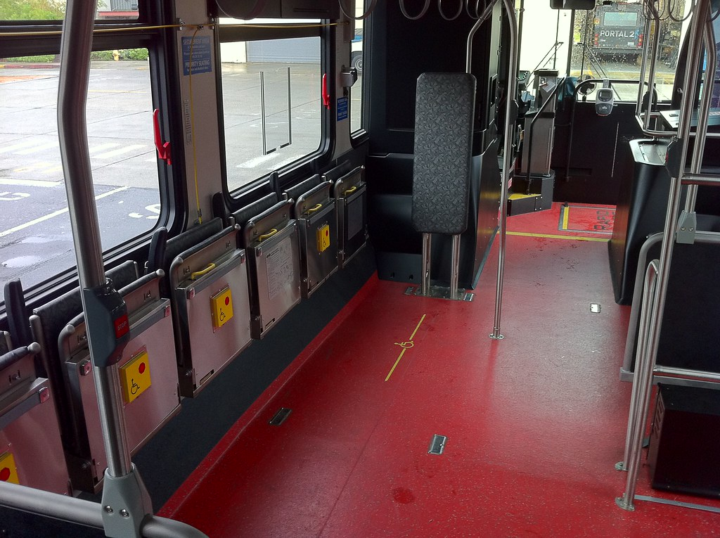
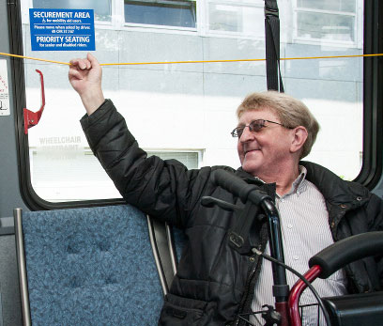
Priority Seating
Notes:
Explain there are priority seats for those that need them on all buses. These seats are reserved for people with mobility or other needs.

Slide 8
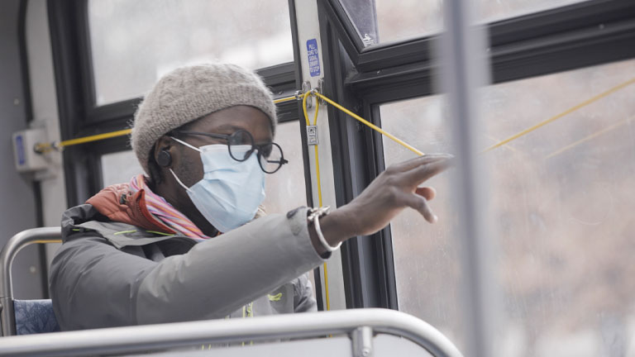
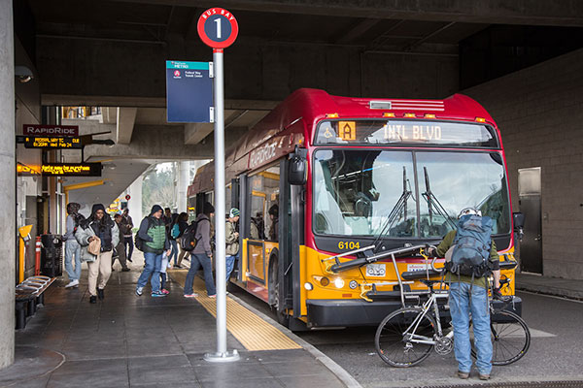
Exiting the Bus
Notes:
Explain there are rules everyone should follow to safely exit the bus including the following:
Using the yellow pull-string along the interior of the bus, or a red stop button, signal the bus driver at least one block before your stop so they have sufficient time to stop smoothly.
Hold onto the railing when exiting the bus. Bus steps and sidewalks can become slippery from rain.
As you leave the bus, watch for cars.

Slide 9
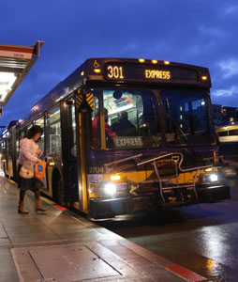
Night Stop Program
Passengers can exit a bus anywhere along a bus route at night, even if it’s not at a bus stop.
Available on all Metro buses from 8 p.m. to 5 a.m.
Ask the bus driver to stop at a specific location and they will stop if it is safe to do so.
Applies to exiting the bus only (not boarding).
Drivers will ensure people with accessibility needs exit at accessible stops.
Notes:
Metro offers a Night Stop Program for riders. From 8pm to 5am, passengers can exit the bus anywhere along a bus route, even if it is not a stop, with a few exceptions. Speak with your driver and if it is safe to stop, they will do so.

Slide 10
Tips for the Bus
Get off at the next stop.
Move closer to the bus driver.
Report the problem to the bus driver.
Take a photo or video of the situation.
Call Metro Transit Police at 206-296-3311.
For emergencies call 911.
Leave a comment, metro.kingcounty.gov/contact, or call 206-553-3000.
Notes:
If you are on the bus and feel unsafe or are concerned about an issue here are some tips. Youth should do what is most comfortable for them, with options including getting off the bus, reporting the issue to Metro via phone or online, or calling 911 for an emergency.

Slide 11
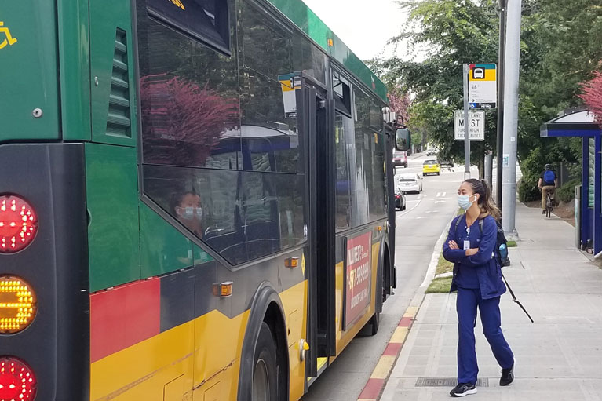
Safe Place Program
If you find yourself in need of a safe place to stay, ask any Metro bus driver for help.
If a young person is in crisis or needs a safe place to stay,
Metro bus drivers will transport them to a Safe Place representative who will find them a safe place to stay until the situation is resolved.
Notes:
Metro offers a Safe Place Program. If you need a safe place to stay, Metro bus drivers will bring you to a Safe Place representative who will work with the young person until the situation is resolved.

Slide 12
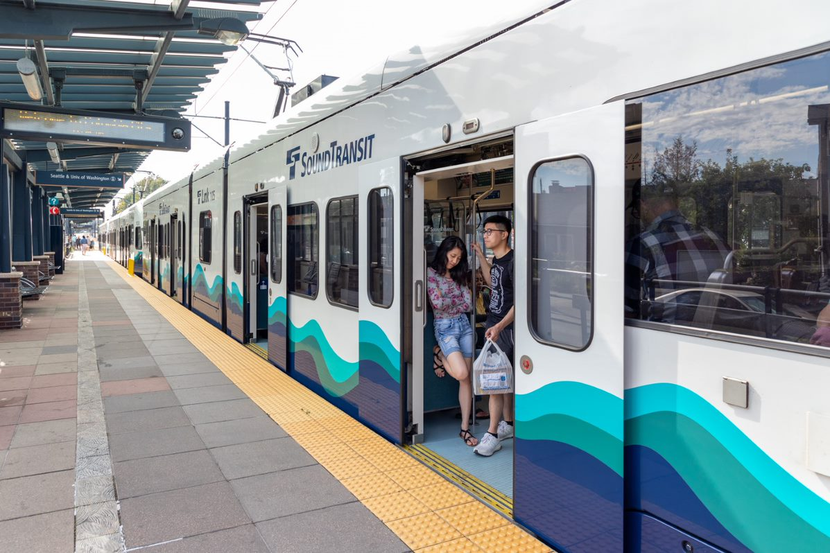
Using the Link Light Rail
Notes:
Explain that waiting for and riding the Link light rail is very similar to the bus with a few differences including the following:
Wait behind the yellow line at the station; stand back when the train is arriving or leaving.
Make sure you are all the way on the light rail; don’t stand in the doorway.
Always look before you cross tracks.
Never stand on or near the rails.
Be aware of where you stand on the light rail some parts of the floor may move around turns.
Let people exit before you board.
Let the train depart before crossing any tracks.

Slide 13
Tips for Link Light Rail
Get off at the next stop, change train cars.
Take a photo/video of the situation.
Call or text Sound Transit security at 206-398-5268.
Press the emergency intercom button on the train or platform.
For emergencies call 911.
Notes:
If you are on the train and feel unsafe or are concerned about an issue here are some tips. Youth should do what is most comfortable for them, with options including getting off the bus, reporting the issue via phone or online, or calling 911 for an emergency.

Slide 14
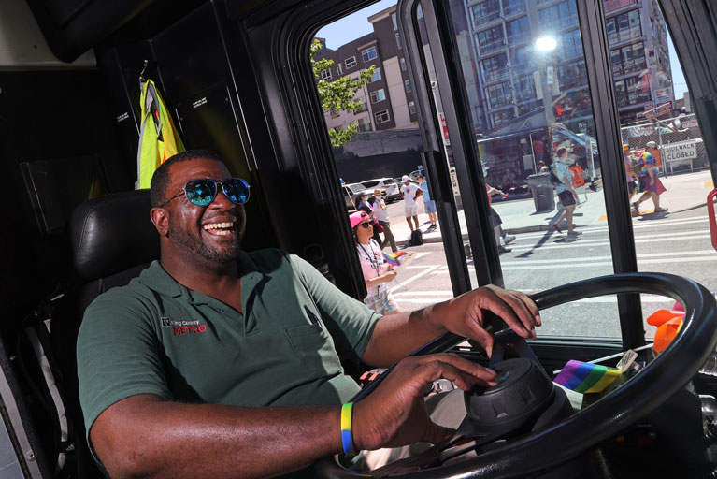
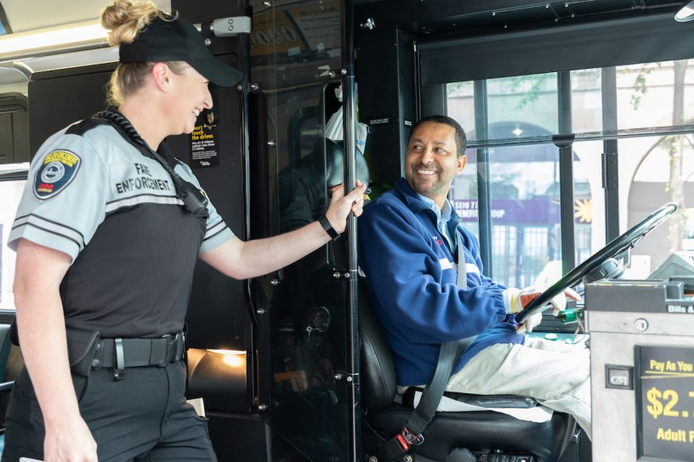
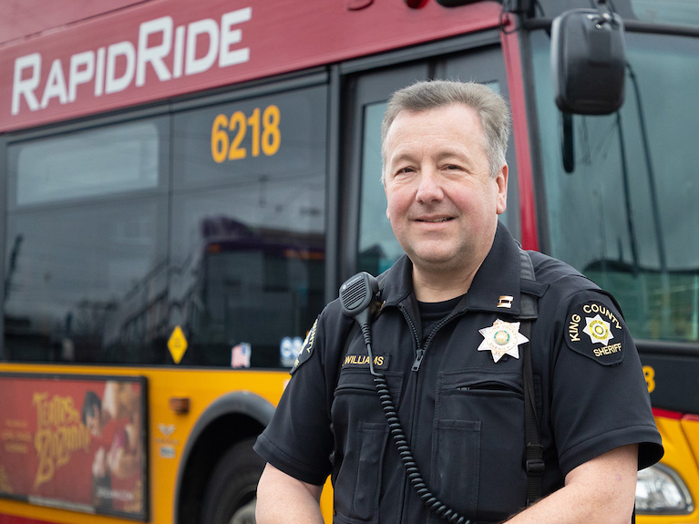
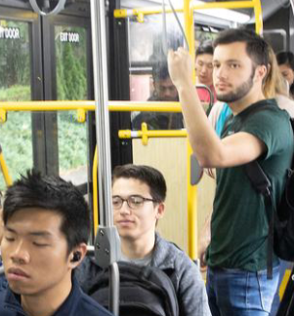
Transit Police
Asking for Help
Driver
Peers
Transit Security
Notes:
Explain that when you are on public transit there are people and systems in place to help keep you safer.
Metro transit drivers are always present and should be the first person you ask for help.
If a transit security officer or transit police officer is aboard or at a stop, they are another great safety resource.
You can also talk with peers on transit for help or support.
There are ways to report transit safety issues or ridership concerns including calling to report on Metro buses, submitting an online comment form, and texting Sound Transit security.

Slide 15
What does it mean
to you to be a respectful transit rider?
Notes:
Discussion opportunity:
Ask students, What does it mean to be a respectful transit rider?

Slide 16
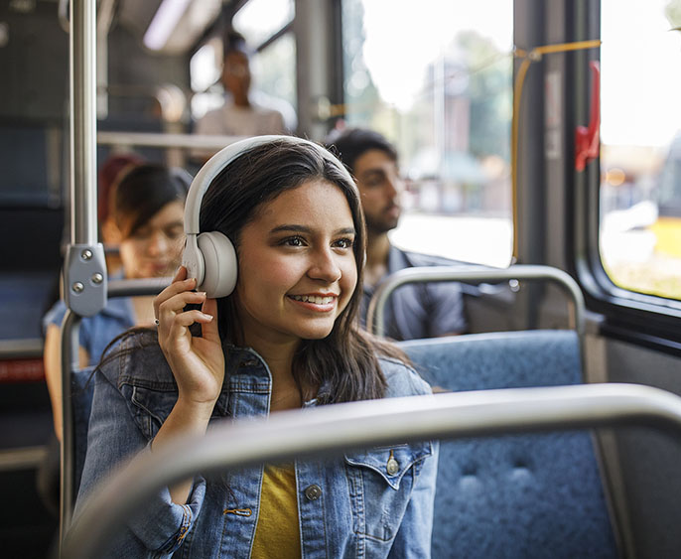
Be a Considerate Passenger
Respect others’ privacy.
Do not harass driver or other riders.
Do not cause safety problems.
No eating or littering.
Do not lie down on the seats.
Respect transit property.
Use headphones.
Use Metro services and facilities for transportation purposes only.
Notes:
Being a considerate passenger on Metro transit can look like using headphones, respecting transit property, and more.

Slide 17
To learn more safety tips and initiatives, visit metro.kingcounty.gov/safety
Notes:
Supplemental opportunity:
It may be helpful to show students the website so they can share information with their families.
Extra information can be found at: https://kingcounty.gov/depts/transportation/metro/travel-options/bus/how-to-ride.aspx

Slide 18
To learn more, visit FreeYouthTransitPass.com
Notes:
Supplemental opportunity:
It may be helpful to show students the website so they can share information with their families.
Show students how to navigate the website to get a new Youth ORCA card or register an existing card.
Extra information can be found at: https://kingcounty.gov/depts/transportation/metro/travel-options/bus/how-to-ride.aspx

