Slide 1
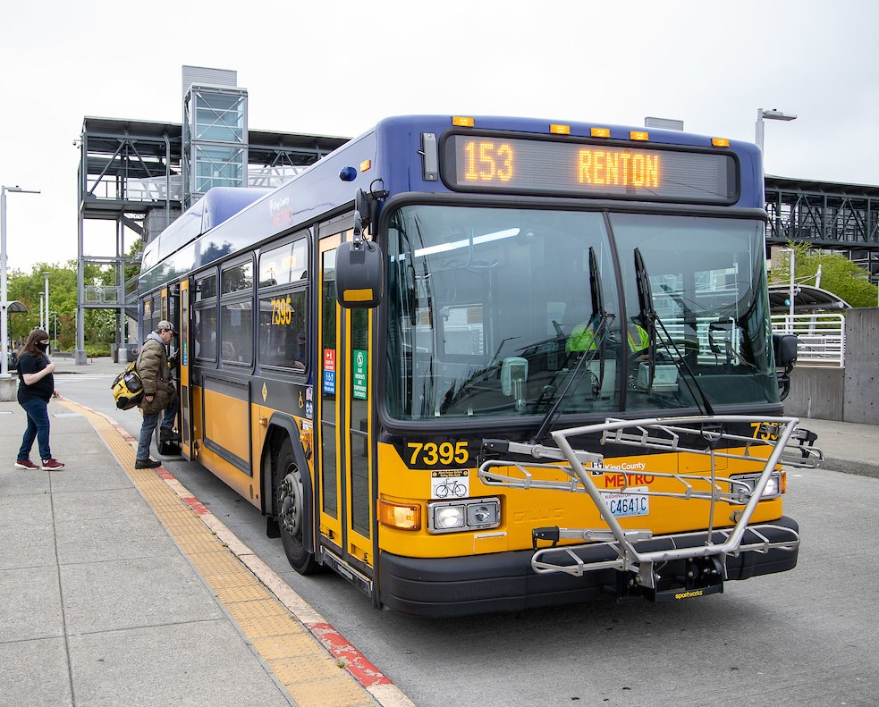
Sustainability and Community Connections
Notes:
Introduce King County Metro – “The organization in our government that provides bus and other transportation services” and the Free Youth Transit Pass program (“riders 18 and younger can take transit for free”)
Explain to students that they will be learning about how riding public transit can reduce greenhouse gas emissions and help the community.

Slide 2
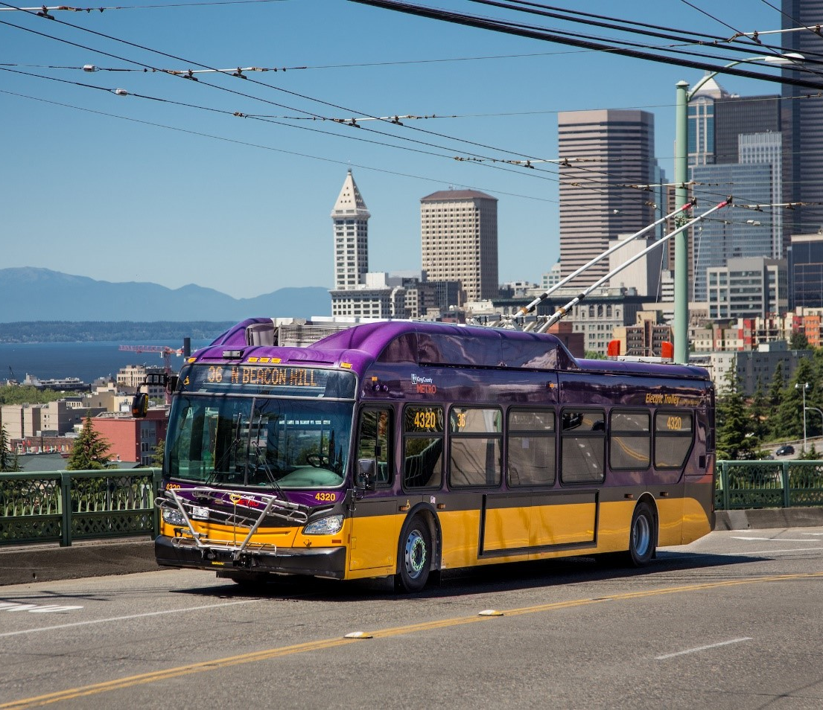
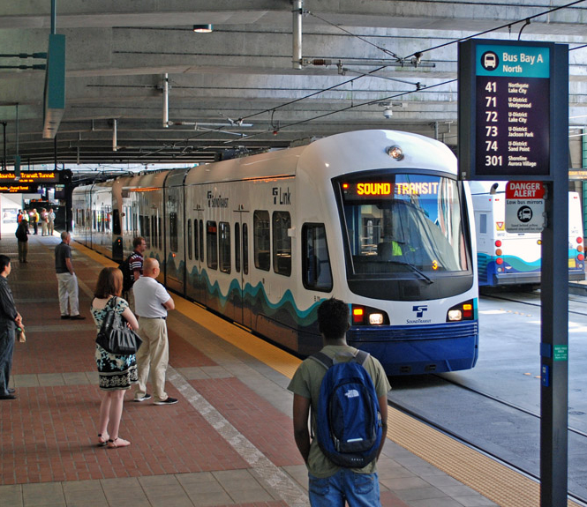
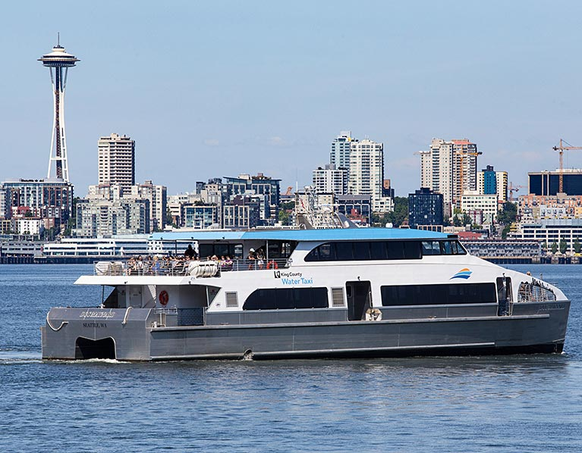
Public Transit
Notes:
As a reminder, public transit can take many forms. Here in King County, some primary forms of transit are buses, light rail trains, water taxis, and much more.
Discussion opportunity:
Ask students how they engage with public transit in their communities. Do they or someone they know utilize Metro services?

Slide 3
Why is public transit important for a community?
How might public transit impact the environment?
Notes:
Discussion opportunity:
Ask students why are public transportation systems important for a community? Explain that public transit is a service provided by the government to help people move around their communities. Public transit is a service that provides access to community spaces and resources supporting community members of different abilities and backgrounds.
Encourage students to consider the environment: ask them how might public transit impact our environment?

Slide 4
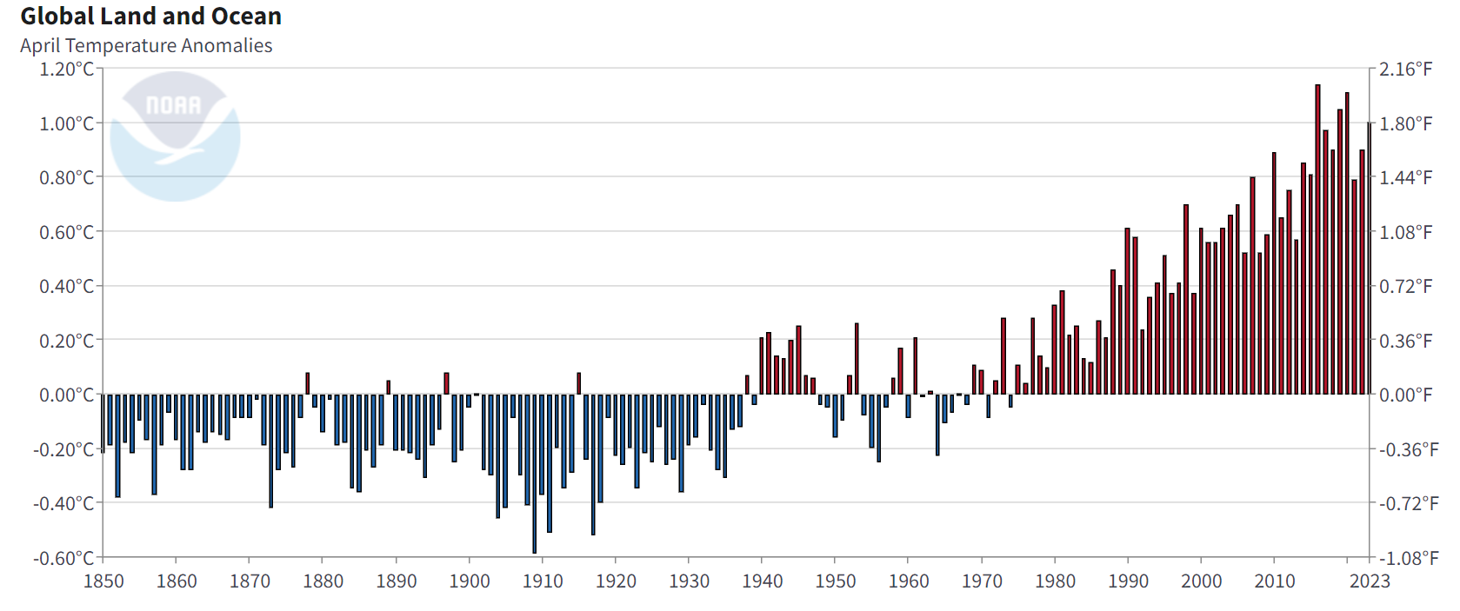
Climate Science
Global warming is the increase in global average temperature.
Climate change is the shift in long-term weather patterns.
Climate change leads to intense weather events.
Notes:
Global climate change is the average long-term atmosphere changes over the entire Earth. These include warming temperatures and changes in precipitation as well as the effects of Earth’s warming. There are several factors that contribute to climate change. However, scientists agree that Earth has been getting warmer in the past 50 to 100 years primarily due to human activities.
Information & graphics from https://kingcounty.gov/services/environment/climate/our-changing-climate/what.aspx; https://www.ncei.noaa.gov/access/monitoring/climate-at-a-glance/global/time-series

Slide 5
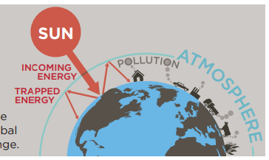


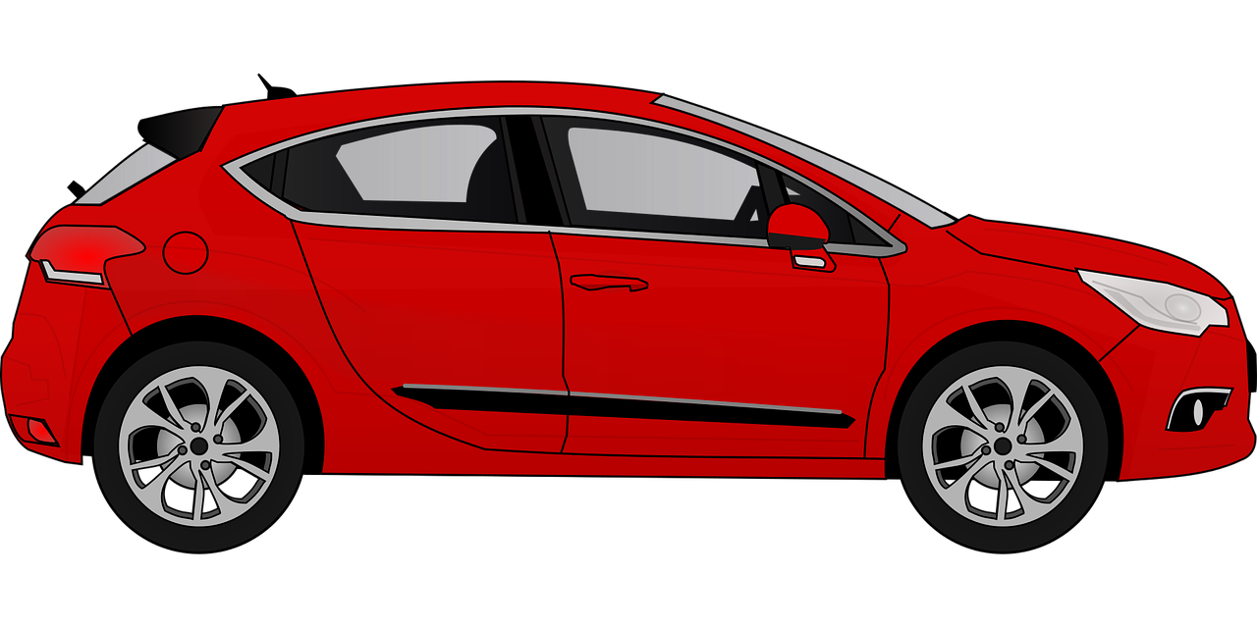
The Role of Greenhouse Gases
Greenhouse gases in Earth's atmosphere trap heat and warm the planet.
Humans emit greenhouse gases like CO₂ and CH₄ through activities such as travel.
Notes:
Certain gases in Earth’s atmosphere block heat from escaping, such as carbon dioxide and methane. These gases are called greenhouse gases (GHGs), and they keep Earth warm like the glass in a greenhouse keeps plants warm.
Human activities, such as burning fuel to power factories and cars, are adding lots of these gasses to our atmosphere. This causes the atmosphere to trap more heat than it used to, leading to a warmer Earth.
Information & graphics from https://kingcounty.gov/services/environment/climate/our-changing-climate/what.aspx

Slide 6
Global Warming and Climate
As Earth warms due to greenhouse gases, climate patterns change.
Global Warming
Notes:
Discussion opportunity:
As temperature increases how might that impact climate in an area?
Encourage them to have a thoughtful discussion as their knowledge of the topic allows.
Graphic from NOAA: https://www.ncei.noaa.gov/access/monitoring/climate-at-a-glance/global/time-series

Slide 7
How might climate change impact you?
Notes:
Discussion opportunity:
Let students share how extreme weather events or climate change have impacted them personally.

Slide 8







Climate Change Impacts
HUMAN HEALTH
Increased heat can lead to more illnesses and more hospitalizations.
LESS SNOW
The average cascade snowpack is decreasing.
INCREASED HEAT
MORE RAIN EVENTS
The number and intensity of heavy rain events is expected
to increase.
RISING SEA LEVEL
Areas around the region may experience coastal flooding.
INCREASED FLOODING
Notes:
Climate change will have local impacts in King County including more severe weather extremes, public health issues, and sea level rise.
Discussion opportunity:
Let students share how extreme weather events or climate change have impacted them personally.
Then ask them to think about how it might impact other people in our community.
What about wildlife?
Some other impacts include, but are not limited to:
Ocean acidification (increased costs to shellfish growers)
More frequent coastal flooding
Rising sea levels
Increased heavy rain events

Slide 9
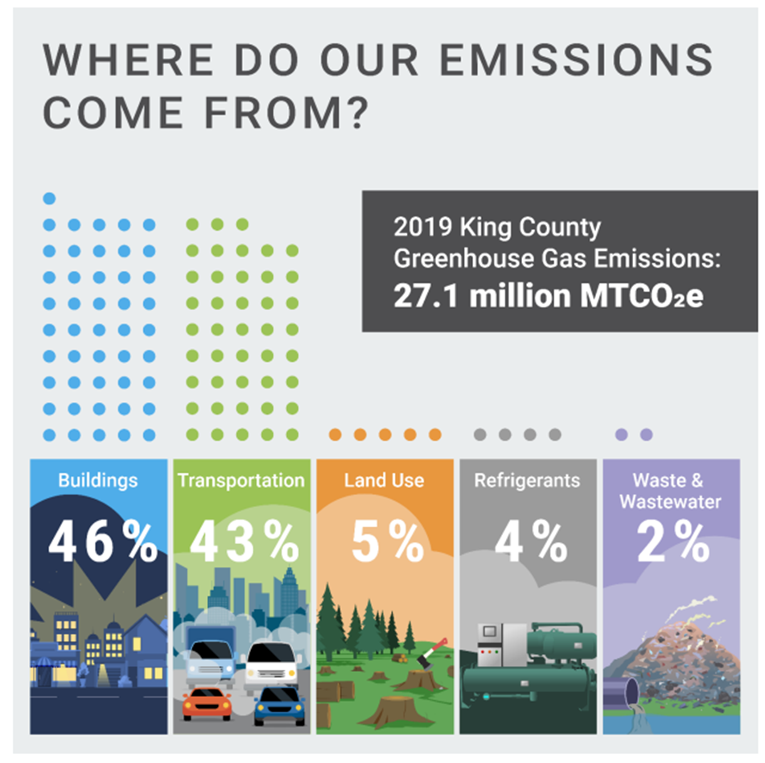
Greenhouse Gases
What do you notice?
Notes:
Discussion opportunity:
Where do greenhouse gases come from?
What do you notice?
Encourage them to have a thoughtful discussion as their knowledge of the topic allows.
Information & graphics from Puget Sound Regional Emissions Analysis, King County GHG emissions in 2019.
King County greenhouse gas emissions - King County

Slide 10
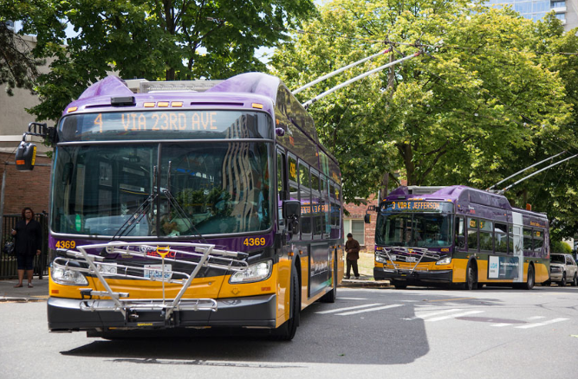
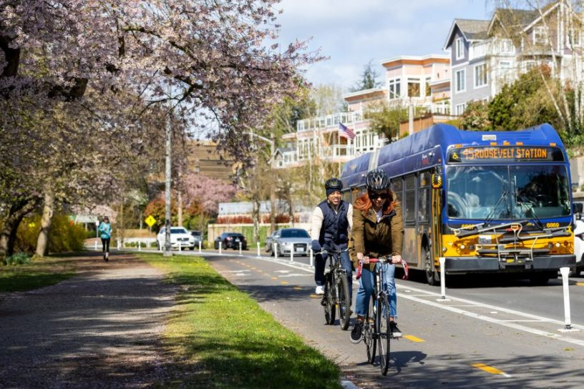
Transportation
Transportation is responsible for 43% of greenhouse gas emissions in King County.
What could you do to reduce greenhouse gas emissions as you move around your community?
Notes:
Discussion opportunity:
What are some ways students move around the community? Does anyone walk? Ride a bike? Use transit?
Explain it is not always possible to use these forms of transportation, sometimes people need to drive their cards or live too far from a bus stop. The important thing is to think about your options, understand the impact, and when you can make choices that are better for our environment that’s great. A 2019 study, King County Geographic GHG Emissions (2019), shared buildings (46%) and transportation (43%) were the largest sources for greenhouse gases. Details provided in the report- https://kingcounty.gov/services/environment/climate/actions-strategies/strategic-climate-action-plan/emissions-inventories.aspx.

Slide 11
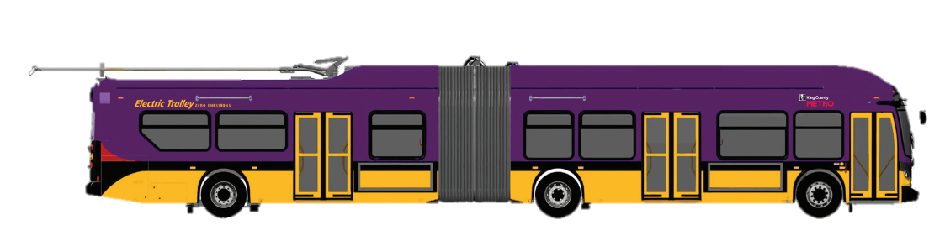
Planning for Climate Change
King County is expanding regional transit ridership.
King County is increasing the number of its electric vehicles and increasing vehicle charging infrastructure.
King County is reducing its fleet greenhouse
gas emissions.
Notes:
King County is committed to climate action and is being proactive in reducing GHG emissions and preparing for climate impacts.
Public transit ridership has greatly increased in the past years and Metro is exploring ways to continue to reduce their environmental impact.

Slide 12
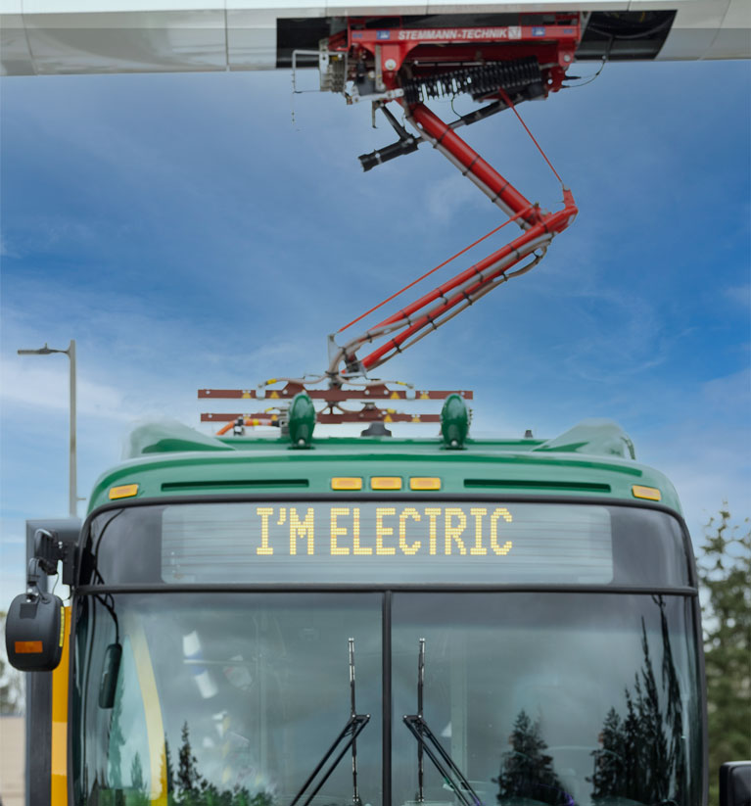
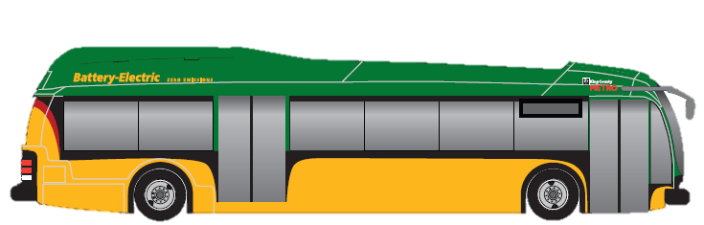

Metro and Climate Change
Metro has a goal to change all buses to battery-electric, zero-emission vehicles by 2035!
Many buses have already been replaced.
These new buses will not emit greenhouse gases.
Notes:
King County Metro is working to replace its bus fleet with electric, zero-emission coaches by 2035 in order to further minimize the environmental impact of public transportation.
Discussion opportunity:
Ask if anyone in the class has used one of the electric buses recently.
You may choose to ask students if they have any other ideas of ways Metro can help reduce its environmental impact and/or help to plan for the impacts of climate change.

Slide 13
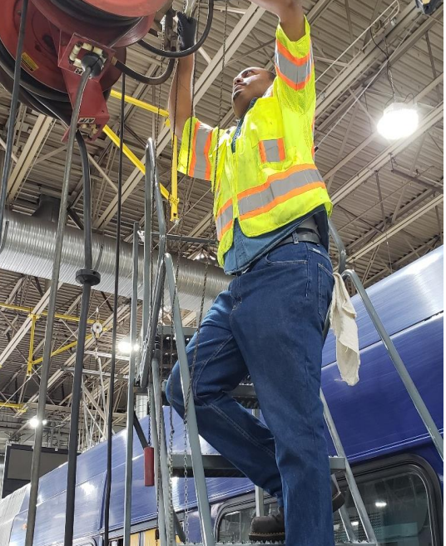
Metro and Climate Change
Metro’s biggest impact is reducing the number of cars on the road, but we are also reducing greenhouse gases in other ways.
We are saving energy in buildings by fixing equipment.
We are constructing new buildings with sustainable materials.
Notes:
King County Metro is working hard to reduce pollution on and off the road. Beyond buses, Metro is saving energy by fixing equipment and constructing sustainable buildings.

Slide 14
How might using transit help our community?
Notes:
Discussion opportunity:
How does using transit support or help the community?
Who should use transit?
What might prevent people from using transit?
Highlight youth programs and accessibility programs.
Explain that public transit is a service to help people move around their communities. Public transit provides access to community spaces and resources supporting community members of different abilities and backgrounds. Help connect how transit can help reduce emissions, reduce traffic, increase environmental health in our region, and help connect people to places.

Slide 15
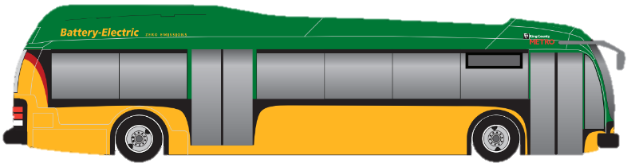
Environmental Sustainability
Sustainability is meeting the needs of today while protecting the ability of future generations to meet their needs.
Metro is committed to environmental, social, and economic sustainability.
Transit can help take 175,000 cars off the road each weekday!
Notes:
Discussion opportunity:
What does Environmental Sustainability mean to you?
How might sustainability connect to transit?
Encourage them to have a thoughtful discussion as their knowledge of the topic allows.
Information & graphics from https://kingcounty.gov/depts/transportation/metro/about/environmental-sustainability.aspx

Slide 16
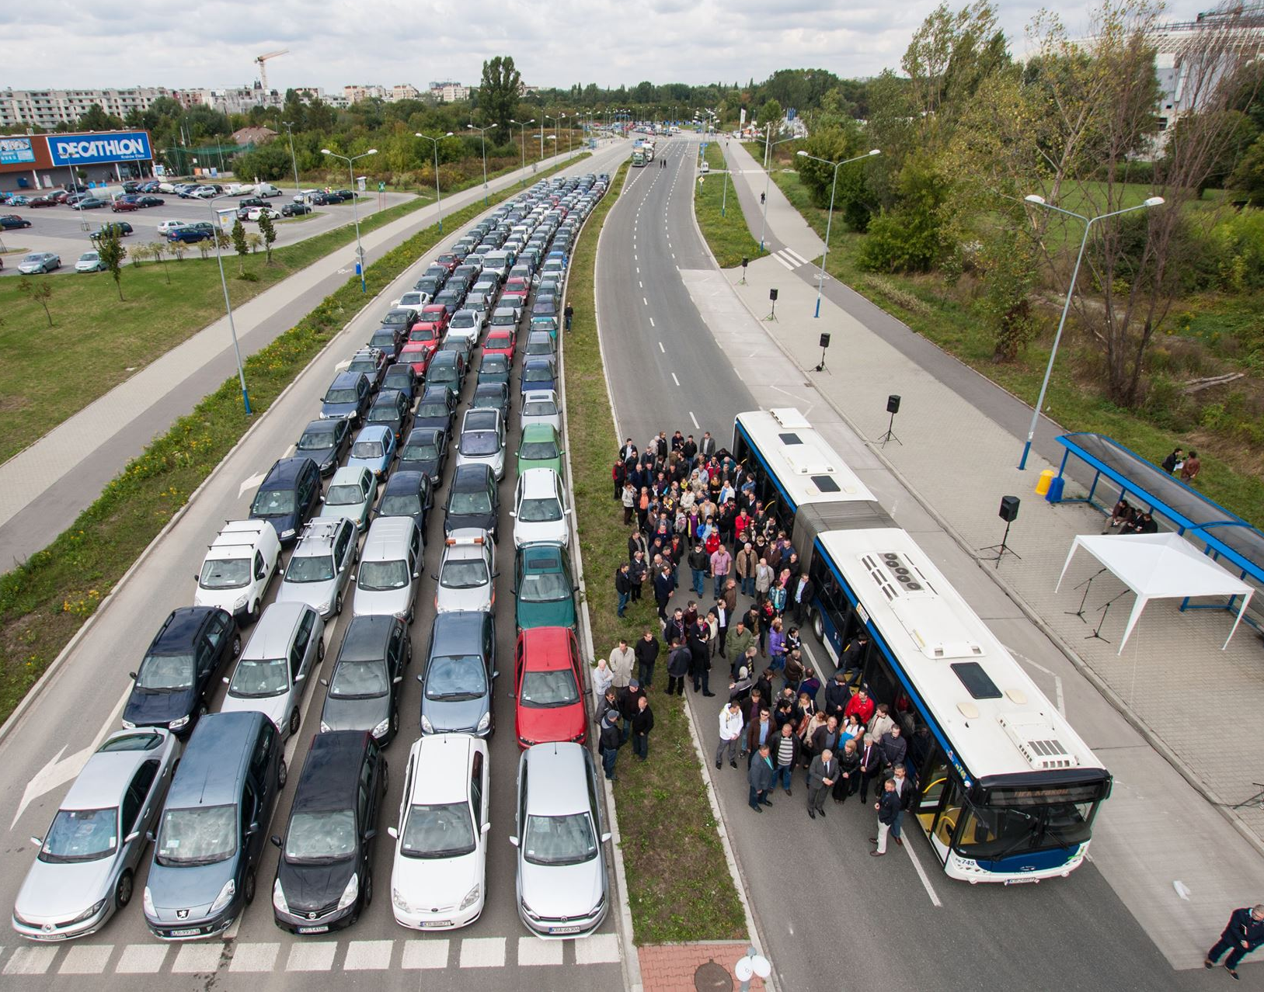
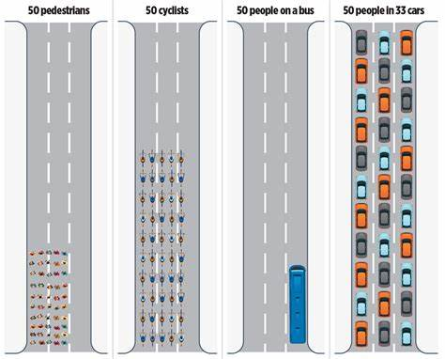
Sustainability and Transit
Using transit can help reduce space required for travel, in addition to walking or biking.
Notes:
Discussion opportunity:
How might reducing cars on the road help our environment?
Encourage them to have a thoughtful discussion as their knowledge of the topic allows.

Slide 17
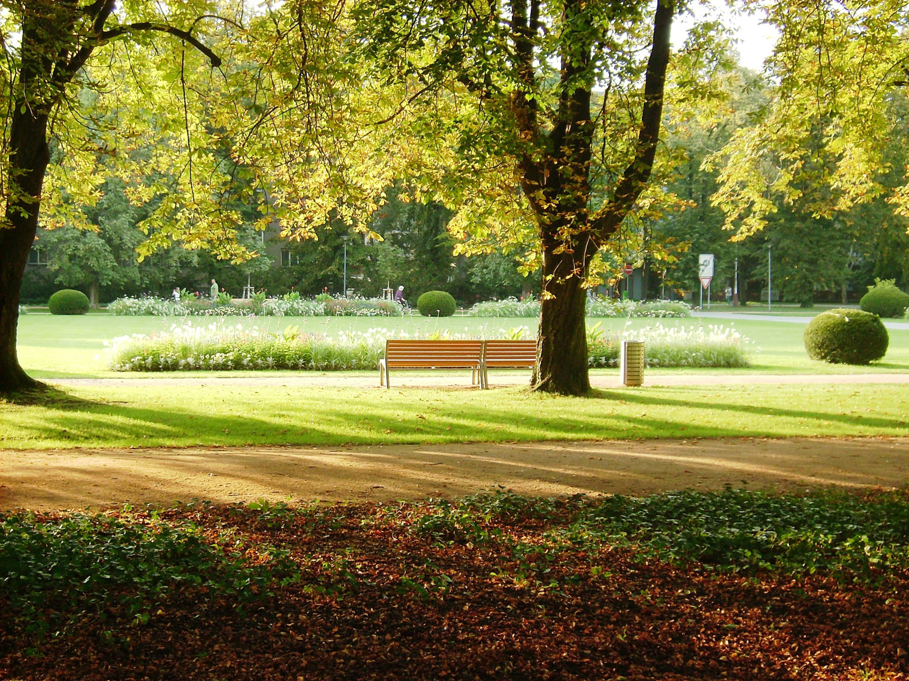
Sustainability and Transit
Fewer cars means more space for people.
Our communities should be places to go to,
not places to drive through.
Notes:
Discussion opportunity:
Would you rather spend time in a parking lot or a park?
If more people travel by bus or light rail, we can reduce the space needed to park cars.

Slide 18
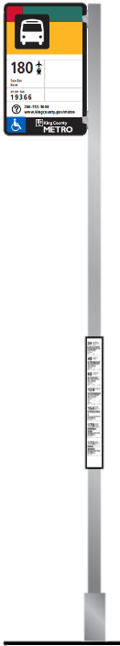
Public Transit Connects Places
Did you know?
25% of people in Washington do not drive.
Many businesses and services in your community depend on people who may not drive. For example, employees may choose to take transit to their jobs to help them save money.
People need transit to get around their community.
Notes:
Explain taking care of our community means taking care of our environment but also taking care of people. Metro wants to ensure that its transit systems are accessible to all community members.
Opportunity for all: healthy transit builds opportunity in a way that cars don’t; consider that ~25% of Washingtonians are not drivers, and even those who can drive may not find it the best option (e.g. having a vehicle, affordability, parking, needing 1 car for every adult in the household if other options don’t exist)
We also want to consider people with disabilities, low-income families, and youth and seniors.

Slide 19





Using transit benefits your…
    money: transit is more cost-effective than driving a car.
    health: riding transit can help you get outside more.
    hobbies: you can read, do homework, or listen to music.
    social life: meet up with your friends using transit.
    time: transit doesn’t require time to find parking.
Notes:
Using transit can have a variety of benefits including helping people save money, get outside more, and expand their social life.
Discussion Opportunity:
Are there any other benefits of transit you can think of?

Slide 20
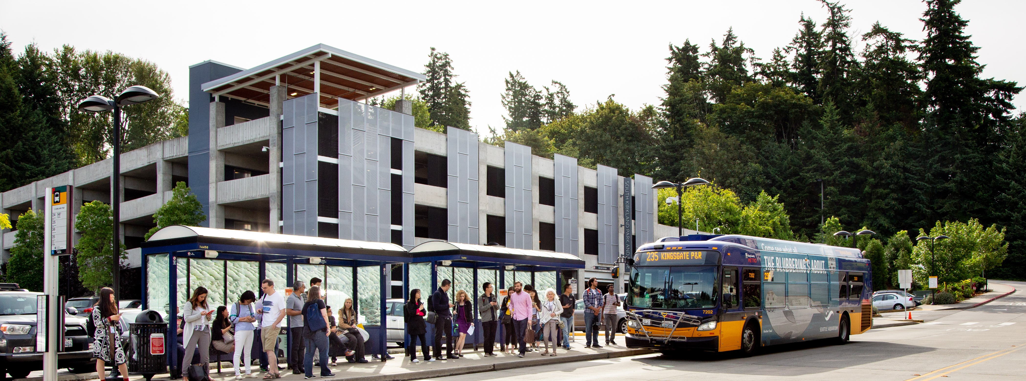
Community Connections
Transit is more than buses and light rails. It offers a sustainable way to reduce greenhouse gases and connects people to places, services, and other community members.
Metro plans for 80% of residents to have access to frequent transit by 2050.
Notes:
End with a note that king County transit services are more than just buses we can ride on. These services support our community by helping us reduce greenhouse gases. These services help people move around the community and the services help us all stay connected.
Metro’s Long Range Plan aims for 80% of King County residents having access to frequent transit (every 15 minutes, stops 0.25 miles apart) by 2050.

Slide 21
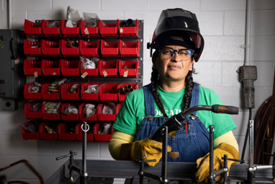
Community Connections
Transit creates jobs that are well-paying and help the environment.
Transit systems are a platform and tool for community activists.
Free youth transit programs started because of local youth activists.
Notes:
Discussion Opportunity:
Ask students how providing jobs, especially Green Jobs might help the community.
Ask students if they know of any examples of social justice events activists that centered around transit.
The regional Free Youth Transit program originally started with students at Rainer Beach High School in Seattle in 2015.
Can they think of other connections to their community?

Slide 22
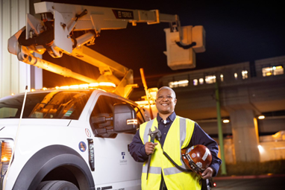
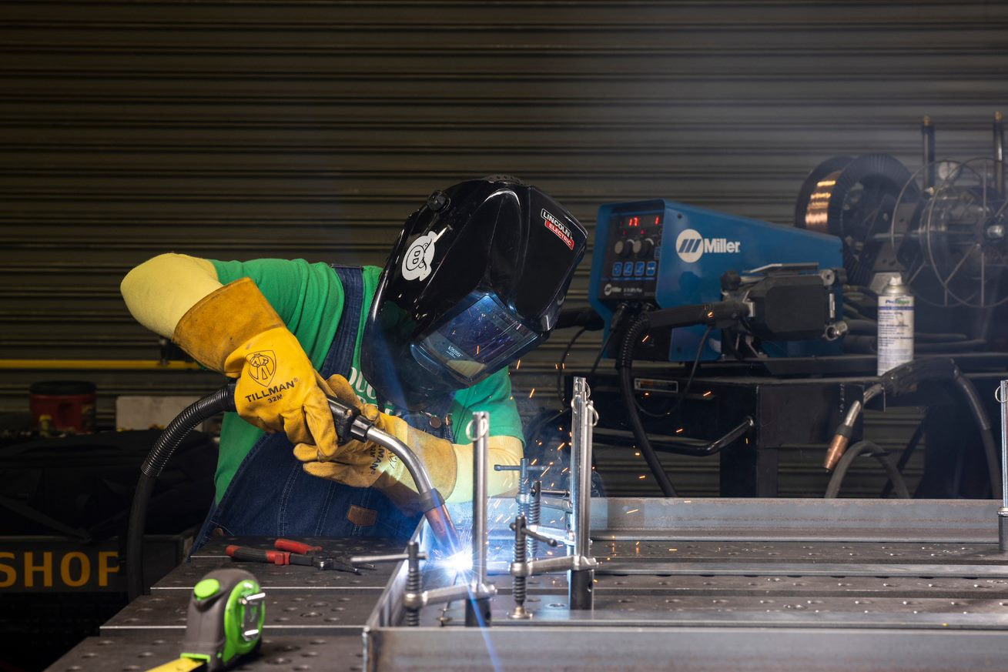
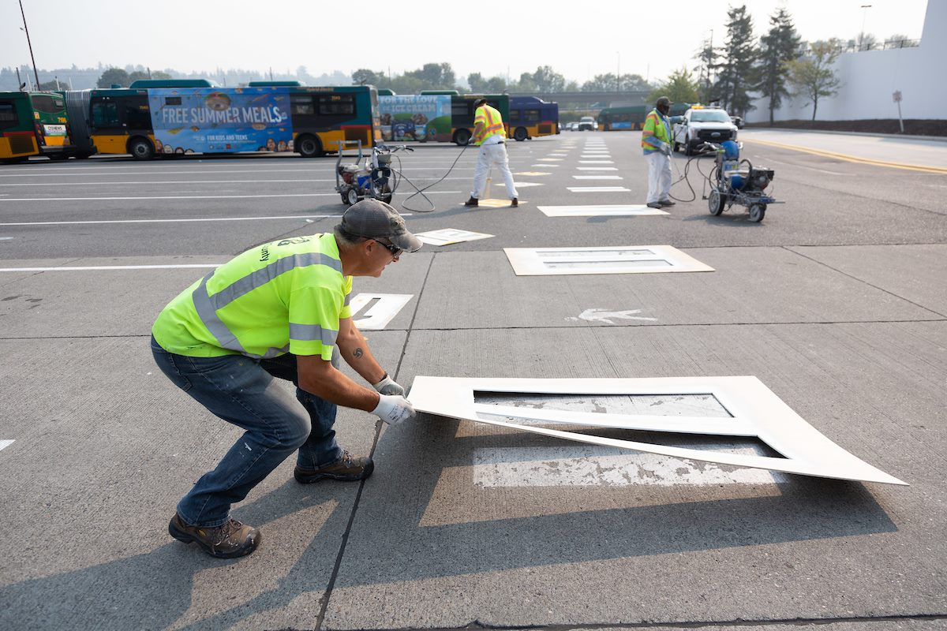
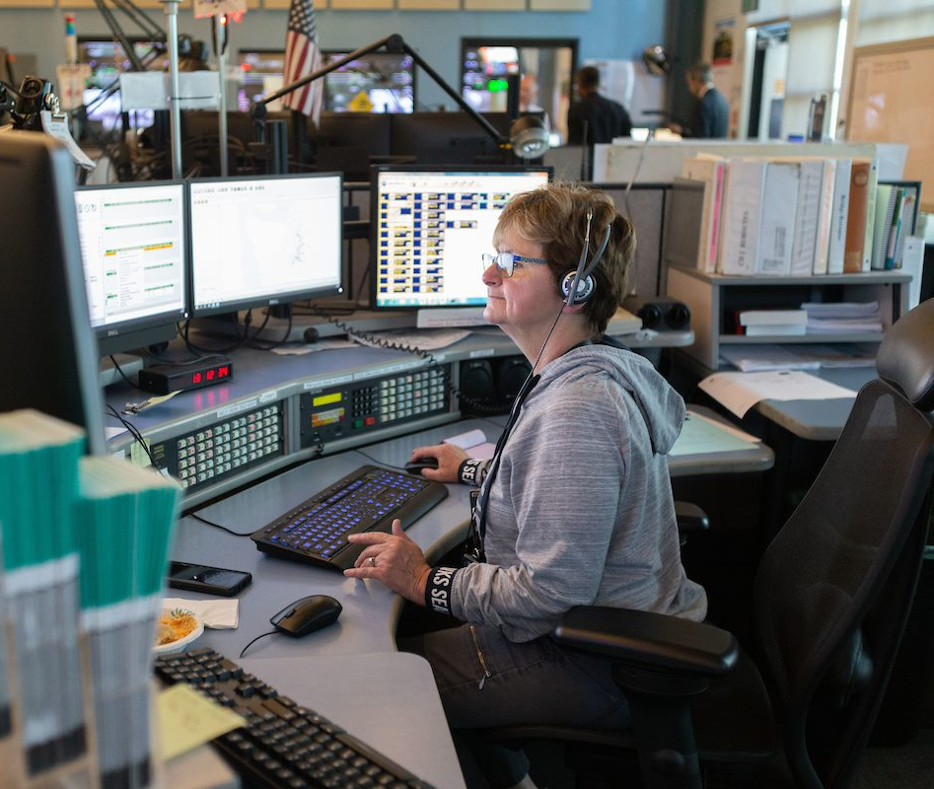
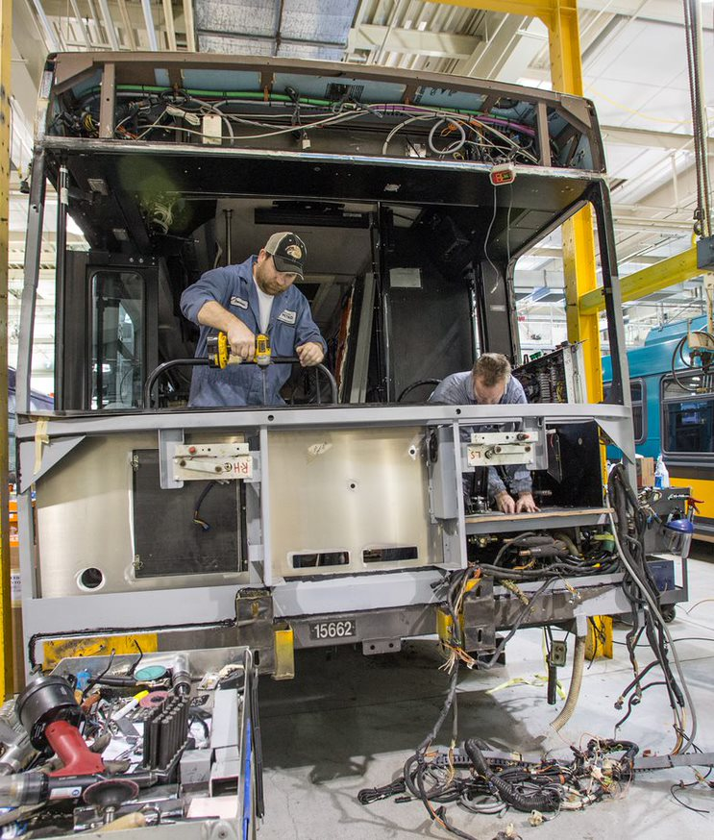
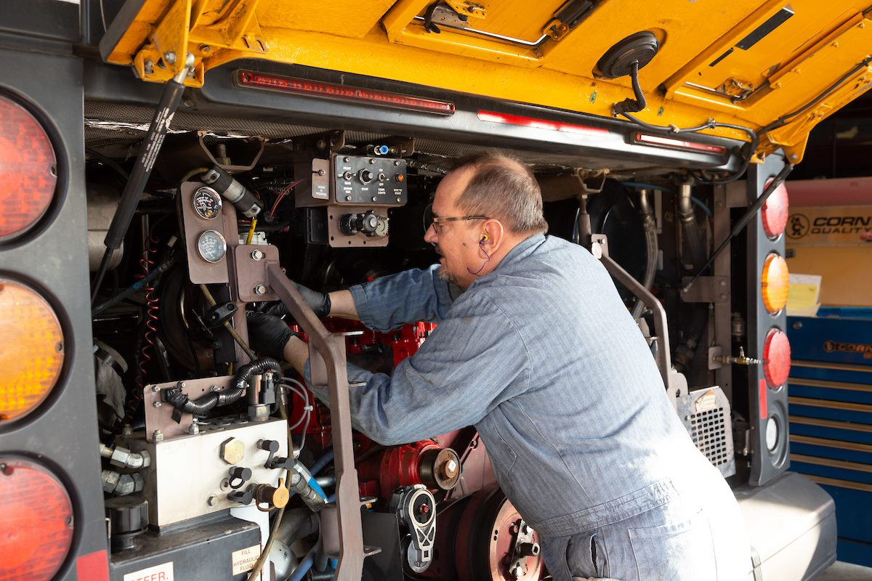
Careers in Transit
Notes:
Graduating students exploring possible careers should think about transit. More information can be found online at https://kingcounty.gov/depts/transportation/metro/about/careers.aspx.
Metro needs talented employees from a variety of backgrounds and fields. Metro employees are creating and supporting vital mobility services. How many dedicated team members does Metro need to maintain and grow an award-winning transit system? A lot. Bring your skills to Metro!

Slide 23
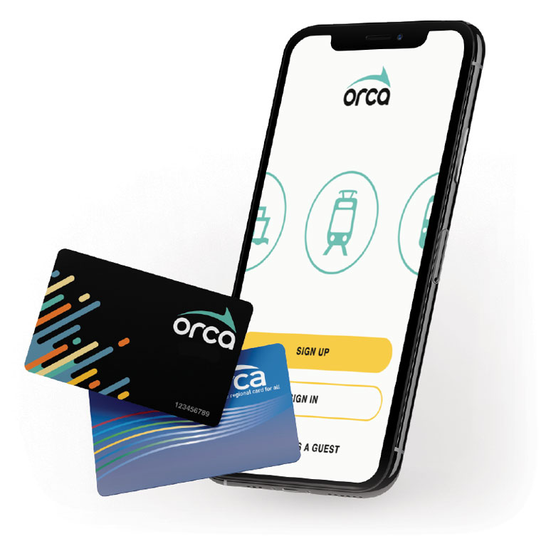
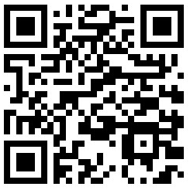

Youth Ride Free
Youth 18 years and younger can ride transit for FREE.
FreeYouthTransitPass.com
Notes:
All youth under the age of 19 can ride Metro transit for free. This encourages individuals to take public transit which is better for the environment as well as beneficial to the community.
Discussion Opportunity:
You may choose to ask students if they have been using the free youth transit passes for Metro.
Ask how they think increased youth ridership might have a positive impact on greenhouse gas emissions and climate change.

Slide 24
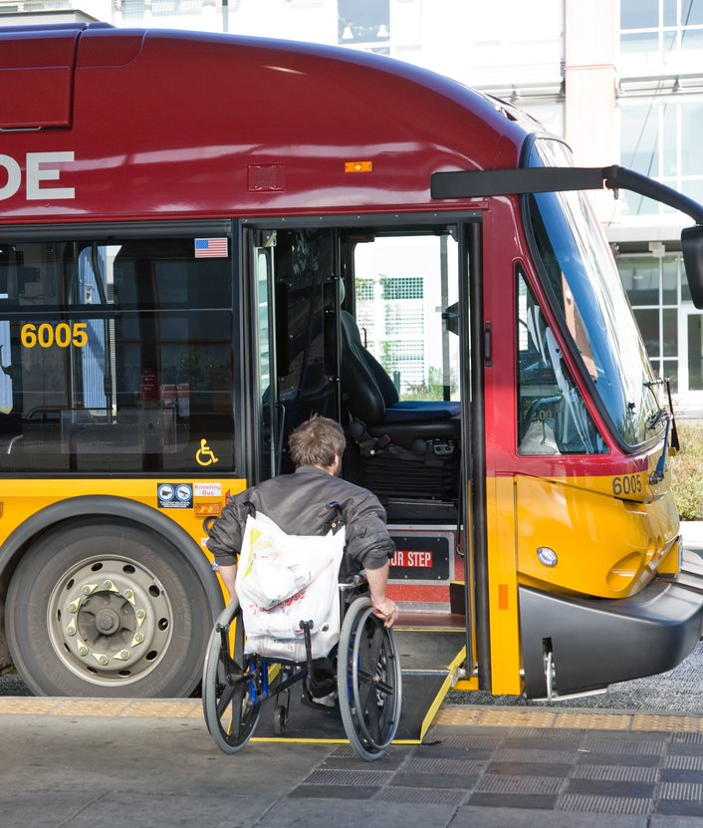







Metro and Accessibility
Metro has services to help all community members travel on transit.
Notes:
Metro has a variety of services to accommodate the needs of community members to help individuals travel around King County, including services oriented to individuals with disabilities, individuals learning the English language, and individuals who may need extra support using Metro services.
Discussion opportunity:
Ask what accessibility means to the class.
Why is accessibility important?
How might having accessible transit help reduce GHG emissions?

Slide 25
Why is accessible
transit important?
Notes:
Discussion opportunity:
What do you think we mean when we say accessible transit?
Why is accessible transit important for a community?
What types of accessible services have you seen on transit?

Slide 26



Accessible Services
Buses have wheelchair lifts and ramps.
ADA Paratransit services.
Drivers can announce stops.
Reserved spaces for riders with mobility devices.
Maps and routes in more than 40 languages.
Notes:
Some examples of accessible services that King County Metro offers include wheelchair lifts and ramps on buses, announcing stops, reserved seating and spaces, language translation, and an ADA Paratransit Program.
Discussion Opportunity:
Ask students how Metro services help address the variety of needs in a community and connect community members with public transit.

Slide 27
To learn more about
climate, visit
kingcounty.gov/climate
Notes:
Supplemental opportunity:
You may allow students time to explore the webpage for more information.

Slide 28
To learn more about accessibility, visit
kingcounty.gov and select “accessible services.”
Notes:
Supplemental opportunity:
You may allow students time to explore the webpage for more information.

Slide 29
To learn more about riding
transit, visit
FreeYouthTransitPass.com
Notes:
Supplemental opportunity:
You may allow students time to explore the webpage for more information.

