Slide 1
Building your CTR program
Getting the most out of your transportation plan

Slide 2
Commute Trip Reduction (CTR)
If your worksite has 100 or more employees your company may be affected by Washington State's Commute Trip Reduction (CTR) law. CTR protects our environment by encouraging employers and employees to find alternatives to driving alone to work. Large employers play a critical role in reducing drive-alone trips and promoting transit, biking, walking, teleworking and alternative work schedules.

Slide 3
History of the CTR Law
Washington State’s Commute Trip Reduction (CTR) Law was passed by the Legislature in 1991 (updated in 2006) with goals to improve air quality, reduce traffic congestion, and reduce the consumption of petroleum fuels through employer-based programs that encourage the use of alternatives to driving alone. Alternatives include riding the bus or train, carpooling, vanpooling, bicycling, walking, working a compressed work week or teleworking.

Slide 4
Effects of the CTR Law (2007-2016)
Employees at 955 CTR-affected worksites increased their non-drive-alone trip rate 4.8%. They left about 22,400 cars home at work every day…resulting in less traffic congestion.
The overall miles decreased by about 79 million miles annually. Which is equal to about 3.7 million gallons of fuel, saving almost $10 million in fuel. This translates into an annual greenhouse gas emission reduction of 33,500 metric tons, the equivalent of 180 rail cars of coal or the same amount of carbon sequestered annually by about 31,500 acres of forest: enough trees to cover almost 60% of Seattle.

Slide 5
Benefits
Environment – Cleaner air, less CO2 production
Health – More exercise from walking (to work or transit), or biking; greatly reduced change of injury from driving
Community – Safer streets, more transportation options in areas that use transit

Slide 6
Transportation Options – ORCA Agencies
Community Transit
Everett Transit
King County Metro
Kitsap Transit
Pierce Transit
Seattle Streetcar
Seattle Monorail
Sound Transit

Slide 7
Transportation Options - Buses
Community Transit – Snohomish County local and commuter routes
Everett Transit – City of Everett local routes
King County Metro – King County local and commuter routes
Kitsap Transit – Kitsap county local and commuter routes
Pierce Transit – Pierce county local and commuter routes
Sound Transit – Inter-county commuter routes

Slide 8
Transportation Options – Light Rail/Trains
Sound Transit
  Sounder South – Seattle <-> Tacoma/Lakewood
  Sounder North – Seattle <-> Everett
  Link Light Rail – University of Washington <-> Angle Lake
  Tacoma Link – Tacoma Dome <-> Tacoma CBD
City of Seattle
  Seattle Streetcar –
    Seattle CBD <-> South Lake Union
    Seattle ID <-> Capitol Hill

Slide 9
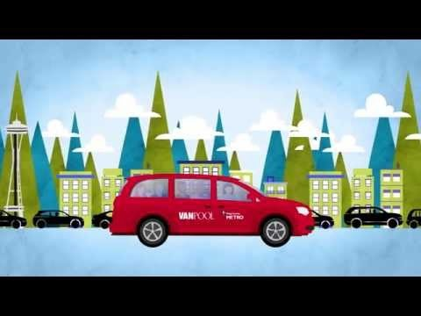
Transportation Options – Vanpool

Slide 10
Transportation Options - Boat
King County Water Taxi
  Seattle Colman Dock <-> Vashon
  Seattle Colman Dock <-> West Seattle/Alki
Kitsap Transit Water Taxi
  Seattle Colman Dock <-> Bremerton Terminal
  Seattle Colman Dock <-> Kingston Terminal
Washington State Ferry (Not included in ORCA business programs, can be added as separate pass)
  Route map

Slide 11
Transportation Options - Bike
Bike Maps
  King County
  City of Seattle
  Puget Sound
Bikes and Transit
  Resources – Bus bike rack how-to-video, bike lockers, FAQ
  Find test racks – Practice putting you bike on a bus bike rack!

Slide 12
Transportation Options – Paratransit
Community Transit – Dial-A-Ride Transit (DART)
Everett Transit
King County Metro – DART and ACCESS
Kitsap Transit – ACCESS
Pierce Transit – SHUTTLE

Slide 13
Transportation Options – Other Services
Community Connections – Innovative community shuttles
Vanshare – Van program to connect your last mile
Carpool – Find riders going the same way you are
School Pool – Find other parents for shared travel solutions
Community Van – Shared community van to help people meet their transportation needs (select partner communities)
Park and Ride facilities

Slide 14
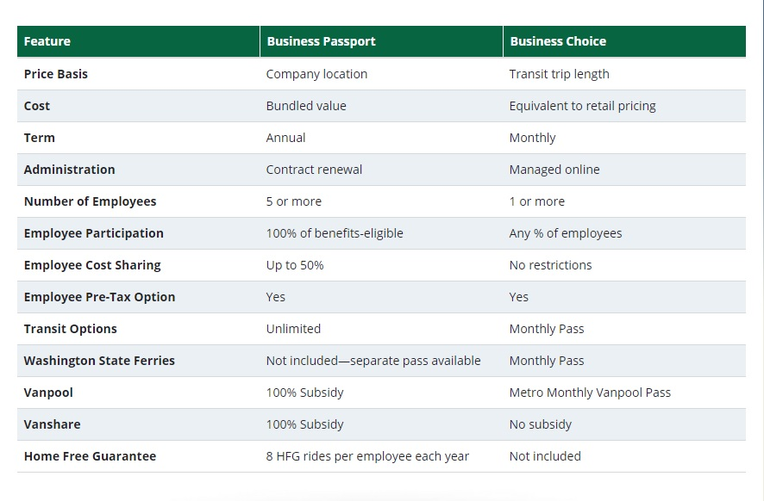
ORCA Business Programs

Slide 15
Communication and Marketing for CTR
Posters/flyers and intranet messages can get the word out about transit options
Tell us about transportation or benefit fairs and Metro can come answer questions
Having an event for Earth Day or Bike to Work month, let us know about those too!
Share links to Transit Alerts or newsletter to know about the latest transit updates
A letter or email from a company executive can help raise awareness of transportation options or drive adoption

Slide 16
We appreciate you!
Thank you for attending this training, if you have any questions, concerns, or feedback please let us know!
Jeanne Suleiman (Auburn, Burien, Des Moines, Federal Way, SeaTac, Shoreline, and Unincorporated King County) -
jsuleimon@kingcounty.gov; (206) 263-3381
Rocco DeVito (Bellevue, Issaquah, Kirkland, and Woodinville) –
rdevito@kingcounty.gov; (206) 263-3391

