Slide 1
Welcome to CTR Employer Program Report
King County Metro Transit

Slide 2
Agenda
Employer Program Report
Elements of an Employer Program Report
Newly effected sites
Thank You!

Slide 3
Program Report
A program report is a standardized questionnaire form used to fill in answers about your site.

Slide 4
What are the elements of an Employer Program Report?

Slide 5
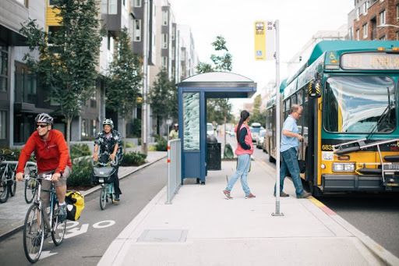
Employers report on programs currently in place to encourage alternatives to drive-alone commuting to their worksites.
Example of the Employer Program Report Questionnaire

Slide 6
Employer Program Reports are reviewed and approved by your jurisdiction to ensure the likelihood it will result in trip reduction.

Slide 7
Did I make the grade?
The employer is working collaboratively with the jurisdiction to continue its existing program or is developing and implementing program modifications likely to result in improvements to the program over an agreed upon length of time.
Good Faith Effort – (RCW 70.94.534)

Slide 8
When is the Program Report due?
The program report takes place on the
even year in the spring. Your CTR representative will give you 45 days advance notice of your due date.
CTR affected sites have a past program report on file for reference unless they are a newly affected site.

Slide 9
Newly effected sites (slightly different process)
Have 90 days to complete a baseline survey once your worksite becomes affected
Within 90 days AFTER receiving the baseline survey results – complete and submit a program report to the jurisdiction for review and approval
After the baseline survey and program report process is complete, the newly affected site will be added to their jurisdiction bi-annual timeline

Slide 10
We appreciate you!
Thank you for attending this training, if you have any questions, concerns, or feedback please let us know!
Jeanne Suleiman (Auburn, Burien, Des Moines, Federal Way, SeaTac, Shoreline and Unincorporated King County) –
jsuleiman@kingcounty.gov; (206) 263-3381
Rocco DeVito (Bellevue, Issaquah, Kirkland, and Woodinville) –
rdevito@kingcounty.gov; (206) 263-3391

